Slide 1
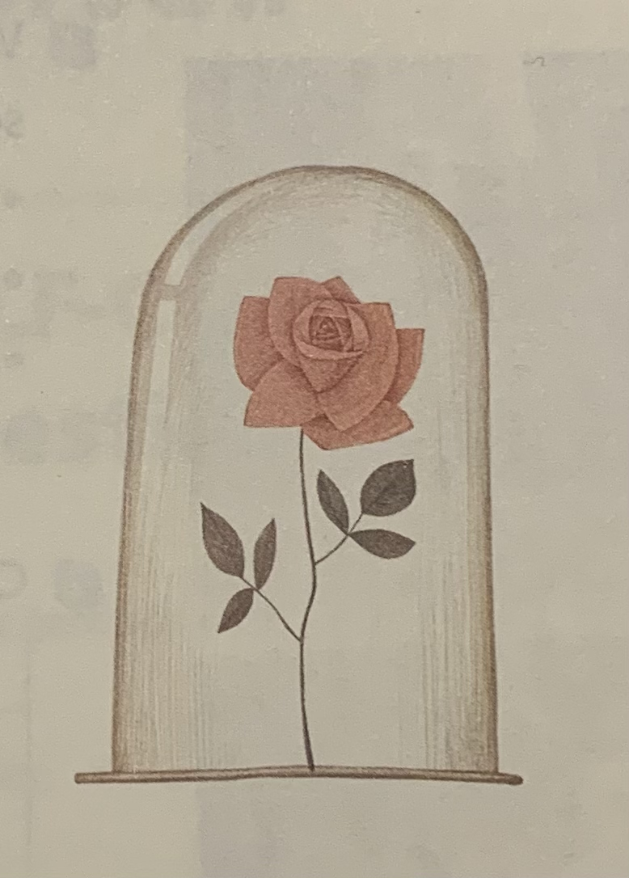
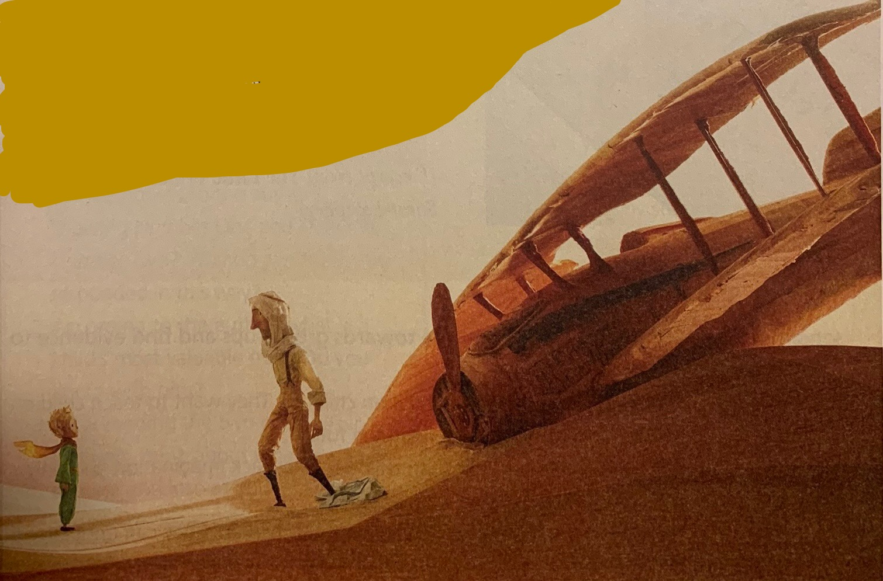
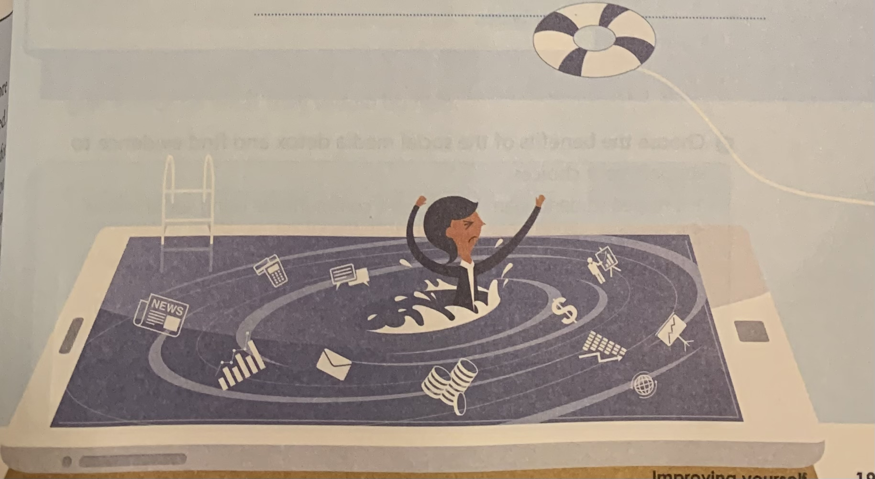
What do you see in each picture?
How do you feel about them?
Observe carefully and use nouns,
verbs and adjectives to help you
describe the pics
Pic 2
Pic 1
Pic 3

Slide 2
Pic 2
Nouns:
flower, bloom, rose, thorns, glass vase? glass dome, a gift (mother’s day, valentine‘s day, house-warming party), petals, decoration, scent/smell/fragrance, love, beauty…
Adjectives:
red, pink, delicate, romantic, sweet, artificial, long-lasting (Feelings: calm, excited, loved/cherished)…
Verbs：keep, be, smell, sense…
I see one single beautiful, delicate rose well kept in a glass dome. I can almost smell its fragrance from the pink petals. It may be a gift from a daughter to her mother to celebrate the mother’s day. The message is to let their mother know how much they cherish and love their mother.

Slide 3

SESSION 2
Use Pictures for Writing & Speaking
贵阳市英语学科带头人工作站“激励教学”
2022年教师培训工作坊
Dr Helen Hou
Ulster University
23/09/2022

Slide 4
Teaching English speaking and writing through pictures
Warm-up
Why pictures?
Examples: The story of Beddgelert & The black hole
Where to find pics?
Reflection, analysis and your takeaway

Slide 5
Why pictures?
Think about the warmer we just did; how did you feel about the use of pictures in an ELT class?
Why should we use pictures in our teaching?
Any benefits?
(Share your thoughts in the chat box )
We will deal with ’how to’ later

Slide 6
A picture is worth a thousand words.
Spark interest and imagination (draw out language and personal experiences )
Our learners are graphic learners (pictures, images, emojis, TikTok videos etc.)
Encourage students to predict, infer and deduce info from a variety of sources
Spice up our lesson
make learning less abstract and more memorable

Slide 7
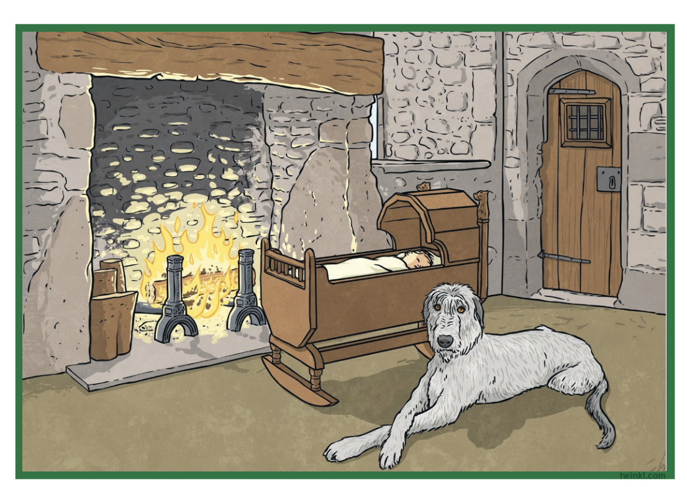
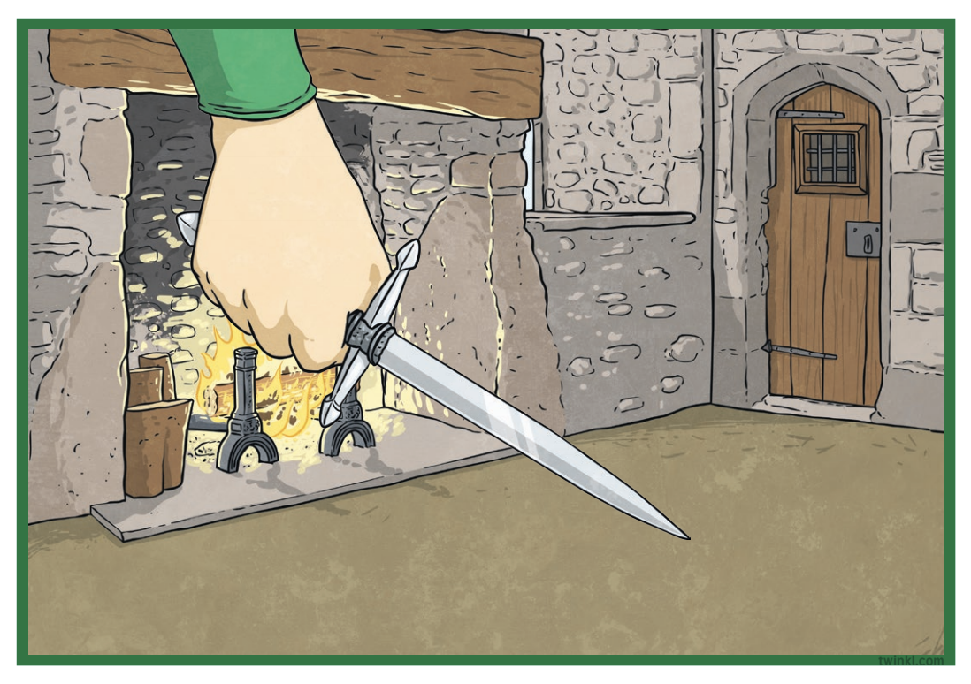
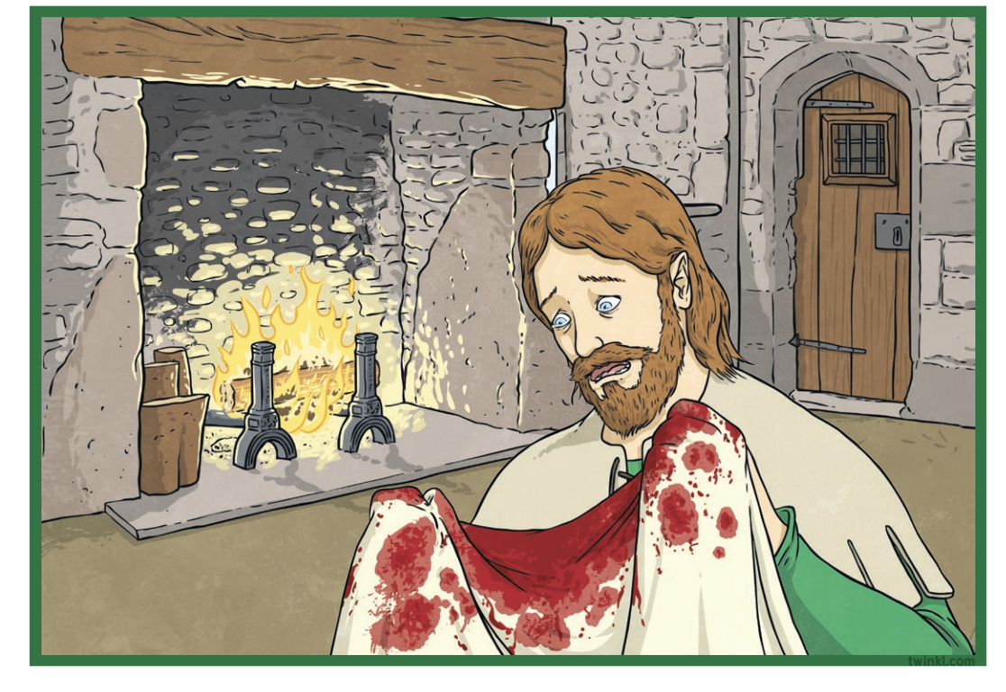
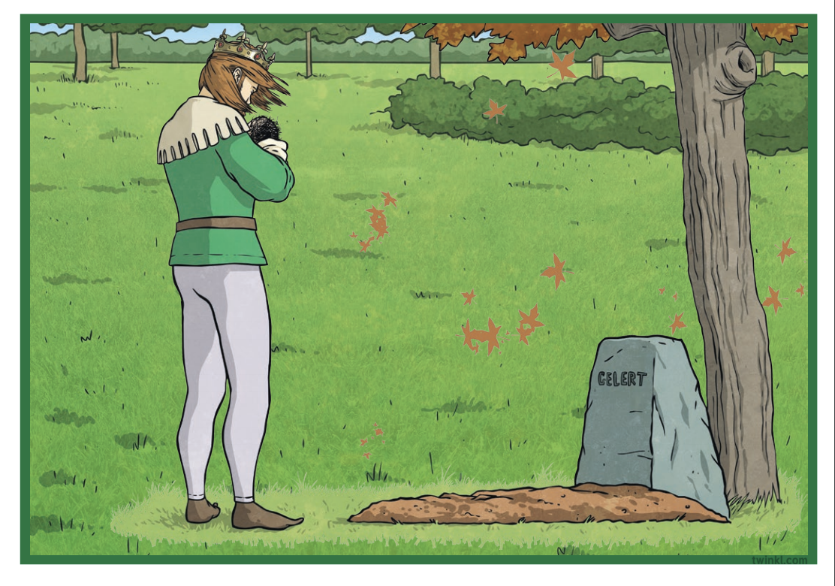
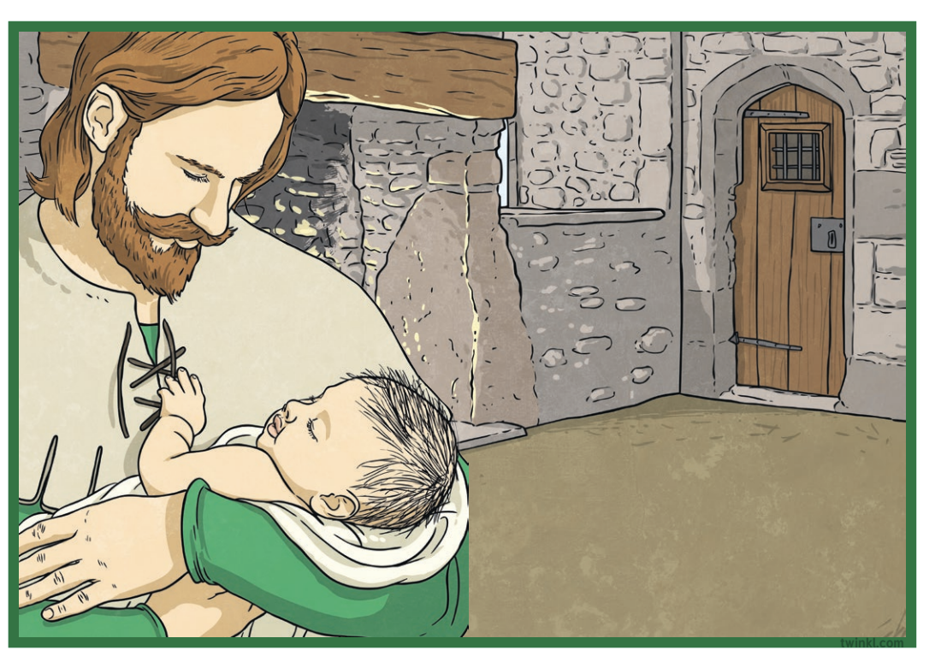
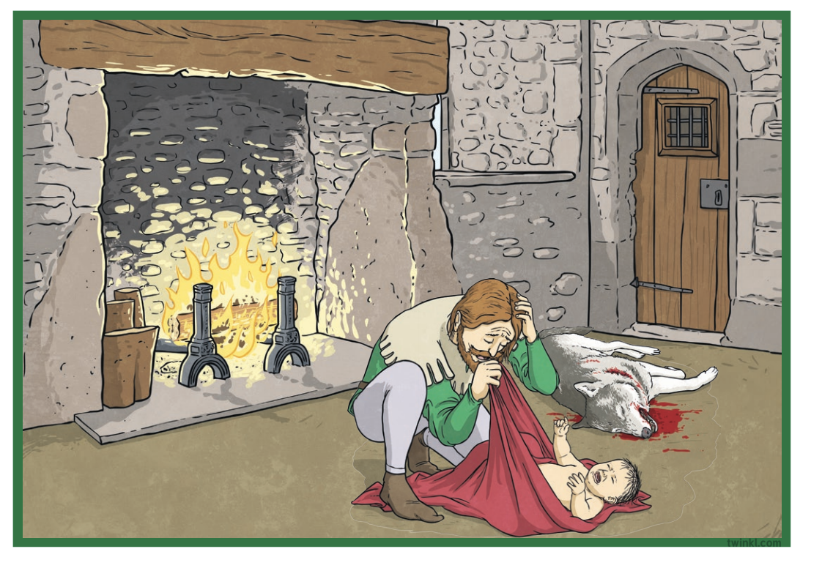
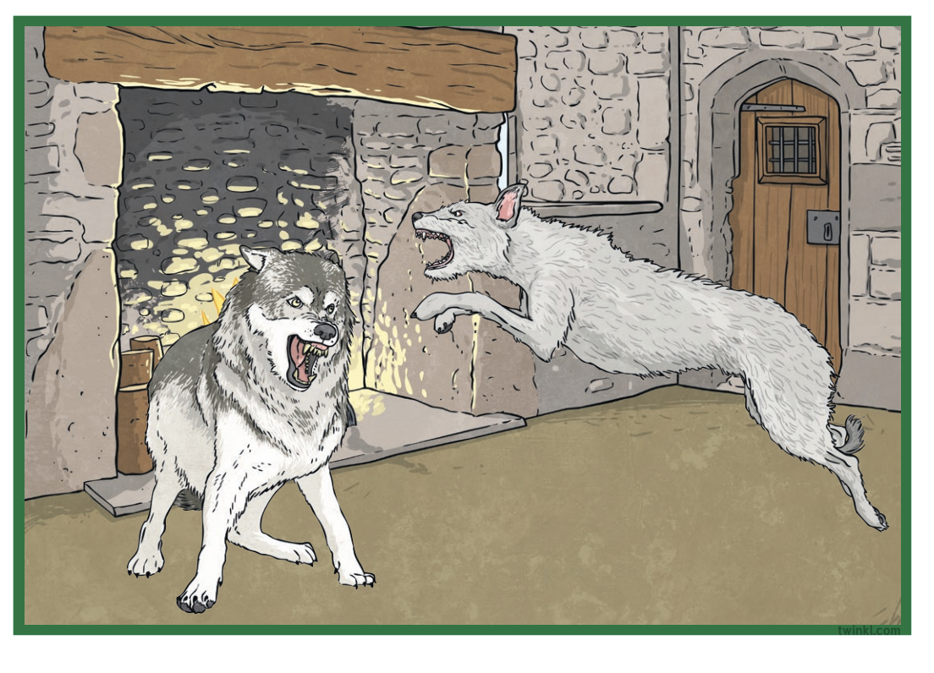
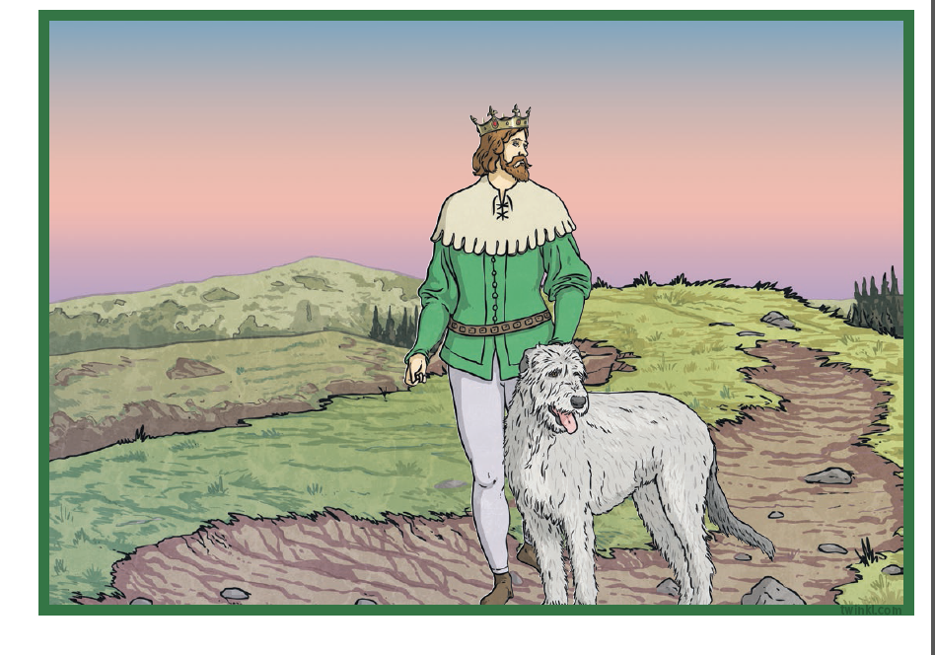
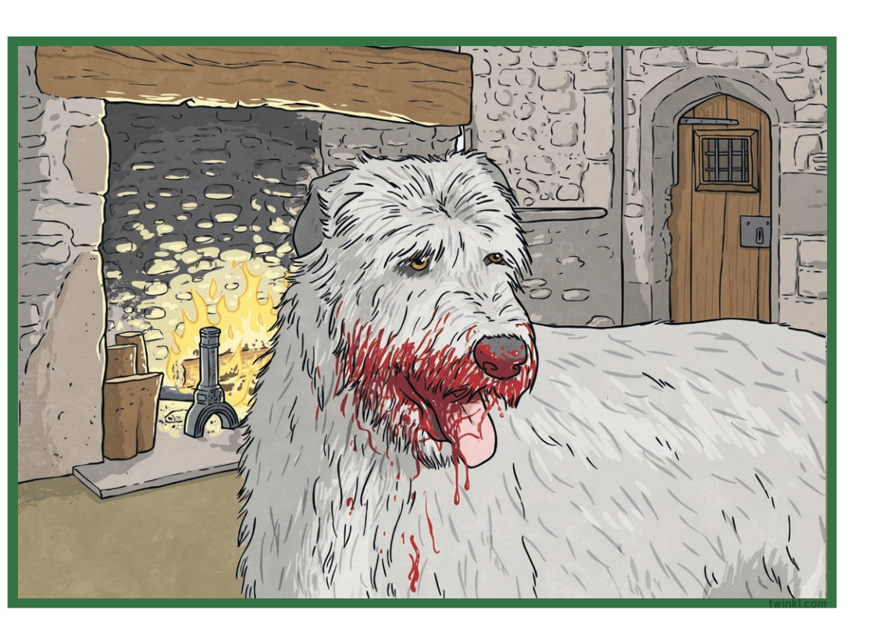
Example 1: The story of Beddgelert
Look at the 9 pictures carefully, use one sentence to describe each pic, and then sequence them to tell a logical story (written or spoken form)
3
4
1
2
9
7
8
5
6
Pics from twinkle.co.uk
Notes:
We can encourage ss to think about where, who, when, what, why and how?
We can then introduce or teach new words
We can encourage the use of a particular grammar structure
We can encourage more advanced learners to write a story

Slide 8
What should we teachers do?
Guide students to observe and notice
Embed the teaching of vocab in context (not PPP approach)
Embed the teaching/learning and practice of a particular language point in context
Pitch your lesson at the right level (not too easy or too difficult but just with the right challenge)
A balancing act (creativity and boundaries )
Notes:
4: lower level students：

Slide 9

Extra activities?
Let’s brainstorm together
What else can we do in order to make the most of pics/pic stories in our class?
Think, type in the chat-box your ideas, and share

Slide 10
Some practical activities
Match
Match the pictures with the correct description/sentences (sentence level, the same or more)
Select
Select key words to summarise each pic
Listen
Arrange the pictures according to the story heard
Read
Read the story to check if you’ve got the sequence right.

Slide 11

Any comments or questions?

Slide 12
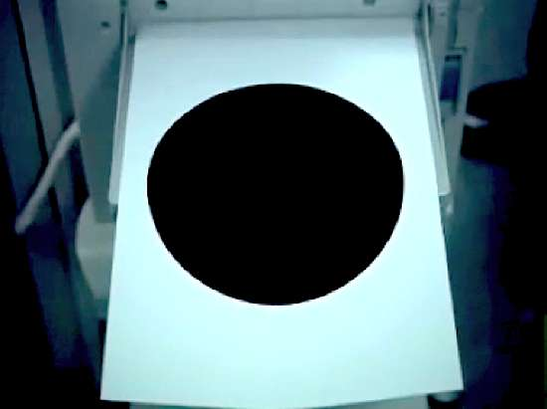
Over to you!
Watch a very short film
Design a few activities that will make the most
of “pics” to enhance your students’ speaking
and writing
Think about a language point/grammar structure
that you can teach using this film. Think about any
Extended tasks you can do with your students.
Feel free to ‘borrow’ any ideas we’ve used
or discussed today

Slide 13

The black hole

Slide 14
Activity 1
Some useful words: frustrated/frustrating, door handle, safe, vending machine, sleep-deprived, overworked, photocopier, photocopy/copy, bored
Have a look at the pictures, make a guess of the sequence of the story. Now, watch the short movie, and number the pictures in the correct order. Write the numbers in the boxes.

Slide 15
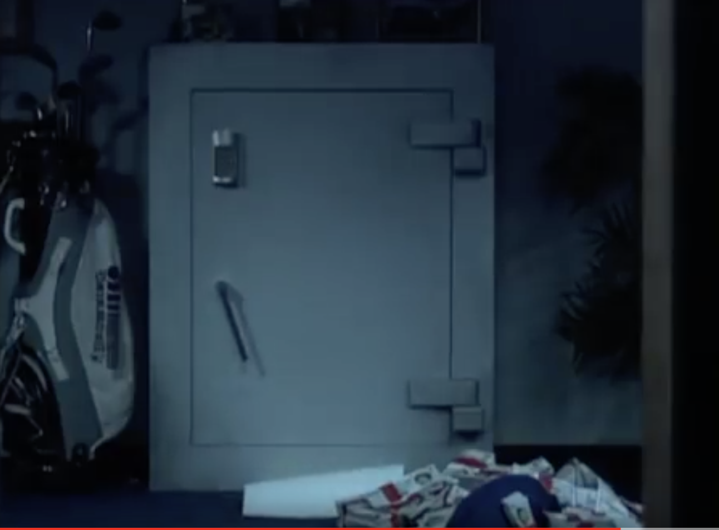
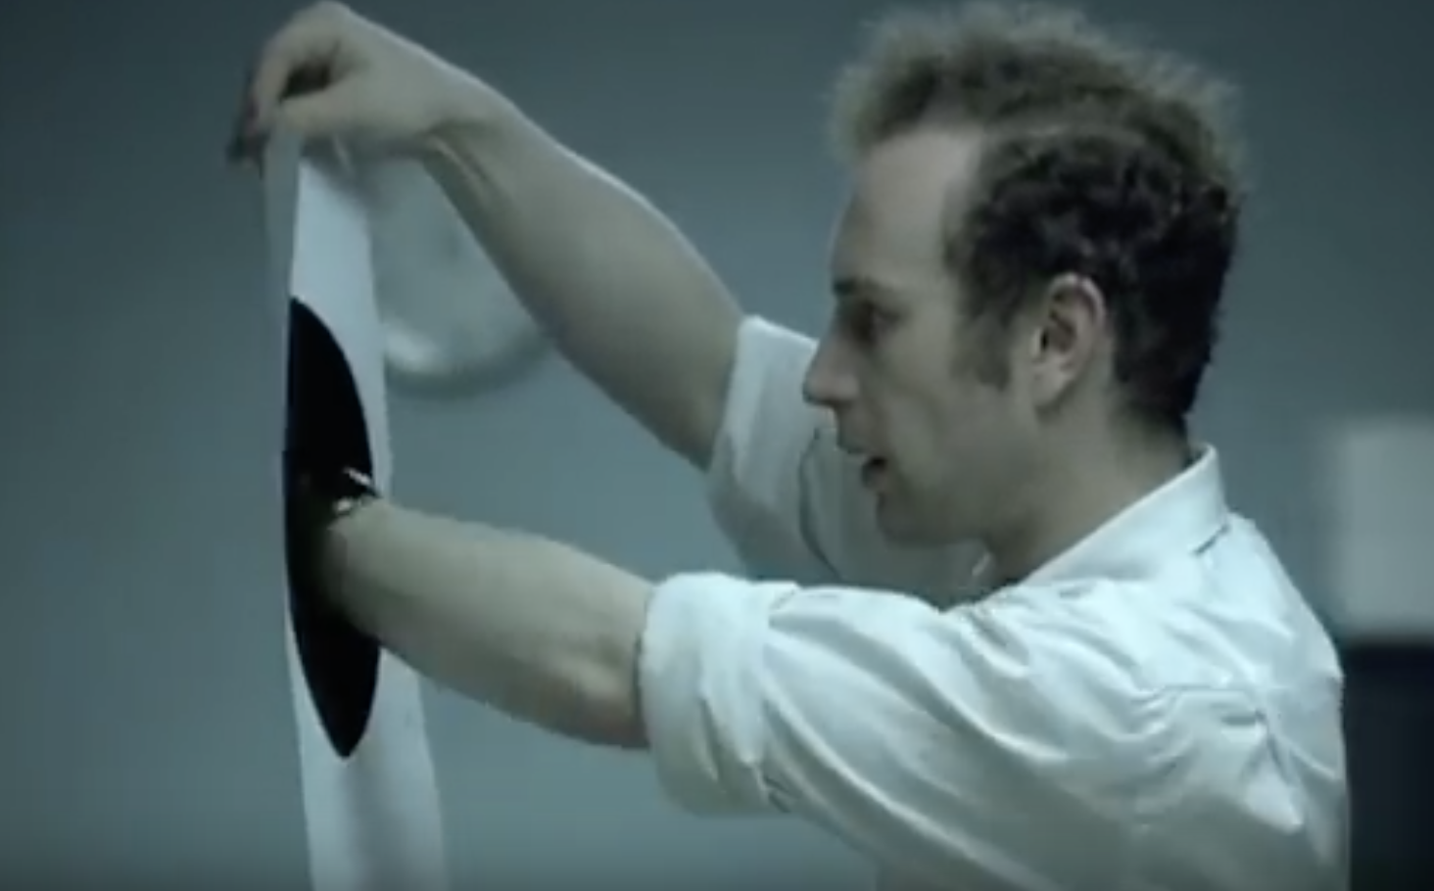
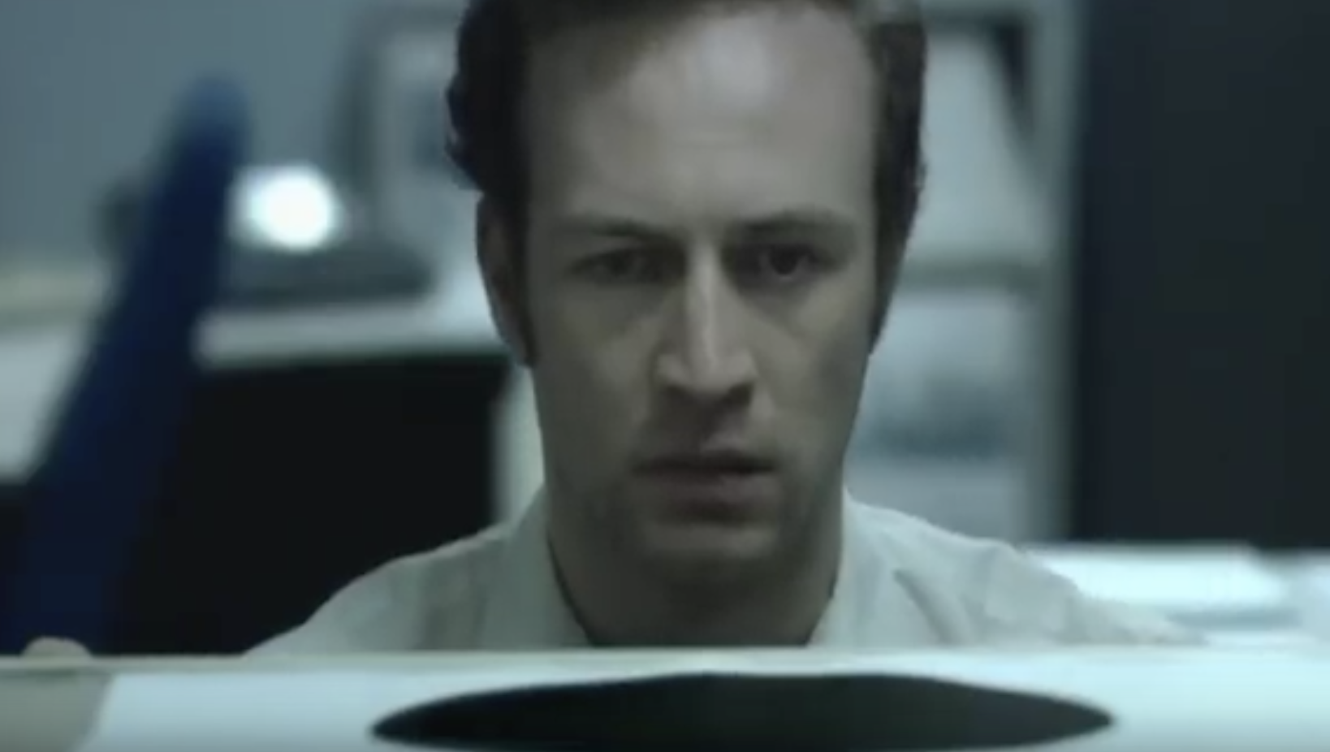
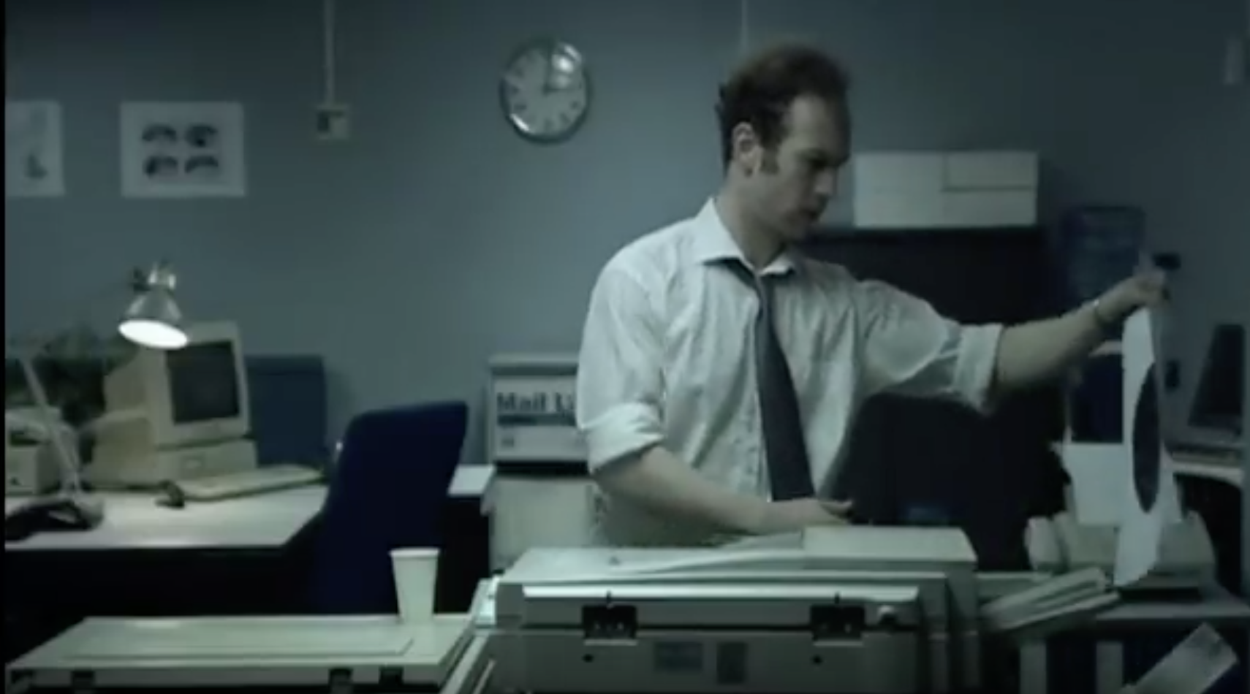
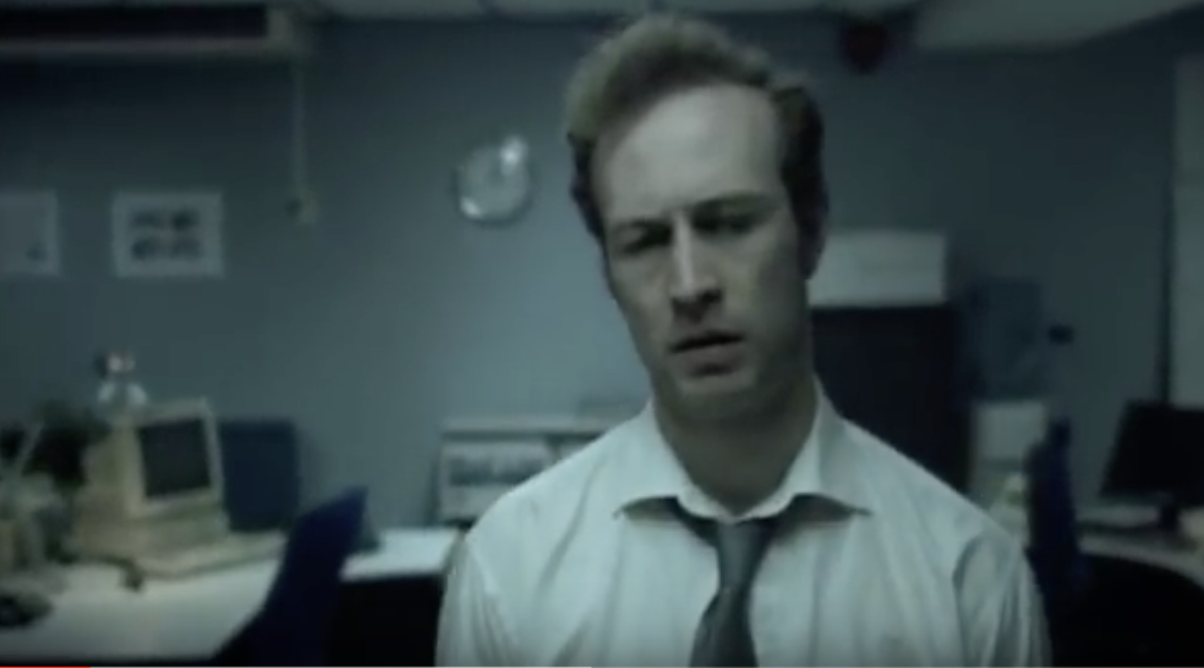
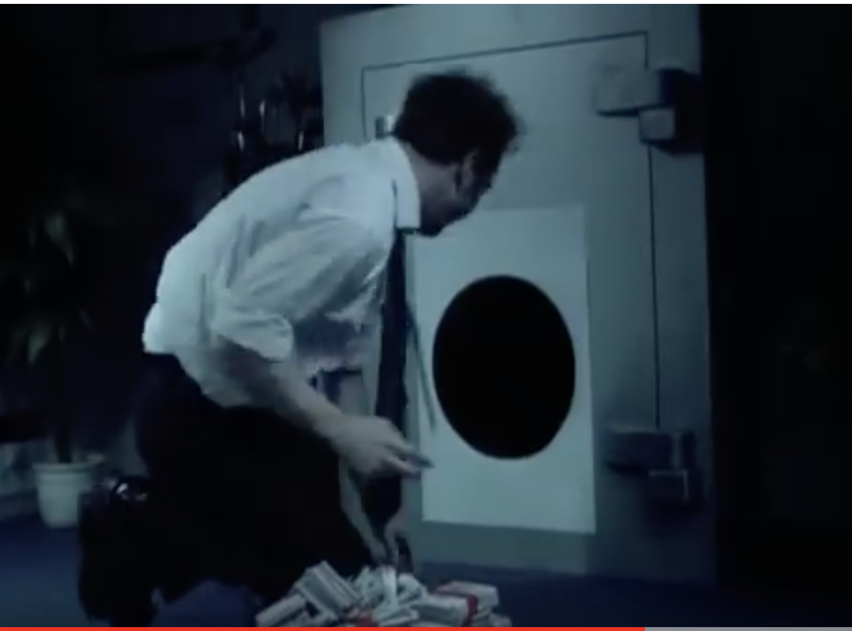
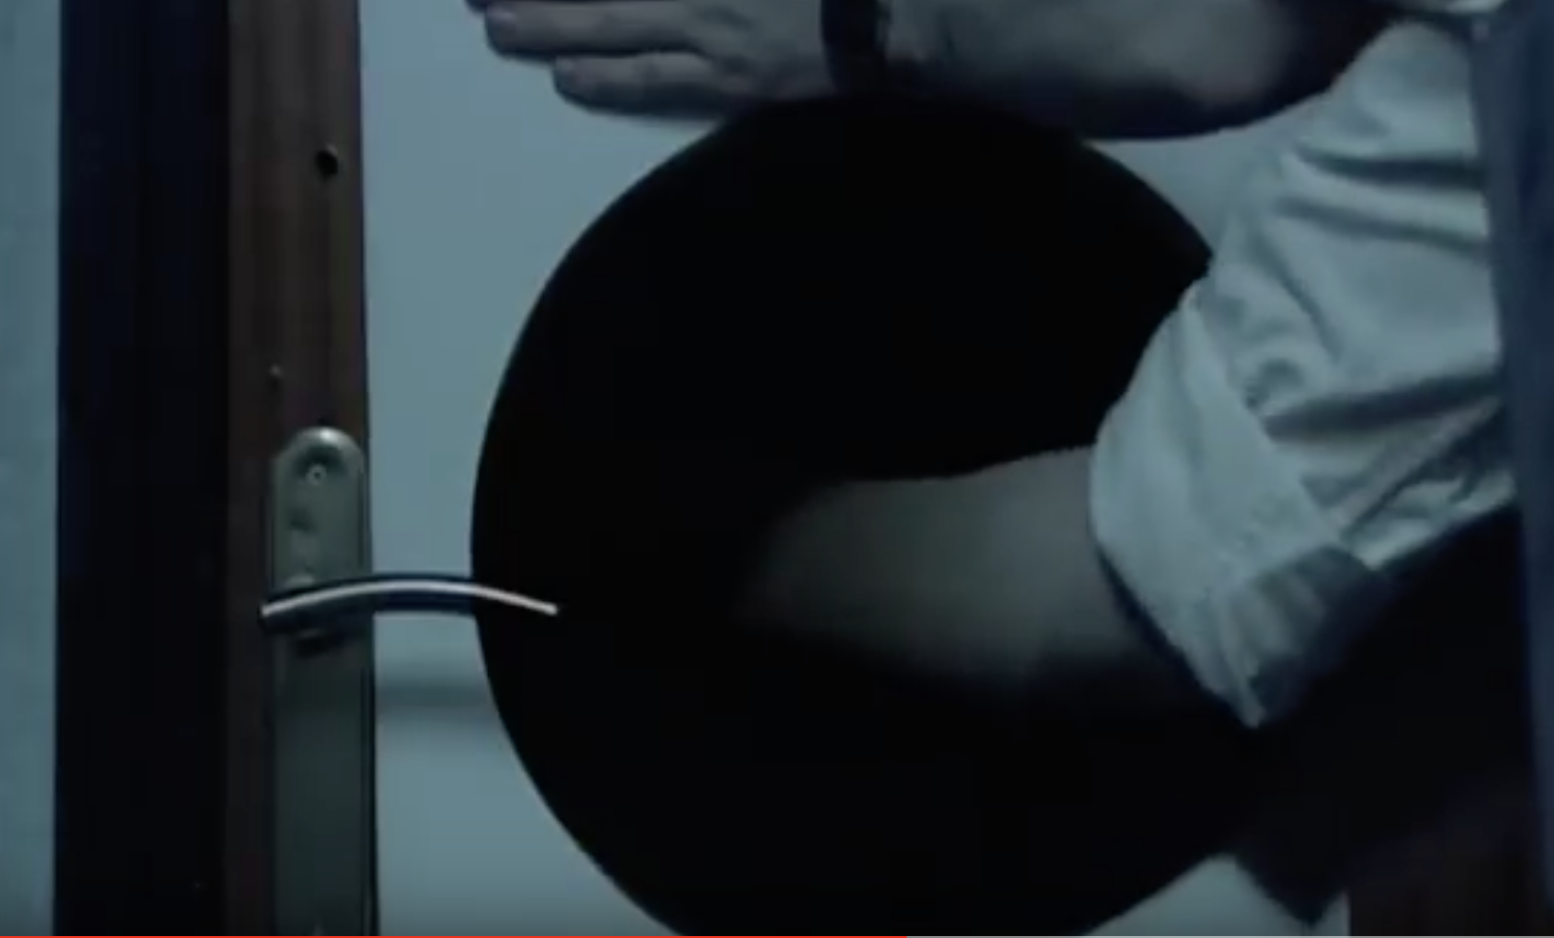
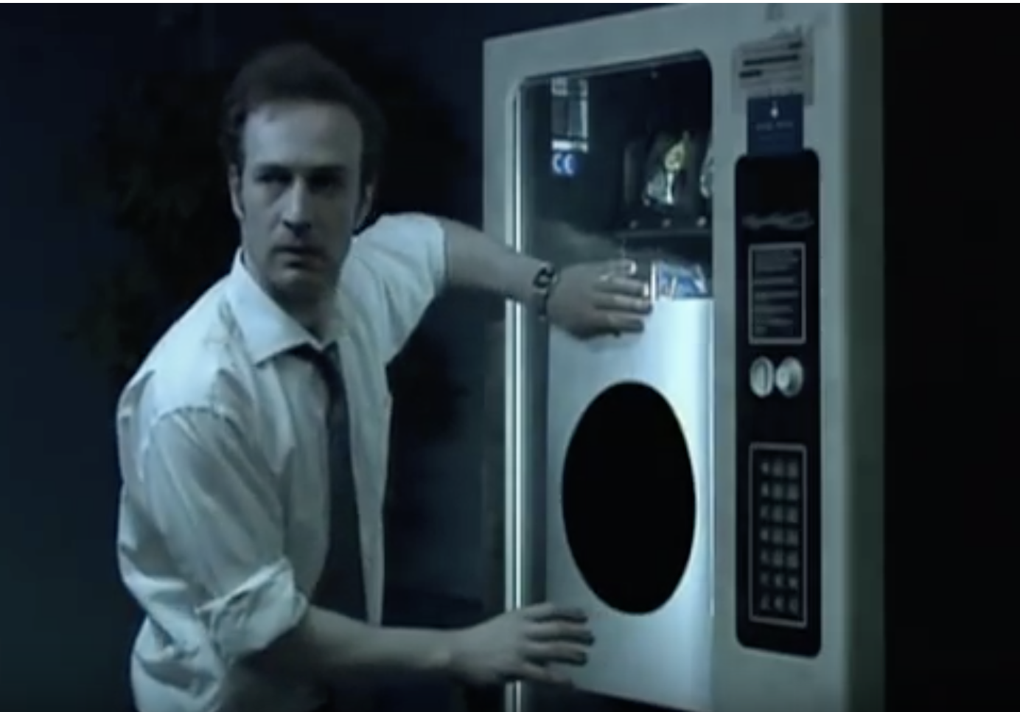

Slide 16
Activity 2
1. | 2.
3. | 4.
5. | 6.
7. | 8.
Decide 4 keys words to describe each picture and then use those key words to retell the story.
Make it more fun by swapping the words

Slide 17
Activity 3
Discuss your chosen words together and decided 24 key words as a group and write them down on a piece of paper.
(Where did the story happen? What time do you think it was? What was this young man’s job? What was he doing? How did he feel about his job? What happened to him?)
Activities 4 & 5 (more advanced learners)
Come up with 2-3 plausible reasons why he decided to open the safe.
What’s the moral of the movie?

Slide 18
Activity 6
Group work: Discuss/write his everyday life before what he did in the video: age, upbringing, education, family (married, single, divorced, single parent etc.), job satisfaction, promotion/going to be sacked, depression etc. (some useful words: repetitive, tedious, bored).
Use ‘must have done, couldn’t have done, or might have done’ in your writing.

Slide 19
Activity 7 (Inner monologue)
Choose one of the following snapshots and write a soliloquy (imagine you are this guy, and based on your discussion/writing in activity 6)

Slide 20
Activity 8
Write/discuss what would happen after he crawled into the safe.

Slide 21
A piece of grammar to teach
Practise the third conditional clause: (be creative but also positive)
If clause had+ v-ed， main clause would/could have + v-ed
Write three sentences about what you would’ve done if you’d had a black hole last year.
If I’d had a black hole, I…
Practise the second conditional clause:
If clause：past simple, main clause would/should do…
If I had a black hole, I….

Slide 22
Any comments or questions?

Slide 23
Where to find pics and stories?
https://www.pinterest.co.uk/grahnforlang/visuals-for-speaking-and-writing/
https://pixabay.com (free photos to use)
https://unsplash.com (the same as the above)
https://www.bilibili.com (movie review, use screenshots)
https://www.twinkl.com.cn (search ‘sequence of a story’)
Cartoons and comic books
Our own or students’ own photos and videos
Our textbooks as a springboard
Socially, culturally and age-wise suitable to our students

Slide 24
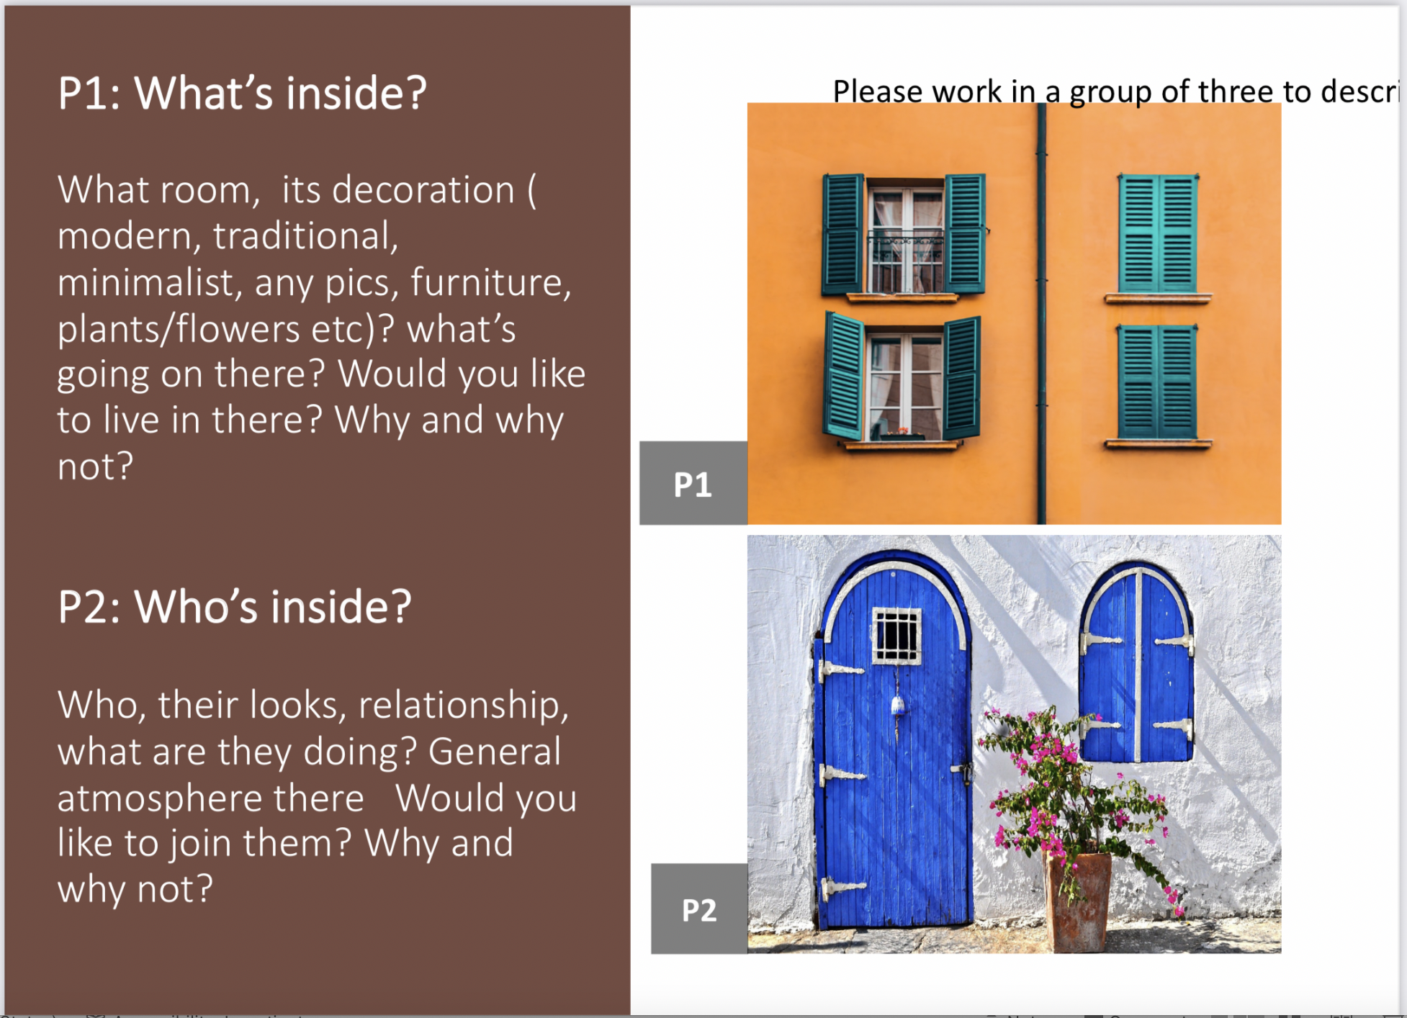
https://pixabay.com B

Slide 25
Reflection, Analysis and Your Takeaway
3 things (teaching ideas, methods, activities or anything new) that you have learned
2 activities that you really like
1 question you’d like to ask

Slide 26

Thank you
& see you next time

