Slide 2
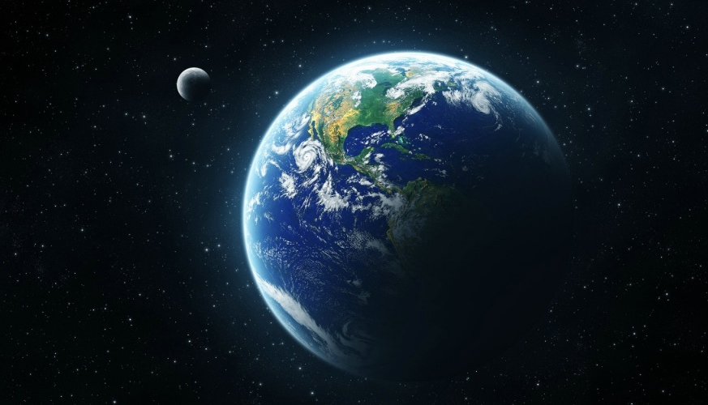
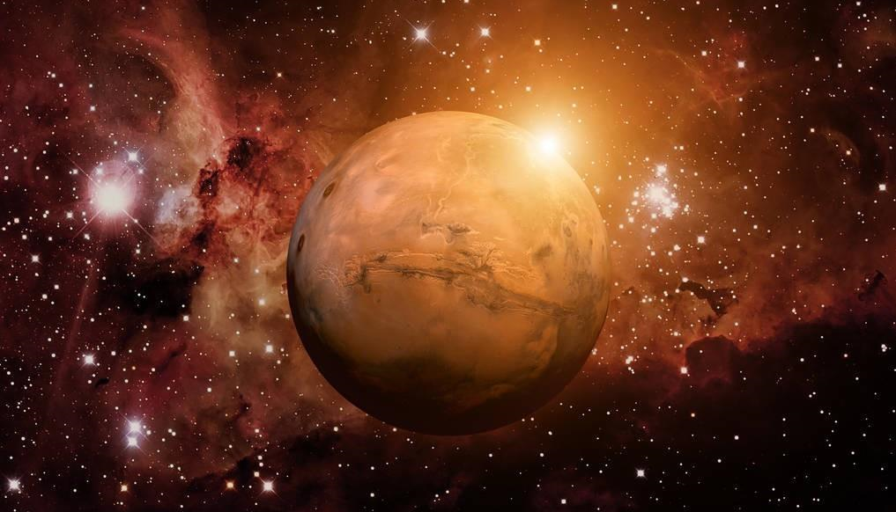
Unit 6 Writing

Slide 3
Lead-in
Watch the video clip and answer
the question.
Where do I want to go?

Slide 4
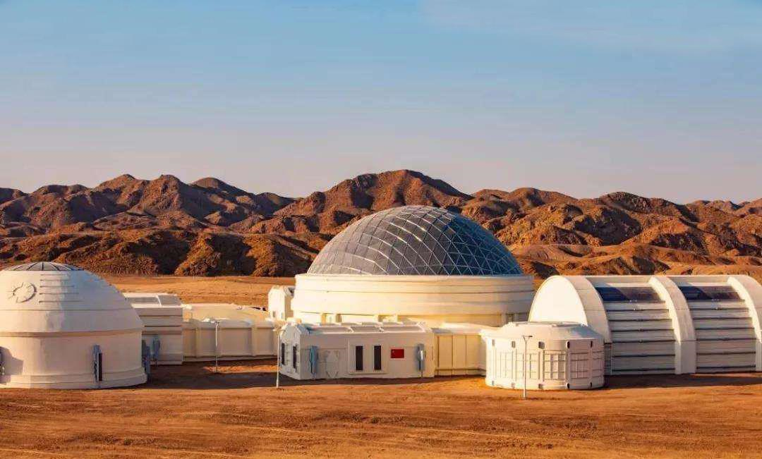
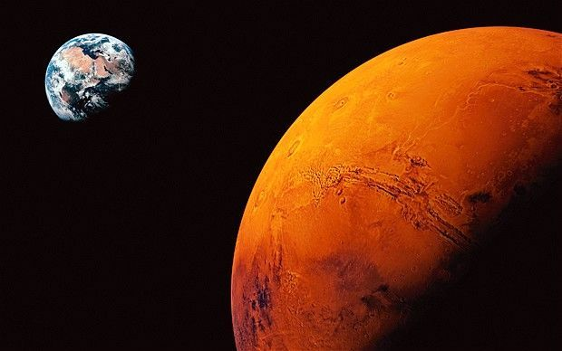
Think: what jobs are wanted for Mars?

Slide 5
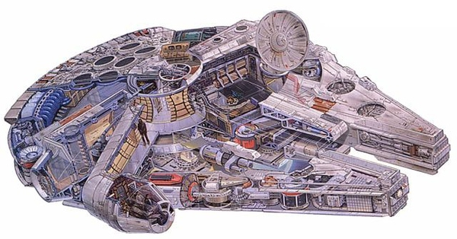
Think of the jobs that can
help build a new city on Mars.
Activity 1 Brainstorming
policeman
cleaner
singer
farmer
bus driver
cook
scientist
engineer
doctor
computer programmar
teacher

Slide 6
Activity 2 Pair work
Make dialogues with your partner.
-- What do you want to be on Mars?
-- I want to be a ________________.
-- Why do you want to be a _____?
-- Because I think _______________.
-- How are you going to do to build a new city?
-- I'm going to _______________.

Slide 7
Activity 3 Group work
Can you organize your sentences into a complete paragragh?

Slide 8
Read the sample writing and figure out its structure.
Activity 4 Make a “Humbuger”
I want to be a teacher on Mars in ten years. I am going to teach Martian some Chinese because we need to communicate with each other. Next, I am going to study Mars language so that I can teach my students better. What’s more, I am going to build a bridge between Mars culture and other cultures. Education is important everywhere. I believe I can be a good teacher and make Mars a better place in ten years.

Slide 9
Activity 5 Write your plan
Please write your own plan that works on Mars.
…
why
who
what
how

Slide 10
Activity 5 Write the first draft
Please write your own plan that works on Mars.

Slide 11
Activity 6 Edit and polish your writing
Hello everyone, I'm from Guiyang No. 17 Middle School. I
feel so excited because I am going to work on Mars. Now I’d like
to share my plan with you.

Slide 12
Activity 7 Presentation
Hello everyone, I'm from NO.7 Middle school. I'm so excited about working on Mars. And I really want to do my own part to do that.
I want to be teacher on Mars in ten years. I am going to teach Martian some Chinese because we need to communicate with each other. Next, I am going to study Mars language so that I can teach my students better. What’s more, I am going to build a bridge between our and others’ cultures. Education is important everywhere. I’m sure I can be a good teacher and make Mars a better place in the future.
In a word, everyone is playing an important role in the city and not a job can be replaced (不可代替). It's our duty to build the city better. We believe we can!

Slide 13
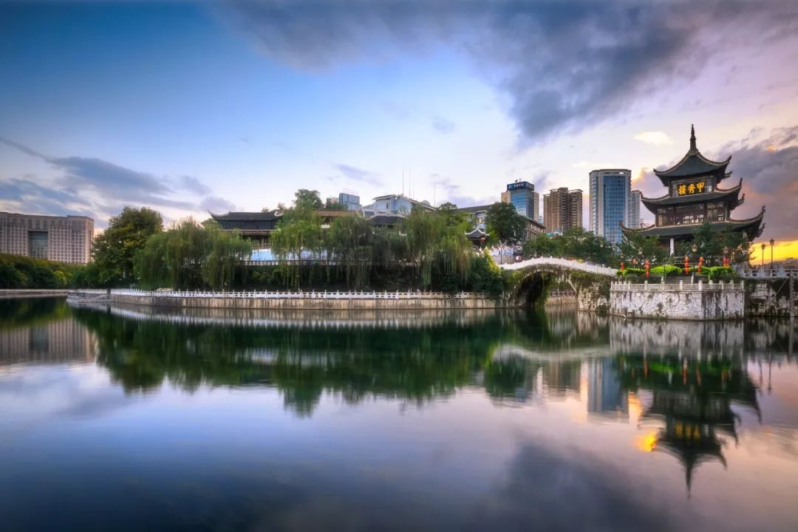
It’s everyone’s responsibility (责任) to build a cleaner, greener and better city for living.

Slide 14
Activity 8 Homework (within 15 minutes)
You have to do:
Polish your plan again according to your draft 2 on your exercise book.
You can choose to do:
1. Shoot a video clip and share your plan to your family.
2. Make a new plan to make your hometown better.

Slide 15
Thank you very much!

