Slide 1
Warmer
Start our final webinar with a positive comment on ourselves. It doesn’t have to be something brilliant or wonderful, and it can be something really small, funny or silly.
For example, You can say: I am proud of myself today because…
I decide to attend this webinar even though I don’t really want to.
I didn’t shout at my son this morning when he was playing with his food.
I have managed to entertain a guess visiting me for four days.
In class, I’d make it as a group activity. When one S finishes saying something they are proud of themselves, the next S will say: Well done, you! Good to know that you… I am also proud of myself today because…
Notes:
We praise everyone around us, but a lot of the times, we forget we should also give ourselves a little pat on the back for what we have done, no matter how big or small the task is.

Slide 2
It’s important to give yourself a little pad on the back!
We praise everyone around us, but a lot of the times, we forget we should also give ourselves a little pat on the back for what we have done, no matter how big or small the thing that makes us feel about is.
Let students feel good about themselves. Encourage their sense of self-worth. Teachers can give silly examples to make students feel at ease.
A good social skill to have as we also learn to appreciate other people’s strength, skills or achievements no matter how big or small.

Slide 3
贵阳市英语学科带头人工作站“激励教学”2022年教师培训工作坊
Session 10
Lesson planning
Dr Helen Hou
Ulster University & QNUN
06/01/2023

Slide 4
We are going to
___________________ what good lesson planning is.
___________________ what we do well or less well, and what we can do even better.
Reflect, analyse and share your takeaway
rethink, reappraise
recognise, critique

Slide 5
Lesson planning is like… (Please share your thoughts in the chat box )
Some examples: LP is like
a chore… I dislike it but have to do it.
a pain in the neck.
a map guiding me through series of activities that help students learn .
…

Slide 6
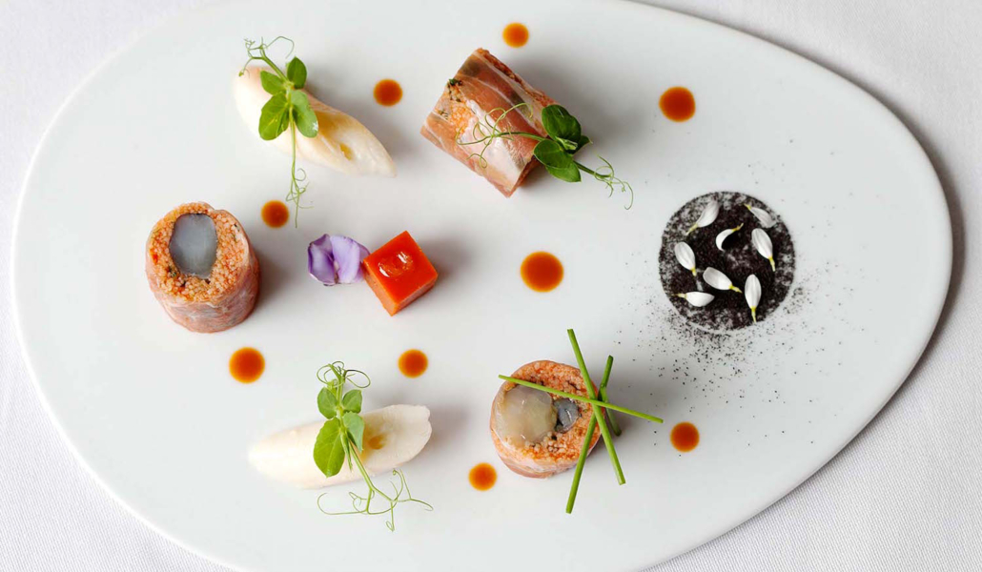
Lesson planning to me is like cooking a three-course meal.
A starter: making ss intrigued and ready for the new input
A main course: the ’juicy, flavoury, substantial bit’ that involves helping students figure out the language points, makes students enjoy, busy participating, practise four language skills if possible.
A dessert: ‘the icing on the cake’, which consolidates what Ss have learnt and gives them a sense of achievement and enjoyment.

Slide 7
Do you…? (1/2)
plan every lesson
write a detailed lesson plan or just an outline
know your student profile
write teaching objectives or students’ intended learning outcome (ILOs) (are there any differences between the two?)
know what characterises a good intended learning outcome?
carefully time different stages in your lesson (how?)
use different interactive patterns (how? Which is your favourite? Why?)

Slide 8
Do you…? (2/2)
8. write down instructions for each activity? (what’s usually in an instruction? )
9. use the same worksheets or differentiate them on purpose (how?)
10. always plan models of language? use authentic language materials?
11. use teaching aids to make lesson suit for different types of learners (what are they?)
12. check or align different stages to your teaching objectives/ILOs?
13. always have a flexible activity that can be added or taken out depending on how much time you have
14. do a (quick) post-lesson evaluation after each lesson (WWW, EBI, WWR)
15. know why a PLE matters?
16. recycle and update your lesson plan

Slide 9
My own practice
Start with the outcome of the lesson. Not what I am going to teach. Ask: What can my students do after attending my class?
So write ILOS as
By the end of the lesson, students will be able to…
recognise the form of present perfect simple ‘have/has+v-ed’
use the form to describe past actions that have an impact on the present in speaking
locate and sort out the right information in a poem
produce their own piece of writing containing the use of present perfect simple and judge their peers’ writing
gain confidence in using present perfect simple correctly

Slide 10
Make your ILOs “S.M.A.R.T”
S: specific
M: measurable
A: achievable
R: relevant
T: time-bound
Avoid using
1. vague verbs such as understand, know 2. verbs that mainly focus on process not product such as listen to, talk about, learn

Slide 12
A memory game as a warmer/hook/spark
have put on has put on
have taken off has taken off

Slide 13
Guess what I did to make me look different now?
T asks the students to look at them very carefully for a few seconds.
T goes out the classroom, closes the door, takes off and puts on a few things, and enters the room with the question:
Guess what I did to make me look different now?
(earrings, rings, scarf, glasses, shoes, watch etc. )

Slide 14
Over to students
Pair work:
Student A and B have a good look at each other, and then ask them to sit back to back to make some changes.
Once they are ready, ask them to turn around and start to tell what their partner has done to make them look different
Explain the form and meaning of PPS

Slide 15
Use it more communicatively with a bit fun? Will you differentiate the worksheet to allow everyone to practise their English together? If so, how?

Slide 16
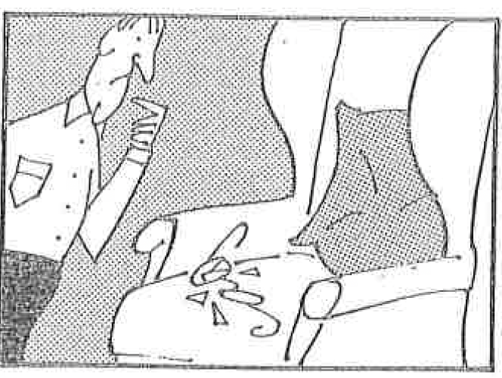
Activity 1: describe and guess (either pair or group): What has happened?
An armchair, angary at himself, a pair of bad glasses, (break/broken)
Cut all picture cards, divide them and give each student 7 cards. They take turns to describe and guess.
Student A describe the picture without using the actual verb.
For example:
A man is standing in front of an armchair and looking at his glasses. He accidentally sat on them. So, what has happened?
Student B: He has sat on his glasses.
He has broken his glasses.
Now let’s try a couple together.

Slide 18
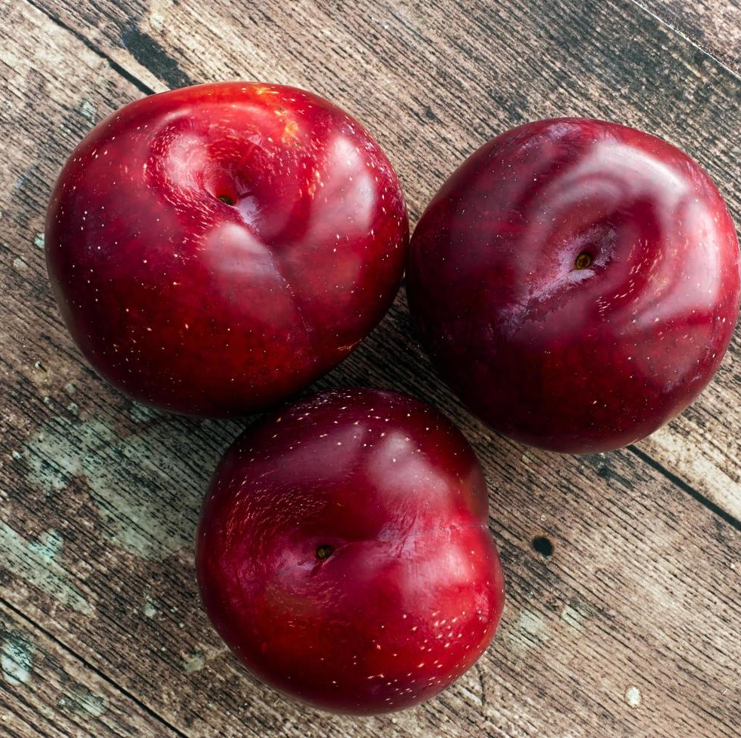
Juicy plums

Slide 19
Can you help me sort out the right order? Read others’ sorry notes
that were in
and which
They were delicious
I have eaten
This is just to say
the plums
the icebox
for breakfast
saving
and so cold
so sweet
you were probably
Forgive me

Slide 20
This Is Just To Say By William Carlos Williams I have eaten the plums that were in the icebox and which you were probably saving for breakfast Forgive me they were delicious so sweet and so cold

Slide 21
This Is Just To Say I have______ the________ that_______ the_______ and which you were probably _________ ____________ Forgive me _____ ______ _______ so _________ and _________
Recall the missing words

Slide 22
Invent/produce your own version of the story, share and vote for the most ‘sadistic’
This Is Just To Say By Helen Hou I have scratched the scratch cards that were on the kitchen island and which you were probably planning to scratch yourself Forgive me I have won and spent so much money and so quickly.
See one more example:

Slide 23
Exit ticket
I have learnt _________ tense today, whose structure is ___________.
I know the tense means _____ actions have an impact on the _______.
I can use the structure to make a sentence: _________________________________________________________.
My favourite part of the lesson is_____________ because___________
I still need help with____________, and I don’t quite understand__________________.
My overall rating of my understanding of the lesson:

Slide 24
Grammaring: Present perfect simple:
By the end of the lesson, students will be able to
recognise the form of present perfect simple ‘have/has+v-ed’ (warmer as a spark and lead in)
use the form to describe past actions that have an impact on the present in speaking (main course stage 1) (activity 1: form and meaning)
locate and sort out the right information in a poem (A2, recall A3 ) Use
produce their own piece of writing containing the use of present perfect simple and judge their peers’ writing (A4) Use
gain confidence in using present perfect simple correctly (affection)

Slide 25
Refection, analysis & your takeaway
What’s new?
What surprises you?
What makes you think?
Any questions you’d like to ask?

Slide 26
To summarise some key components of lesson planning
ILOs
stages
A variety of activities/tasks (controlled-semi-controlled-free practice)
timing
teaching aids
anticipated problems
interaction patterns
student profile
constant checking & feedback
Homework
PLE

Slide 27
Rod Ellis on TBL task and exercise
A TBL task:
Involves a primary focus on meaning
A task has some kind of ‘gap’
Ss choose the linguistic and non linguistic resources needed to complete the task.
A task has a clearly defined communicative outcome
While an exercise :
primarily focuses on using language correctly
There is no gap
Text manipulating (recall)
Successful performance=accurate use of target feature

Slide 28
Thank you for taking part!
Best of luck!

