Slide 1
Motivating teaching for English teachers at GAESC 贵阳市英语学科带头人工作站“激励教学” 2022年教师培训工作坊 08/09/2022

Slide 2
Bits and bobs
Who am I?
Purposes of the training
Approaches used for training
My expectations of you
Your expectations of the training workshop

Slide 3
Who am I ?
26th March Maths teacher
Helen
Youyou ice cream

Slide 4
Purposes of the training
By the end of the workshop, teachers will
Have a clear understanding of what makes a lesson motivating, and know how to plan lessons so that they are intrisincally motivating for students.
清楚地了解如何让课堂变得激励，并知道如何规划课程，以便他们为学生提供内在动力
Be familiar with principles of effective lesson design for listening, speaking, reading and writing activities that develop students’ all-round language skills
熟悉有效的听、说、读与写课程设计原则，以培养学生的全方面的语言技能
know a variety of methods and techniques with which you can motivate students to take ownership of learning
了解各种教学方法和技巧，以便学生真正成为学习的主体

Slide 5
A two-hat approach
You as a ’student’ and ’teacher’
I as a ‘teacher’ and ‘teacher trainer’
Teach &
Reflect, analyse and apply in your own class

Slide 6
Teacher Cognition 教师认知的重要性 Does it matter?
What teachers think, know, and believe and the relationships of these mental constructs is closely related to what teachers do in the language teaching classroom.
Borg, 2003, p81
Key words: beliefs, with/out enjoyment, comfort zone, desire to change

Slide 7
My expectations and yours
1. Be here and now
2. Actively engaged in all activities
3. Ask questions (no questions are silly questions.)
4. Understand, apply and create
5. Have some fun if you can
What about your expectations of the workshop? Let me know in the chat box.

Slide 8
Session 1 Dictogloss （听写重构）
Before we get started, you will need
Some sheets of paper (几张草稿纸)
Earphones （耳机）
A pen (笔)
A notebook （笔记本）
A cuppa

Slide 9
Session 1 Dictogloss （听写重构）
Foci:
Attentively listening and reconstructing the discourse heard/dictated
Differentiation in using dictogloss with pre or intermediate learners
Extended tasks
Your analysis, reflection and takeaway

Slide 10
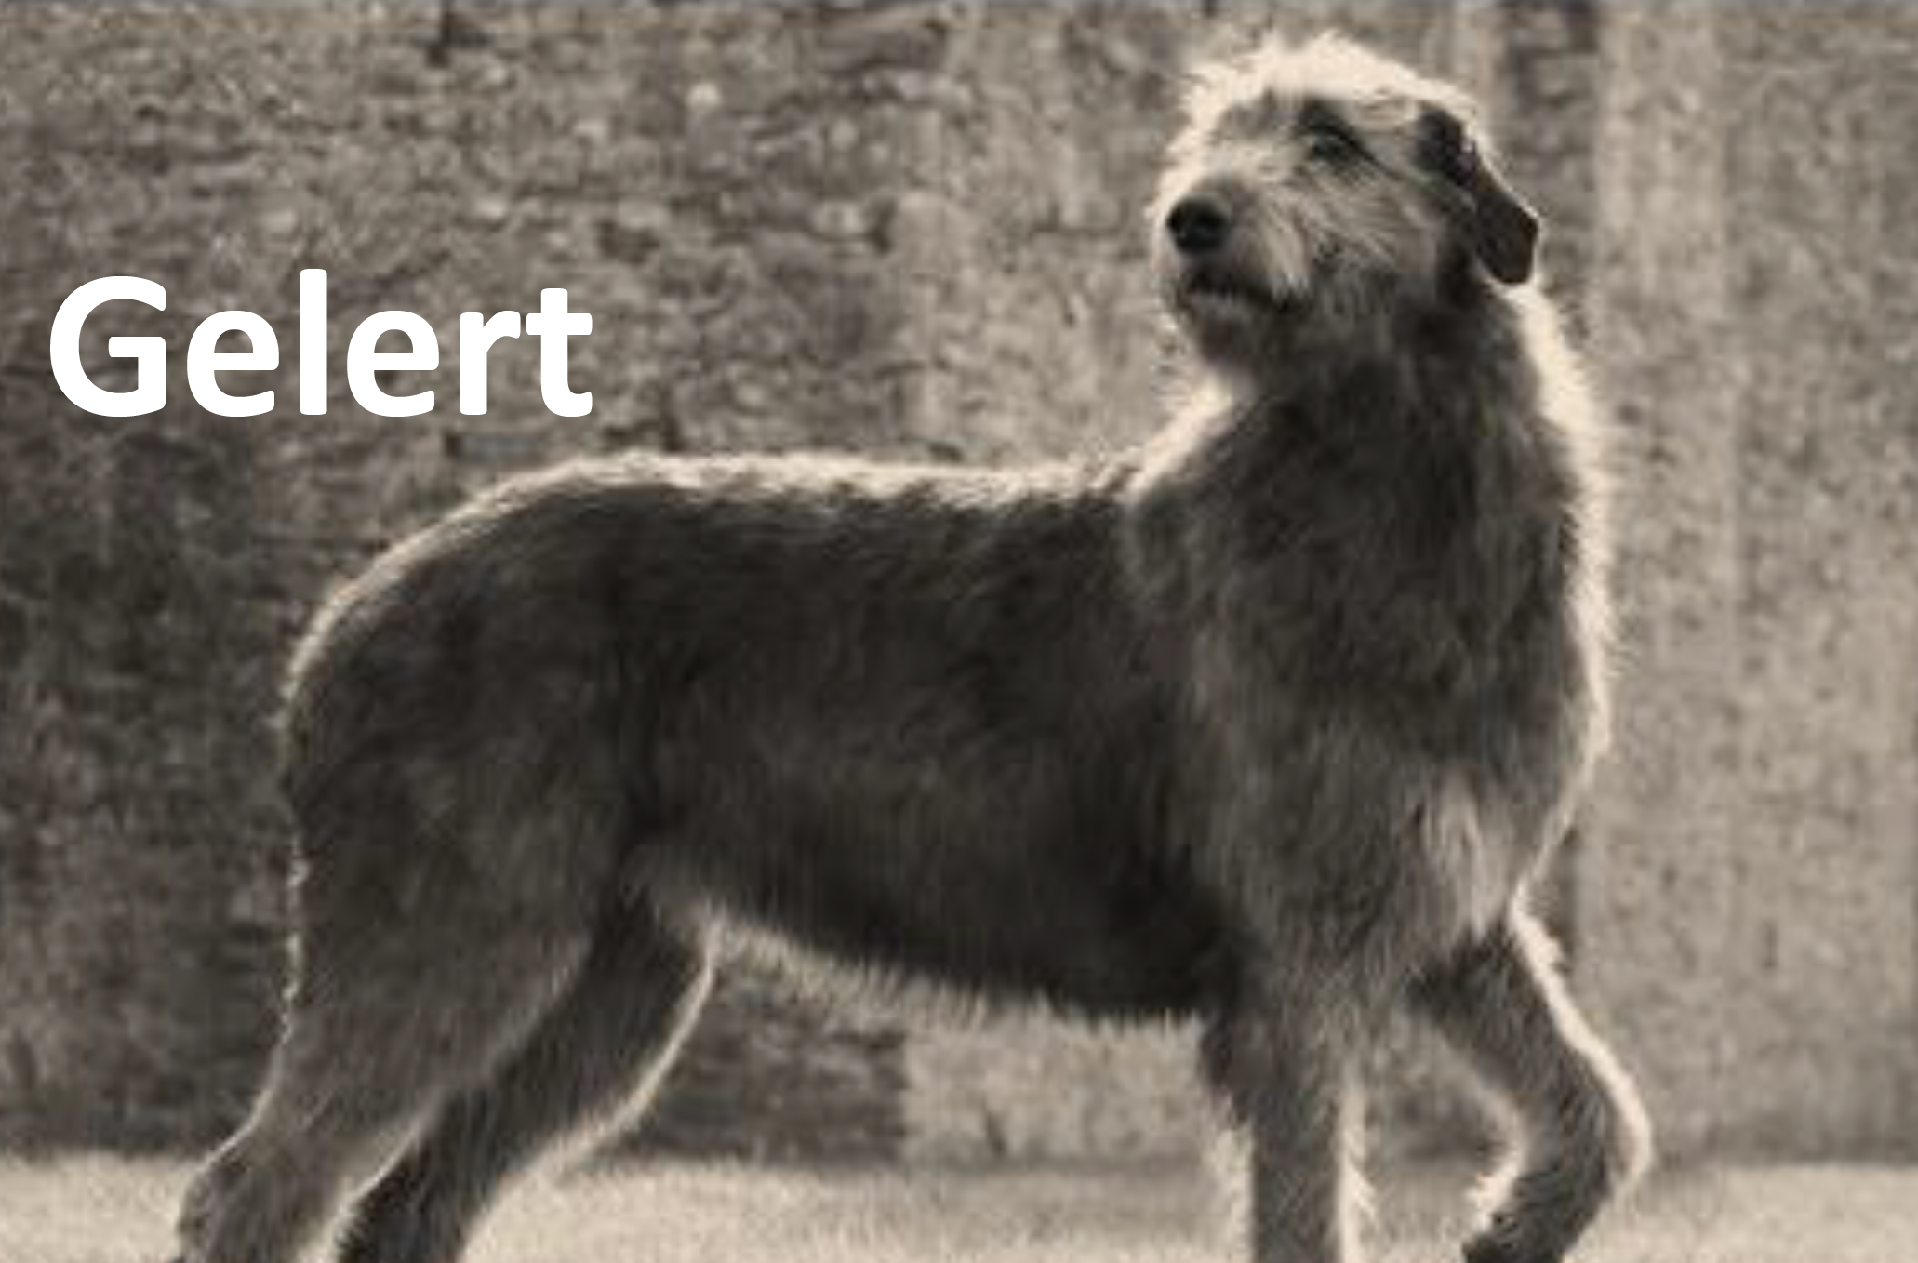
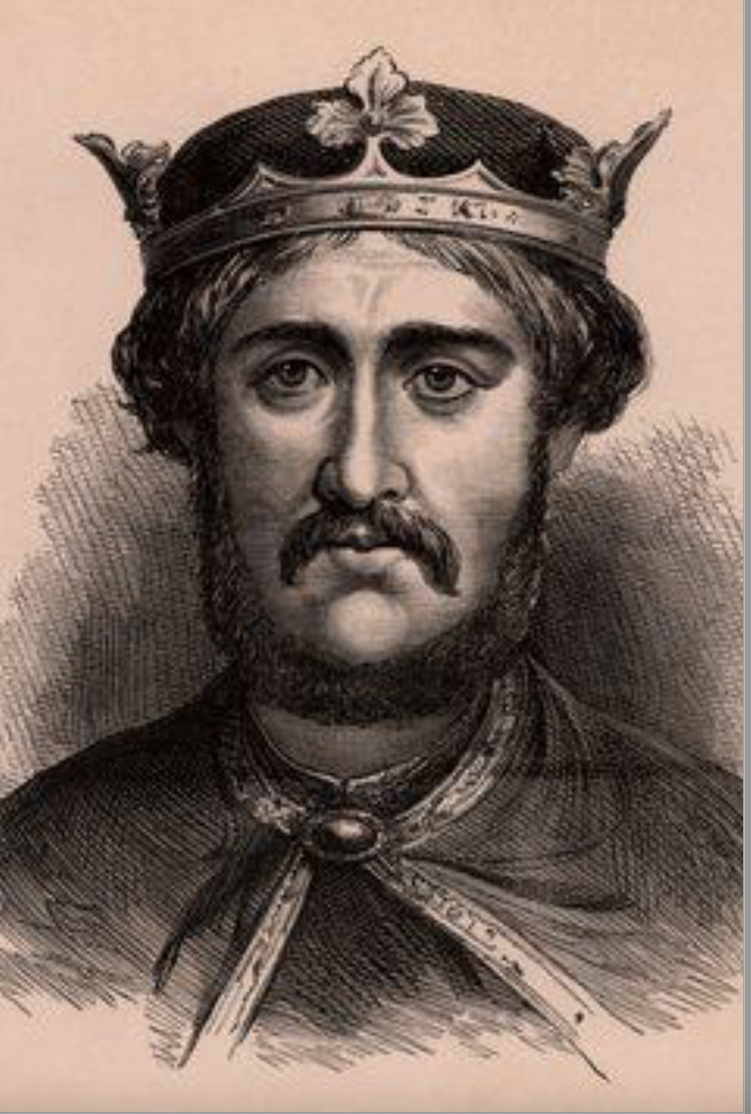
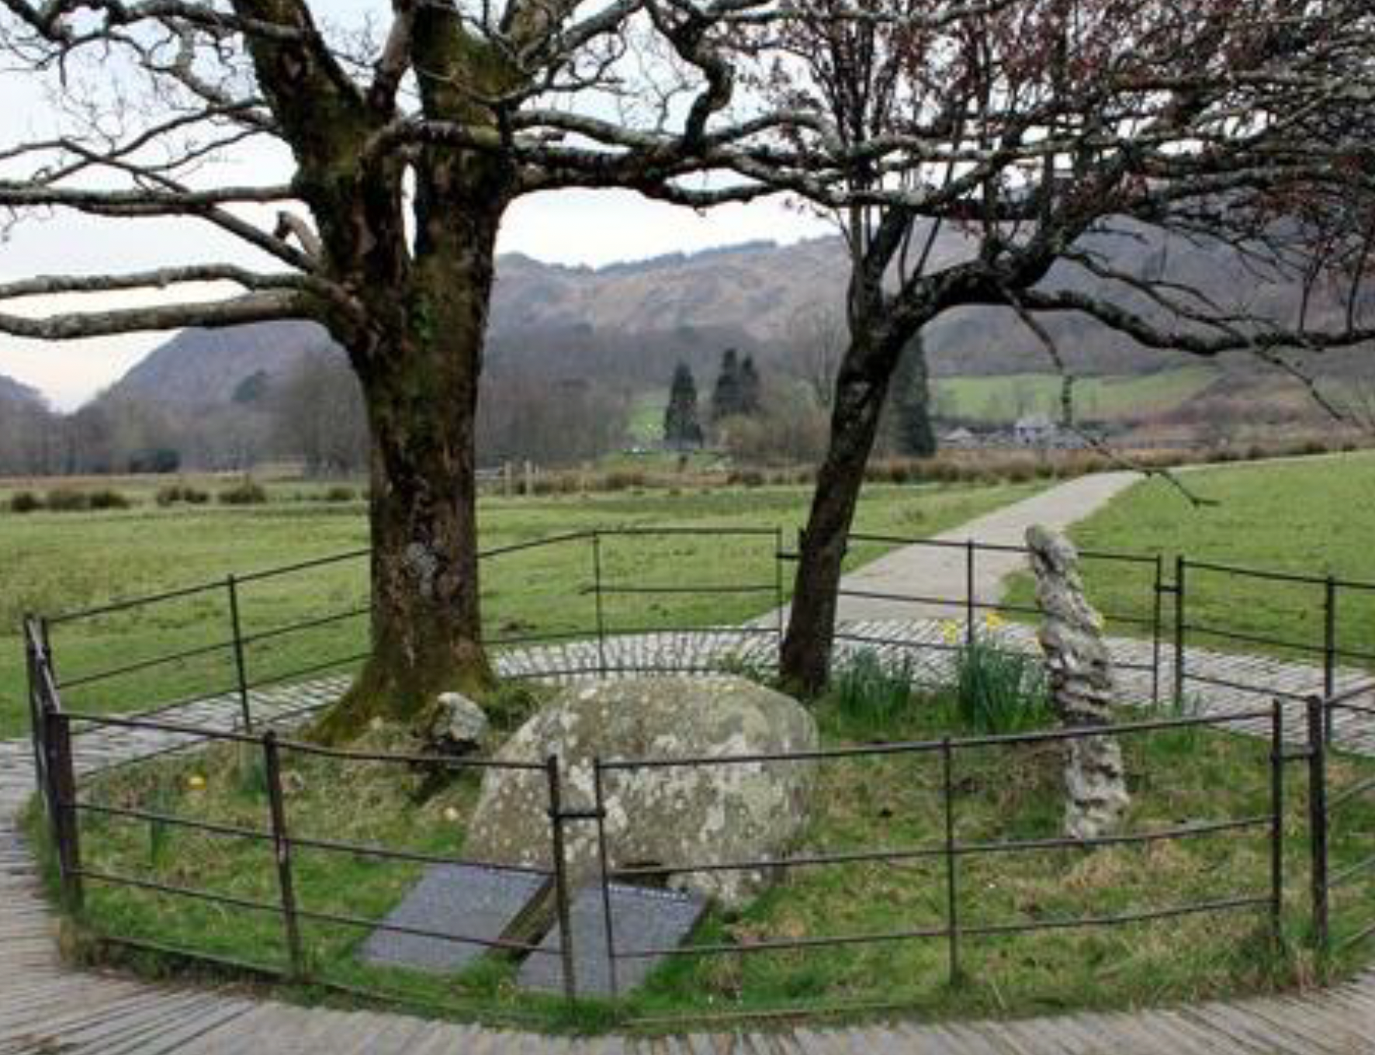
Dictogloss: The story of Bedgelert
Prince Llewelyn & his dog
Listen to the story. You may wish to jot down some key words
Listen to the story again.
Reconstruct the story using your own words

Slide 11
Now write/construct the story. It DOESN’T have to be exactly the same words BUT the meaning must be the same and it must be GOOD English! 1-2-4 in a group Move around, read and revise
Use the following vocabulary when you write the story, and use past tenses his faithful/loyal/trustworthy dog to guard/protect/look after the baby He broke down/collapsed The furniture was smashed

Slide 12
The story of Bedgelert

Slide 13
What is Dictogloss?
Pause here, and write your own understanding or definition of dictogloss? You may wish to also include its procedures.

Slide 14
What is Dictogloss?
Dictogloss is a language teaching technique used to teach grammatical structures, in which students form small groups and summarise a target-language text.
First, the teacher prepares a text that contains examples of the grammatical form to be studied. The teacher reads the text to the students at normal speed while they take notes.
Students then work in small groups to prepare a summary of their work using the correct grammatical structures, and finally each group presents their work to the rest of the class. Dictogloss activities encourage learners to focus on the form of their language while also being based in communication, and are used in task-based language teaching.
From wiki
https://ealresources.bell-foundation.org.uk/information/great-idea-dictogloss

Slide 15
What’s good about it?
Reflect on you being a student in the activity and write down the pros of using this activity in a language class?

Slide 16
Benefits of using dictogloss activities
They integrate the four language skills of listening, reading, speaking, and writing.
They also give students opportunities to talk about both content and the language itself.
Dictogloss activities are a useful way of presenting new factual information to students and encourage them to listen for key points.
They give support to less confident students, as they are encouraged to participate in their groups as part of the structure of the activity.

Slide 17
Time for a break (10 mins)

Slide 18
How can we use dictogloss with lower-level students for raising grammar-awareness or teaching grammar in context? Pause here and write down a few ideas. Differentiation (差异性教学)

Slide 19
Look at the two activities (Differentiation)
Which of these past tense verbs do you hear in the story? Tick them off the list
(from Jo Gakonga)
Use those words to write 4-5 short sentences that summarise the story
 | In the story | NOT in the story
was
admired
named
loved
went hunting
lived
slept
walked
left
returned
got home
listened
looked
saw
realised
cried
built

Slide 20
Extended tasks
It’s human nature to love listening to/reading stories. Stories make us laugh, cry, think or even act, so they are great resources for some follow-up activities.
Pause here, have a think about what follow-up tasks you can design to encourage students to do more in your class.

Slide 21
Extended task 1: interview the prince
For more advanced learners, in each group, come up with 5-6 questions that you’d like to ask the prince. One acts as the prince, and the rest take turns to ask him a question.
For lower-level students, teachers can give a list of questions, then give prompts and key structures to encourage them to answer the question.

Slide 22
Extended task 2: write a eulogy/news report
For upper-intermediate students, we can encourage them to write a eulogy (give a model, or outline of what makes a good eulogy) or write a news report (again, make sure you provide a model and give a clear structure to guide them to write a news report.
Extended task 3: recall the story or design a cloze
For pre- or intermediate students, we can encourage them (in pairs) to decide the 10-15 key words that they believe can best retell the story.
Or give them the story and ask them to design a cloze activity (it can be a blank in every 3 or 5 words, it can be a cloze with words given to fill in etc.)

Slide 23
Reflection & Analysis
1. What did I do in the session (from the beginning to the end)?
2. Which part did you enjoy the most? Why?
3. Which part did you enjoy the least? Why? How would you do it differently?
4. What are your gains?
5. Can you use dictogloss in your own class? If so, what piece of reading, in which unit will you use?

Slide 24
Post-session task
Go trough your current English textbooks (1-4), have a think about the grammar structure, the ‘story’ or fun texts, follow a similar design you have done today, and design a dictogloss lesson.
Need to consider your students’ level of English and the amount of support you need to give them.

Slide 25
Questions?
Thanks for watching and see you in session 2.
Looking forward to hearing your dictogloss ideas
I will be sharing mine with you too!

Slide 26
Acknowledgment
Jo Gakonga TESOL lecturer at Warwick University

