Slide 1
Rebus puzzles (带有图片和单词的字谜游戏)
I believe in you
read between the lines
think out of the box
top secret (adj)

Slide 2
Fill in the blanks
When you are faced with difficulties, you need to calm down and then
_______________________.
The Gaokao papers are locked because they are _______________.
If you __________________________, you will find out the letter is really a request for money.
4. I'm sure you'll do great in the interview—_______________________!
think out of the box
top secret
read between the lines
I believe in you

Slide 3
Over to you!
Use
‘think out of the box’,
‘read between the lines’,
‘top secret’ and
‘I believe in you’
to make four sentences and share in the chat box.

Slide 4
Session 3 Integrating reading & writing (1) How to write a book review
贵阳市英语学科带头人工作站“激励教学”2022年教师培训工作坊
Dr Helen Hou
Ulster University
13/10/2022

Slide 5
Integrating reading & writing
Rebus puzzle as a warm/cooler
Write a book review: Rain before rainbows
Reflection & analysis
Differentiation
Some food for thought

Slide 6
Online class rules
Be here and stay focused
Take notes
Be active
Have some fun
A two-hat approach

Slide 7
Some questions to ponder
Where do we see book reviews?
Why do people write or read book reviews? (purposes)
Have you ever read or written book reviews?
share your thoughts in the chat box

Slide 8
What makes a good book review? Share your thoughts in the chat box, thanks!

Slide 9
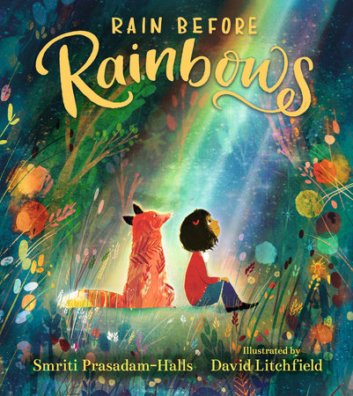
Rain Before Rainbow
What can you see on the cover?
How do those colours make you feel?
What’s your understanding of the title ‘rain before rainbows’?
Can you predict what the story is all about?

Slide 10
Let’s read the story together
Read the story and have a close look at the illustrations
Then we are going to listen to the story
Decide if you like it or not (jot down reasons)

Slide 12
Let’s ‘design’ the framework of the book review together!
What should we include?
(Note: I’d spend quality time here when teaching to make sure that the framework/template is co-constructed in the class by students.)

Slide 13
The must-have components in a good book review
The author (and illustrator)
Begin with a brief summary of the book.
Pick out the most important aspects of the book.
Include brief quotes as examples.
Write a conclusion that summarises everything.
Give it a star rating. For example: a mark out of five or ten.

Slide 14
A couple of examples
Read two book reviews about this book quickly and use the framework we’ve just designed and agreed to judge if they are good reviews or not.
The author (and illustrator)
Begin with a brief summary of the book.
Pick out the most important aspects of the book.
Include brief quotes as examples.
Write a conclusion that summarises everything.
Give it a star rating. For example: a mark out of five or ten.

Slide 15
Example 1
The author (and illustrator)
Begin with a brief summary of the book.
Pick out the most important aspects of the book.
Include brief quotes as examples.
Write a conclusion that summarises everything.
Give it a star rating. For example: a mark out of five or ten.
Most of us have had troubles in our lives of one sort or another. In many cases, the dark days started in our childhoods even - and that can really mess a person up. What is important, is to remember to be kind (do no harm but take no shit) and this book Rain Before Rainbow helps with that.
In the book we meet a little girl and her fox friend. They are moving from a troubled past to a better future, thus teaching the readers about taking it step-by-step, but never giving up.
The story is told in rhyme and pretty minimalistic, instead letting the art speak for itself. But the message doesn't need any more elaboration.
A very cute and to-the-point little book for young and old readers with a very important lesson about courage, friendship and perseverance as indispensable helpers of hope.

Slide 16
Example 2
For anyone going through a difficult passage, this uplifting picture book, written by Smriti Halls and illustrated by David Litchfield, is about finding optimism in the darkest of places.
Rain before rainbows, clouds before sun, Night before daybreak—a new day’s begun.
In this heartfelt children’s picture book about companionship, courage, change, and moving on, an unknown girl and her companion (friend) fox travel together away from a sorrowful past, through challenging and stormy times, toward colour and light and new promising life. Along the way they also find friends to guide and support them, and when the new day dawns, it is full of promise.
With captivating, beautiful illustrations and immense hope at its heart, Rain Before Rainbows holds out a ray of sunshine for anyone looking for light. I would rate it 10 out 10. It is a must-read for anyone who is looking for some comfort and hope.
The author (and illustrator)
Begin with a brief summary of the book.
Pick out the most important aspects of the book.
Include brief quotes as examples.
Write a conclusion that summarises everything.
Give it a star rating. For example: a mark out of five or ten.

Slide 17
Now, over to you. let’s write & Share (5 mins)
1. The author (and illustrator)
2. Begin with a brief summary of the book.
2. Pick out the most important aspects of the book.
4. Include brief quotes as examples.
5. Write a conclusion that summarises everything.
6. Give it a star rating. For example: a mark out of five or ten.

Slide 18
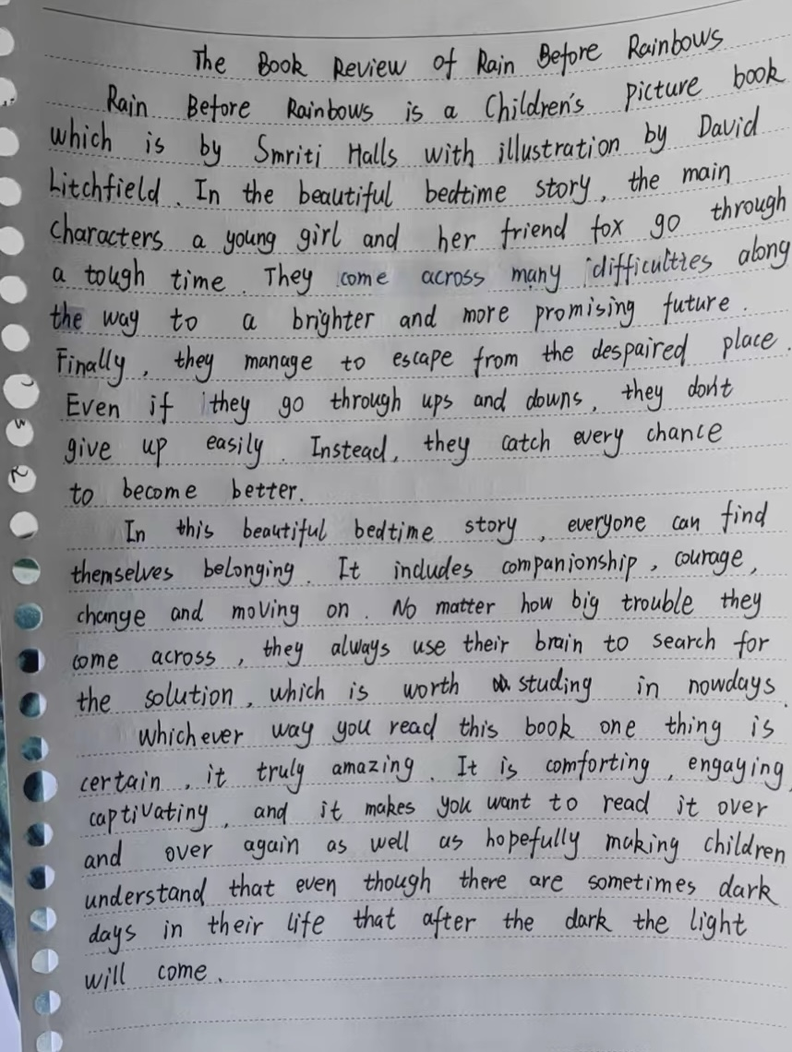
Students’ writing

Slide 19
Students’ writing

Slide 20
Student’s writing

Slide 21
Student’s writing

Slide 22
Reflect & analyse
1. What have we done tonight?
2. Was it necessary to ask students to design the framework of writing a book review together? Why and why not?
3. The sample writing of book review: before or after?
4. Timed-writing in class (sections, not a whole passage)
5. How can we use feedback and feedforward in class to better support students? (grammar mistakes, finding the knowledge gaps, and targeted scaffolding, sense of audience)
6. What improves writing more: quality v.s quantity?
7. What’s the advice you’d give to your students about writing?
8. Can we use the same material with students at a lower level? If so, how?

Slide 23
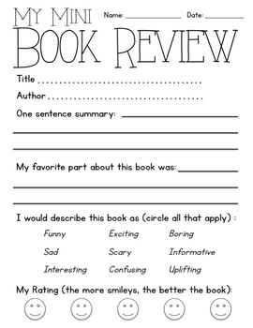
Differentiation: Design a book review poster
Teach useful phrases in advance:
The interesting story is about_______.
a real page-turner,
a must-read
I read it over and over again!

Slide 24
Your takeaway
What have you learnt from today’s session?
Any food for thought to you?
Is there any bits that you can use in your own writing class?
design and agree a writing framework (template)
use the template to write, self-assess and peer-assess
give sample writing before/after students’ writing
write a section and give immediate feedback to feedforward in class
share writing with everyone (sense of audience matters! )
What else would you like to comment on or ask?

Slide 25
Thank you & see you next time

