Slide 1


A warmer
Pick one question below & share your thoughts with us
What’s the best piece of advice you’ve ever been given?
If you had to delete all but 3 apps from your smartphone, which ones would you keep?
If you had a time machine, would you go back in time or into the future?
If you could choose any two famous people to have dinner with, who would they be?

Slide 2

贵阳市英语学科带头人工作站“激励教学”2022年教师培训工作坊
Session 6
Teaching Listening
Dr Helen Hou
Ulster University & QNUN
01/12/2022

Slide 3
We are going to
Focus on approaches to teaching listening (jigsaw listening)
Reflect & analyse
share your takeaway

Slide 4

Online Class Rules
Be
Be here and stay focused
Take
Take notes
Be
Be active: think, share & question
Have
Have some fun

Slide 5

Things that you need
Your pen(s), notebook and earphones
Some water & snacks
A good mood

Slide 6

What do you/your students like or dislike about teaching listening?
Is there a particular listening activity both you and your students enjoy doing? What is it? Why do you enjoy it?
What do you wish to learn about teaching listening? What’s your burning issue when it comes to teaching listening?

Slide 7
Pass the paper activity
Prep and steps:
8-12 A4 size sheets of paper
Some coloured markers
One topic written on one piece of paper
Divide students into groups
Within a given time (usually 1 min or 2 minutes) each group focuses on one topic and brainstorms as many ideas as they can
Pass the papers clockwise when the time is up and focus on another topic (within 4 groups)
Repeat this until each group has done all the topics at least once.
Ask each group to summarise and report back
Features of spoken English
A list of listening activities
Challenges of English listening
Strategies for effective listening

Slide 8
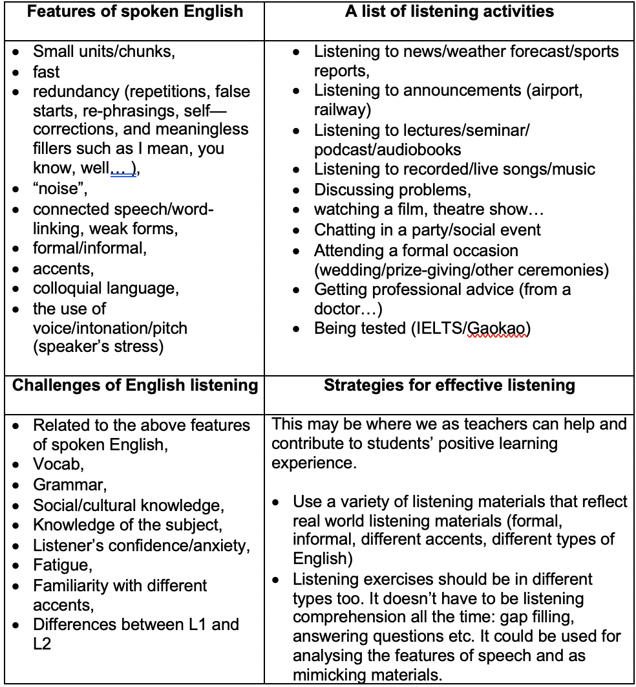
Recap: the use of pass the paper activity
What’s good about it?
Can you and would you use it with your students?
Now: the actual activity itself
Adapted from Ur, 1984

Slide 9
How do you listen in each case?
Are there any differences?
What listening strategies will you use for each case?
Think about the following two scenarios
Over lunch, your friend tells you a story about a recent holiday, which was a disaster. You listen with interest and interject at appropriate moments, maybe to express surprise or sympathy.
That evening, another friend calls to invite you to a party at her house the following Sunday. As you’ve never been to her house before, she gives you directions. You listen carefully and make notes. (Morley)

Slide 10
How do we listen?
Top-down
(topic, purpose & structure)
Bottom-up
(Sounds, words & details)

Slide 11
Top-down or Bottom-up?
Before we start listening, we can already predict some possible words and phrases that might be used because of our knowledge of vocabulary associated with the topic.
We listen carefully to a recording several times so that we can’t find a word we can’t hear clearly.
When we can’t clearly hear something, we can make a good guess about what was said based on our knowledge of similar conversations.
We know the normal structure of a conversation (e.g. booking a doctor’s appointment over the phone) and this helps us to understand the conversation when we listen.

Slide 12
A General Approach (but not the only way)
General Topic
Pre-L
More detailed
While-L
Language focus
Post-L
Elicit what learners already know about the topic
Predict the content and structure
Listen for gist
Listen for specific details / comprehension
Gap fill, short answer, matching, T/F/NG activities
E.g. phrases for making a request
Students record this language
pronunciation

Slide 13
Some Ideas for Listening Lessons
Jigsaw listening
Dictogloss
you read a text aloud only once (e.g. a radio news report), students must listen and make notes individually. Students then work together to recreate the text and answer questions.
Student recordings
Students record a listening text with a partner and create questions for other pairs to answer when listening. Give students a model text first (e.g. a strange invention).
In groups students listen to different parts of a text and complete comprehension activities. Students then meet with other groups and share information to form a complete understanding of the text together.
Collaborative listening
Your idea

Slide 14

Punting in Cambridge
A bit on the backstory
And how do I teach this lesson
with real learners
pre-listening
(a short video, K&W in KWL chart,
teach some new words)
Act as a punter (with background
music on to create a relaxing
atmosphere ) to take ss on an imaginary
tour
An extension activity: pair work
(provide a tour about one of Guiyang’s
Places of Interest and record it and
design their own jigsaw listening )

Slide 15


Slide 16


The Bridges of Sigh
Mathematical bridge

Slide 17
Cambridge punting tour
Numerical challenge or factual challenge?
Students will be divided into A and B groups
Each group will be given a different listening task
They will listen to the recording either once or twice and complete the task
One Group A Stu works with a Group B Stu to check their answers
They then listen to the recordings one last time

Slide 18

Reflect & analyse
What have we done tonight?
What should teachers bear in mind when designing a jigsaw listening activity?
Differentiation is the core of the approach. Why?

Slide 19

Your exit ticket
Overall feeling about this session
2-3 things that you think you will take away
1-2 things that you think you can do with your students
1 question that you still have

Slide 20
References
Morley, C. Listening: Top down and bottom up https://www.teachingenglish.org.uk/article/listening-top-down-and-bottom
Penny Ur (1984), Teaching Listening Comprehension, Cambridge University Press

Slide 21
Thank you for taking part!
See you next Thursday!

