Slide 1
Brainstorm 20 uses of a potato
Use it for cooking
Use it to grow more potatoes
Use it to make potato starch
Use it as a weapon
Use it as as a flower holder/vase
Use it to clean the dirty on the window/ scrub stains of cooking pots
Use it to remove rust from rusty tools
Use it as a smart phone holder/dock
Use it as a paperweight (镇纸)
Use it as an incense holder
Use it as shoe polish
Use it to polish silver/gold jewellery
Use it as a facial mask/under eye pad
Use it for gaming (potato & spoon race)
Use it as a hammer
Use it to as stamp for drawing & crafts
Use it to generate power
Use it to make earrings
Use them to massage sore muscles/back
….

Slide 2
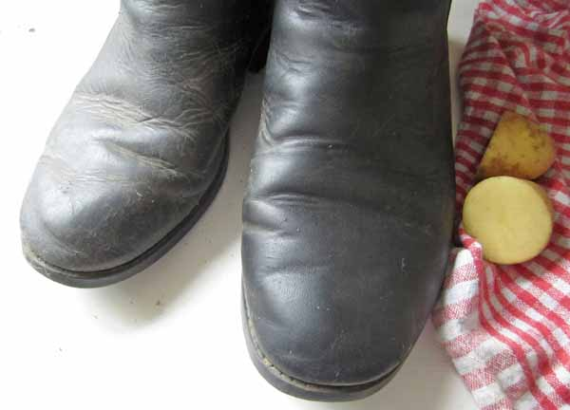
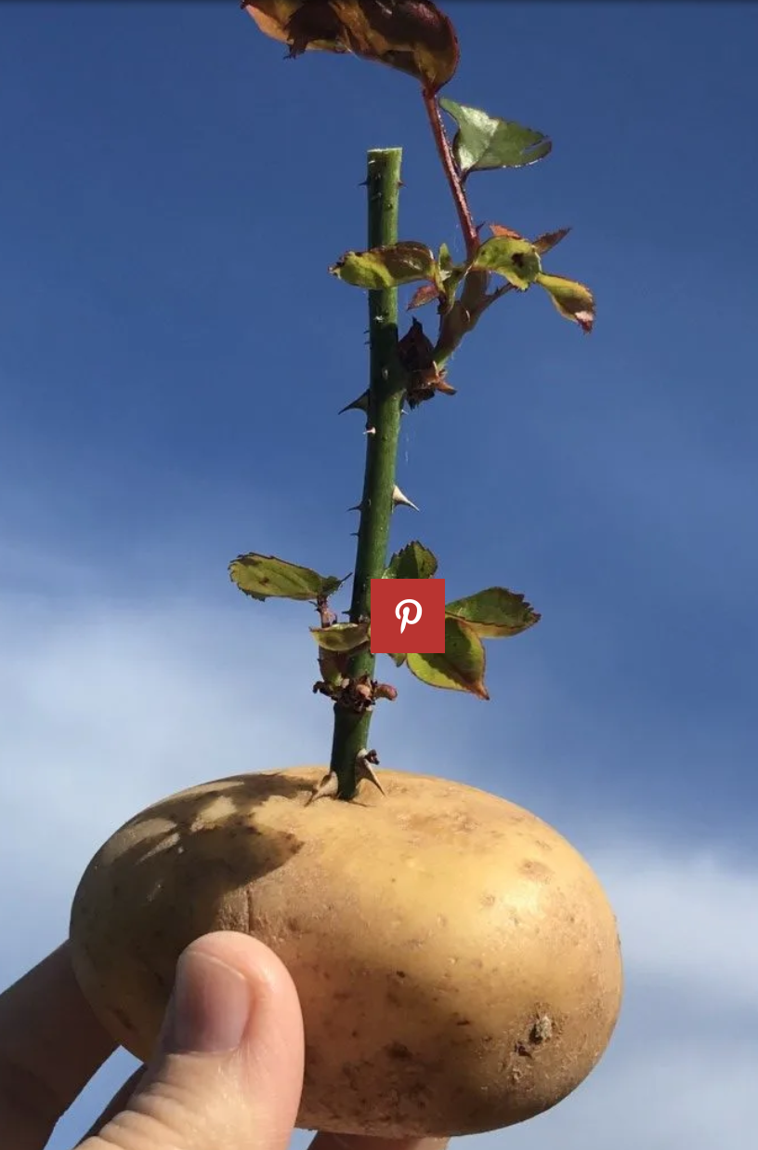
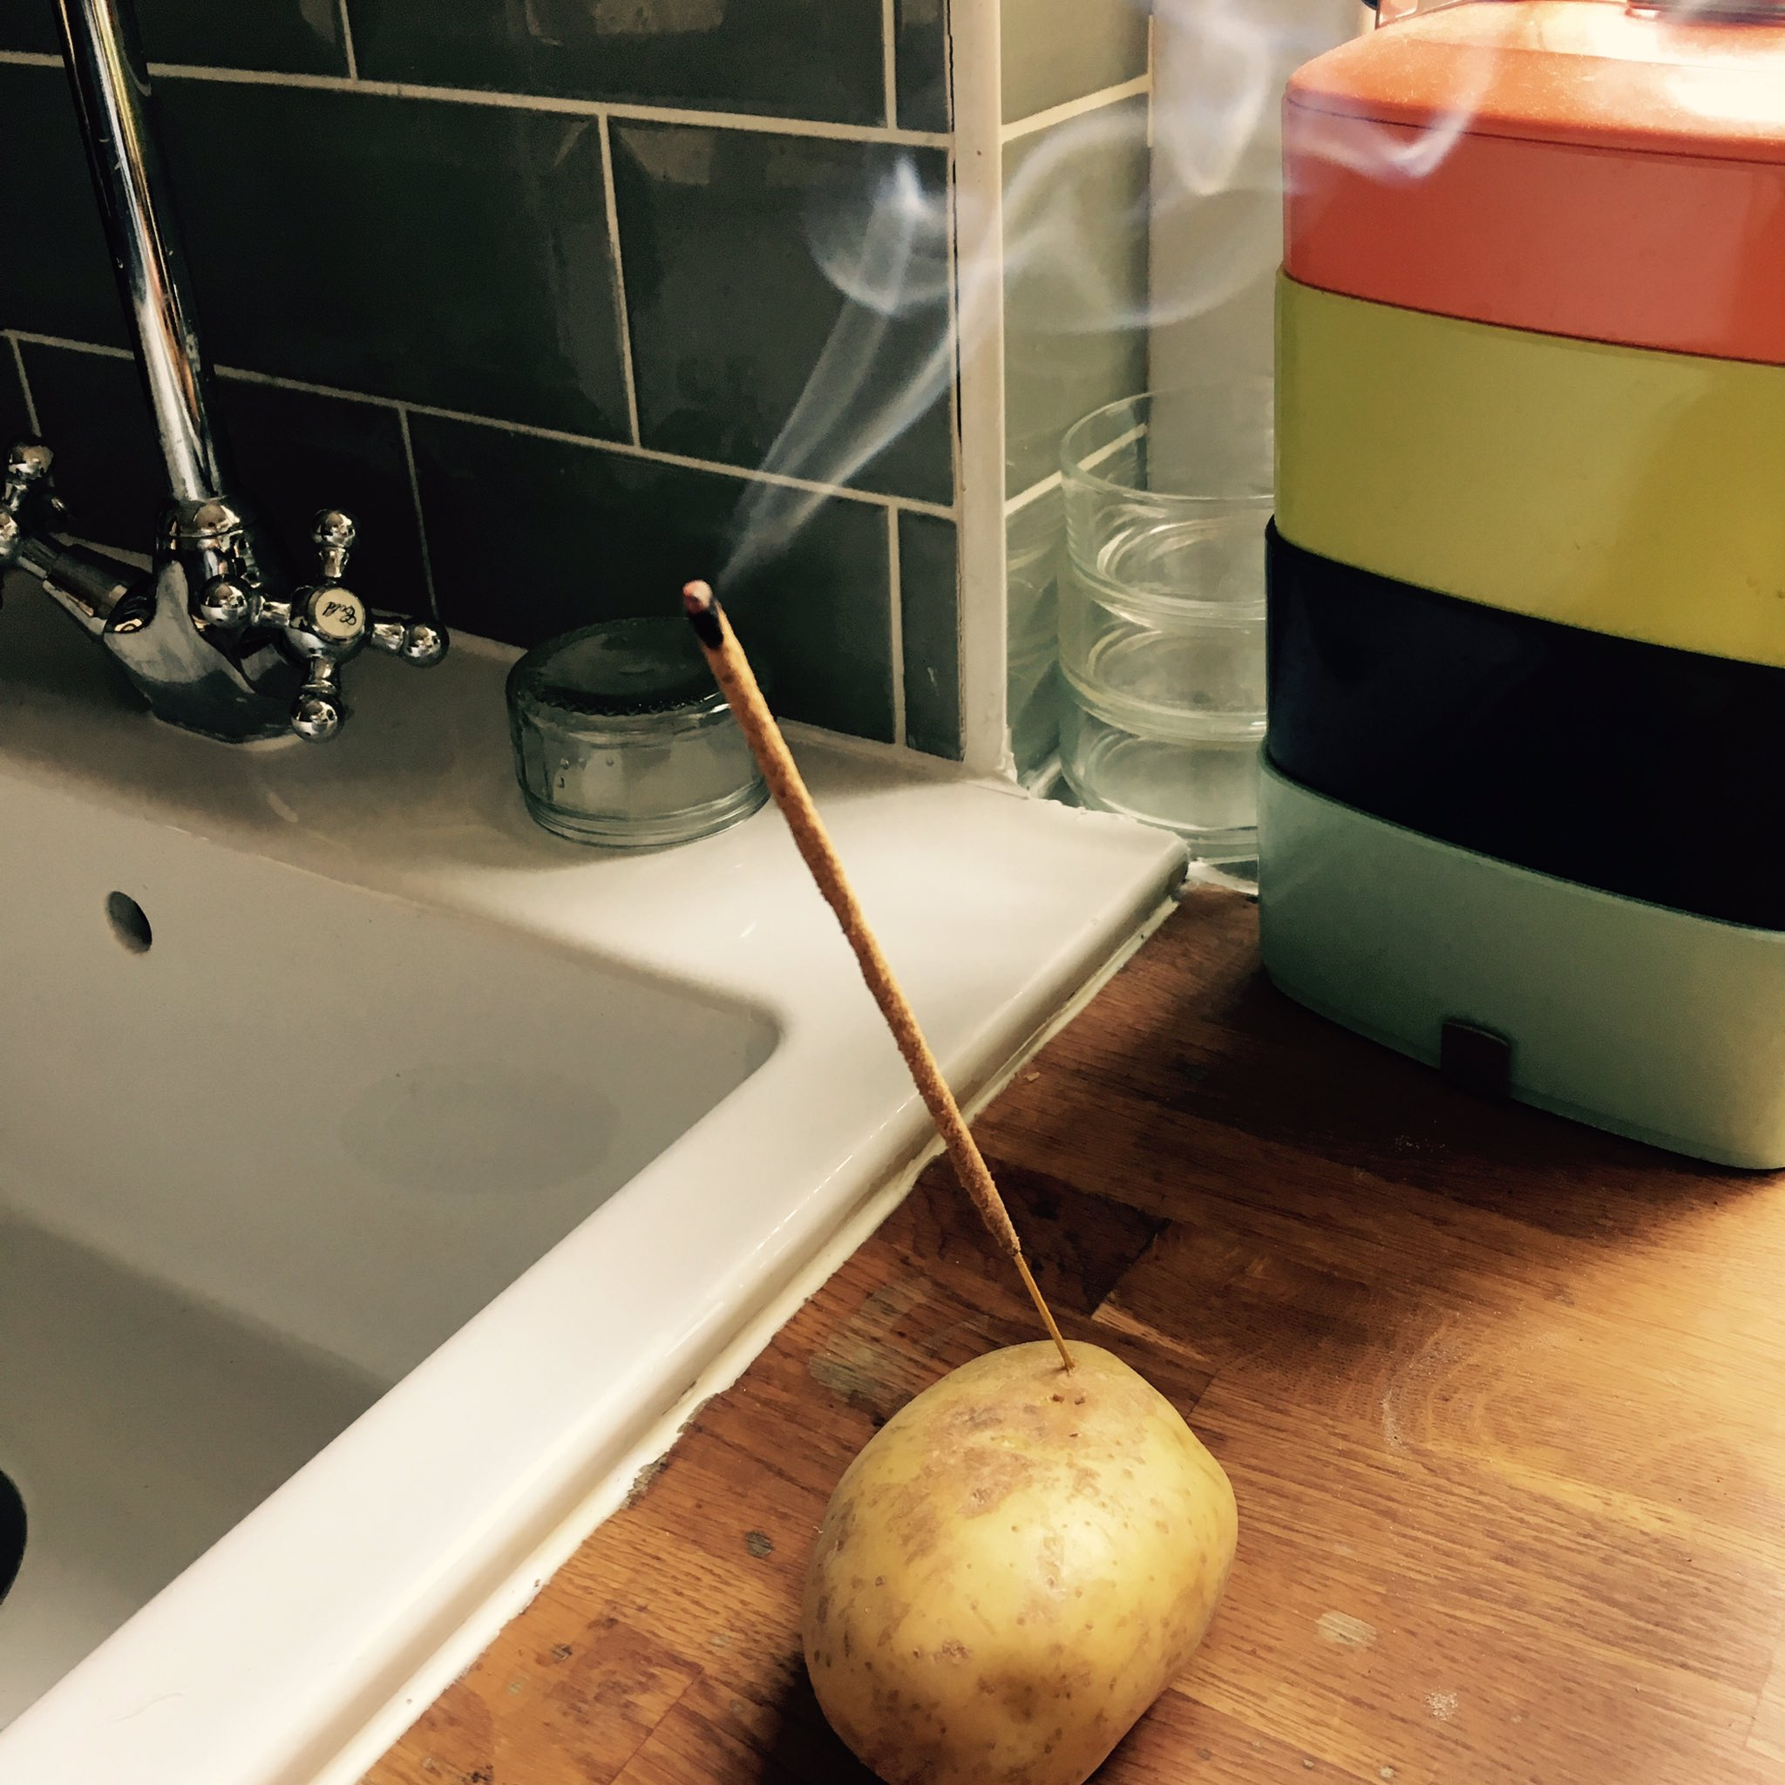
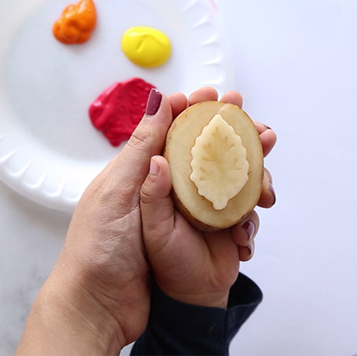
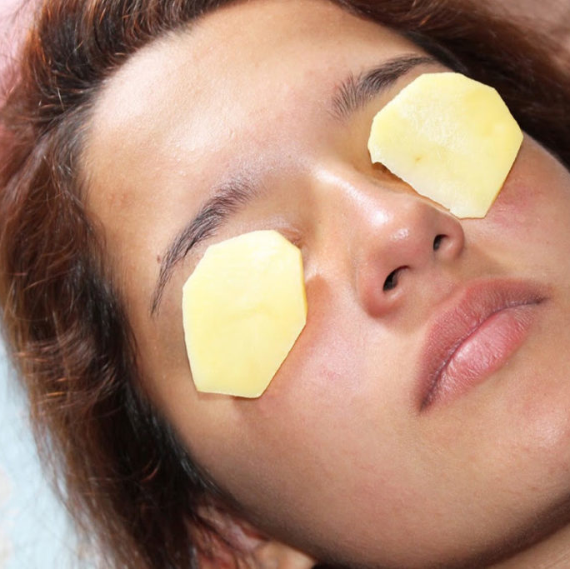
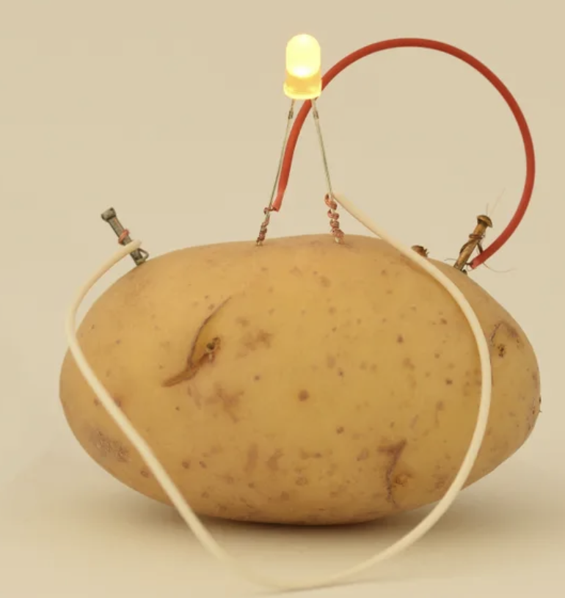

Slide 3
贵阳市英语学科带头人工作站“激励教学”2022年教师培训工作坊
Session 8
Exploiting Texts in
ELT class
Dr Helen Hou
Ulster University & QNUN
15/12/2022

Slide 4
We are going to
Exploit texts
Texts as a key unit of language
TAVI, TALO, TASP and TASE (how much G and V)
Example
Reflect and analyse
Share your takeaway

Slide 5
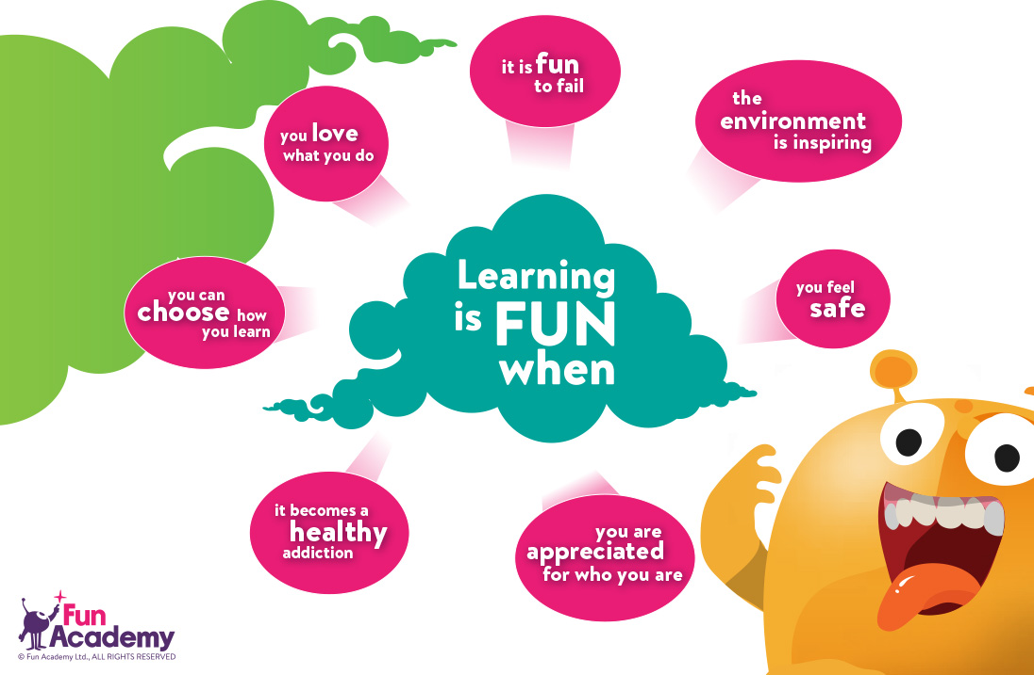
Online Class Rules Your active participation is key to a successful webinar !
Be here and now
Jot down some ideas that might be useful
Think, analyse, reflect, question & share
Enjoy it if you can

Slide 6
Remember to have:
Your pen(s), notebook and earphones
Some water & snacks
A good mood

Slide 7
Textbooks, subject-related readings such as articles, books etc
Text messages (WeChat, phone messages)
How many different kinds of texts have you engaged with
in the last 24 hours?
News, novels, website browsing…
Emails
Students’ essays
Your social media apps (WeChat moments, QQ, Weibo, Music)

Slide 8
Why do we need to use texts?
Language is realised first and foremost not as isolated sounds, words or sentences, but as text. It is text which is the significant unit of language. As teachers, it is a priority to help learners engage with texts.
Scott Thornbury
In the absence of interesting texts, very little is possible.
Ray Williams
Notes:
Ok, so this bring us to the question many of you might ask: why bother?
Please have a look at Thornbury’s explanation here,…. I think it gives an excellent answer to the question. Let’s move on to some other comments made by other scholars.

Slide 9
One of Tomlinson’s six key principles:
--expose the learners to authentic language
Why?
presents authentic text types / genres
presents language as it is really used
generates engagement, interest and motivation
promotes genuine real-world interaction
boosts confidence / sense of achievement
Notes:
I can start from the second point and move on:
Bridges the gap between classroom learning and real world use of English.
If you stop here, and try to recall your second language learning experience. Yes we all start from learning sounds, words, sentences, but quickly, we move on to beyond sentence. We start to have more complex dialogues and reading passages at the discourse level.
If you haven’t learnt a second language, a useful way for you to understand this is to have a look at the most common materials we come across in teaching and learning English. If you fetch any textbooks published by oxford, Cambridge and Mcmillan on ELT, you will notice straight away, they are heavily text-based and especially as learners move to intermediate, upper intermediate and advance levels. Reading is an essential part in those textbooks. Link this back to the very question I asked at the beginning of the lesson. How many different kinds of texts have you engaged with in the last 24 hours? The answer is obvious, we get to know the world through exposure to texts in both written and spoken forms of a language.

Slide 10
Key points for using texts in the EFL classroom?
use authentic genres and authentic language
enable skim, scan, intensive reading
provide exercises that reflect real-world responses
TAVI, TALO, TASP, TASE
Johns & Davis 1983; Beaumont 1985
Notes:
I hope I have justified the importance of using authenic texts in elt class, now the next question is now?
I’d like you to remember thoseacronyms, and make good friends with them, and know them like the back of your hand.
So what do they mean?

Slide 11
TAVI, TALO, TASP, TASE Johns & Davis 1983, Beaumont 1985
Text As a Vehicle for Information • information within the text is seen as more important than the language
Text As a Linguistic Object • used for language work, specifically grammar or vocabulary
Text As a Source of Production • using text as springboard for another task, usually speaking or writing
Text As a Source of Enjoyment
using text to enhance motivation
Notes:
Read through those expliantions.
OK, now I will use the following activities to show you how we can exploit a well-chosen authentic text to teaching all those aspects.
We also practice the use skimming (overview) and scanning (for specific info) skills and identify how we can design TAVI, TALO TASP and TASE activities together.

Slide 12
An Example

Slide 13
A worldwide survey reveals that the world’s most popular colour is _____
https://yougov.co.uk/news/
Notes:
After inviting students to report back to the whole class, we can then move on to this question. The purpose is to raise students’ interest. So, what do you think the world’s most popular color is?
White, red, blue or black?

Slide 14
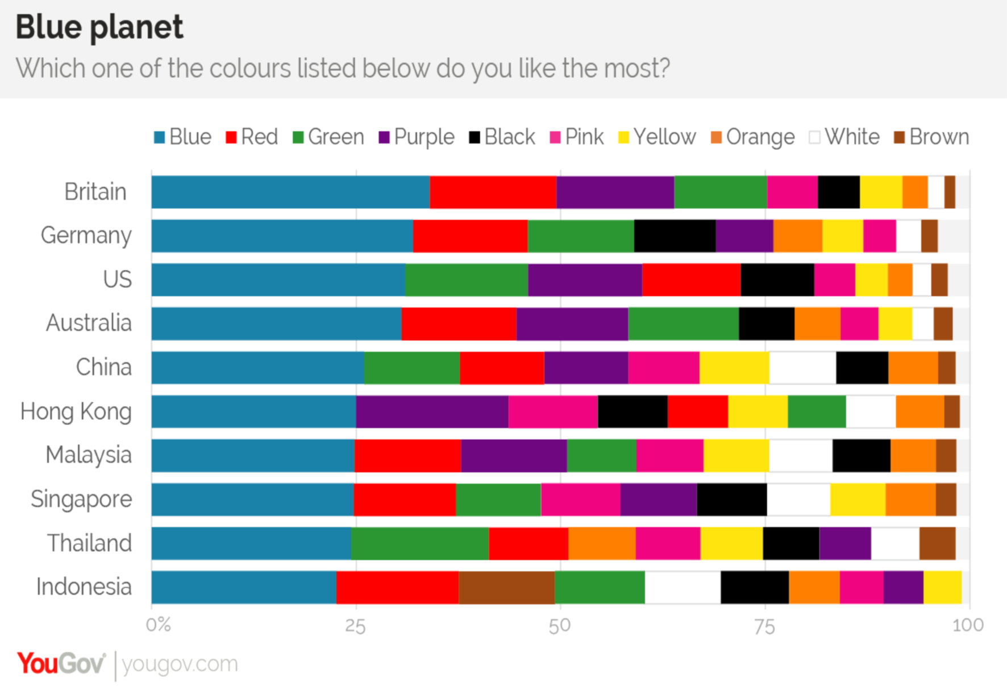
Notes:
Superisingly to me, it’s blue. Even including countries like China.

Slide 15
Pass the paper activity
Lead in (option 1)
P 1.
My favourite colour is___ because…
My least favourite colour is____ because …
P2. Write down as many colours as you know and associate them to a country according to your own understanding
P3. What does the following colours represent
Red: Blue:
Yellow: Black：
Purple: White:
P4. Suggestions given on what colour to wear when attending one’s interview for a job
You should wear___ because____
My (least) favourite colour is…. Because….
Colours and countries
What do those colours represent?
What colour to wear for a job interview?

Slide 16
Lead in (2) work in small groups and discuss
1. What do you usually notice about people when you first meet them?
2. What can this tell you about them?
3. Are your first impressions usually right?

Slide 17
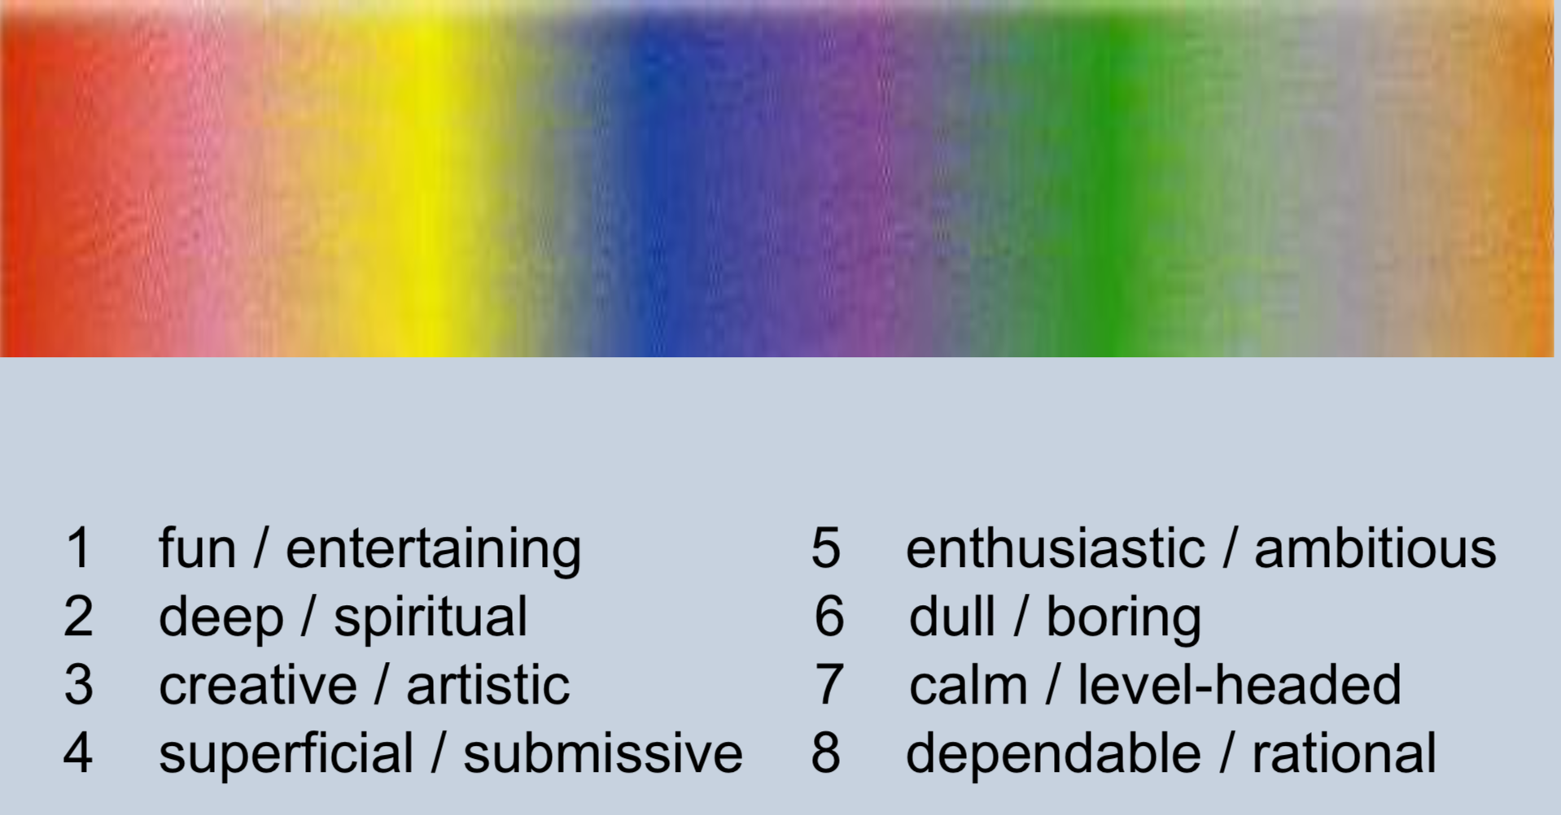
We are going to read an article about the importance of colour in first impressions. Match the pairs of adjectives to the colours you associate them with. Then check your prediction.
Notes:
Now, spend a minute looking at the 8 pairs of words. In each pair, the are two words, they are similar in meaning. Have a look at them on your own, and note down any words you are not very sure of, then have a chat with your colleague sitting next to you, and exchange your ideas on those words.
After that, it’s an opportunity for the teacher to pre-teaching some of those words before reading.
Now, what sort of color would you associate with fun, deep, creative etc. could you write down your answers to those pairs of words

Slide 18
Notes:
It’s hard to read the passage, so I have typed in a word doc.
Then I will give you some time to go over your prediction and also the actual answers provided in the passage. Then I will invite you to look at the passage again more carefully this time to think about TAVI, TALO, TASP and TASE.
To give you a hint, can you look for perhaps certain verbs or phrase verbs that we can teach?

Slide 19
Read the article again. According to the writer, which colours:
1 give a good impression?
2 give a bad impression?
3 may give a mixed impression?
red, green, orange, blue
pink, grey
yellow, purple

Slide 20
TAVI? TALO? TASP? TASE? What can we dig for teaching?
Notes:
It’s hard to read the passage, so I have typed in a word doc.
Then I will give you some time to go over your prediction and also the actual answers provided in the passage. Then I will invite you to look at the passage again more carefully this time to think about TAVI, TALO, TASP and TASE.
To give you a hint, can you look for perhaps certain verbs or phrase verbs that we can teach?

Slide 21
1. Verbs (TALO, TASP, TASE or TAVI?)
suggests conveys is for could signal has ... connotations
stands for
Can you add some more similar verbs?

Slide 22
2. In the text, find ten interesting and useful adjectives or nouns for describing personality. Add them to the table below.
(TALO)
Adjective | Noun
assertive | assertiveness
ambitious | ambition
enthusiastic | enthusiasm
… | …
3. Is the main word stress the same in the adjective and the noun?
4. Which of the words best and least describe you? Why?
(TALO)
(TASP)

Slide 23
5. Work in pairs and discuss the questions. (TASP / TAVI / TALO/ TASE?)
1. Do you tend to wear the same-coloured clothes or a variety of colours? Which colours and why?
2. What does your appearance say about you? Think about clothes, colours, hair, accessories etc.

Slide 24
6.1 Find three examples of ‘a lack of ...? (TAVI/TALO/TASP/TASE?)
6.2 What are other useful/common collocations with ‘a lack of’? (T-led/Ss-led)
6.3 What other forms of ‘lack’ are there?
a lack of depth a lack of personality
a lack of conviction

Slide 25
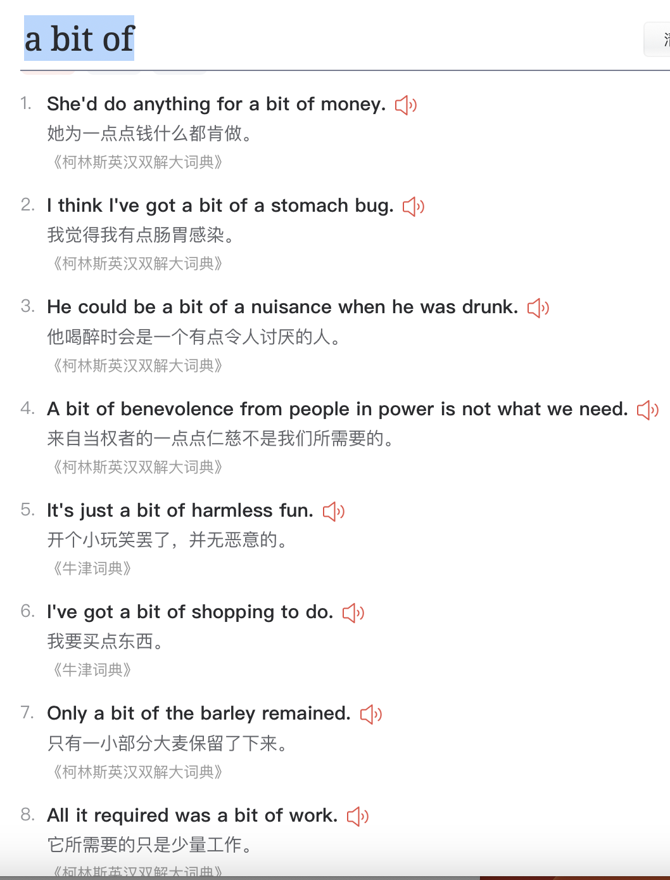

Slide 26
Complete the definitions with words and expressions from the text.
1 ‘A ____-______ is someone who is determined to succeed and works hard to achieve this.
2 ‘A _____-_____’ is a person who works well with other people as part of a group.
3 ‘A bit of a __________ describes a person who likes to entertain people by doing or saying funny things.
4 ‘A bit of a __________ describes someone who prefers to be independent and to do things on their own.
Do you know any people who fit any of the descriptions?
(TALO)
(TASP)

Slide 27
A personality quiz
Are you a bit of a loner?
Q1: I can spend a month or longer without having any social interaction.
True False
Q2: I actively avoid having to talk to people, even if it means looking awkward.
True False
Q3: Every time the phone rings, I get nervous to answer it.
True False
Q4: My social circle consists of:
>50 people . 25–50 people
11-24 people <10 people
I don’t have a social circle
How much of a goal getter are you?
Q1:In your free time
You spend time with your friends.
You like to go shopping
What free time?
Q2: Your friends are always impressed by your:
Sense of humour b. generosity
Dedication to your work or studies
Q3: The present you’d most like to receive is:
An electronic organiser
Tickets for a concert
Q4: in the next five years, you hope to:
Travel the world, and get a well-paid job
Make more friends and enjoy more yummy food

Slide 28
Over to you What TAVI, TALO, TASP, TASE activities can we design?
You are going to teach the following short passage ‘a haunted mansion’
It was a dark and stormy night; the wind was whistling through the trees and the rain was pouring down. Not only was I completely soaking wet, but also my teeth were chattering because of the icy wind. I knocked on the door of the ancient run-down mansion as hard as I could; little did I know the horror that awaited me on the other side of the door. No sooner had I ceased my knocking than the door swung slowly open. The darkness on the other side was pitch-black but so desperate was I to get out of the storm that I jumped inside without a second thought. Hardly had I set foot inside the house when the door slammed shut behind me…

Slide 29
Your exit ticket
Overall feeling about this session
2-3 things that you think you will take away
1-2 things that you think you can do with your students
1 question that you still have

Slide 30
Thank you for taking part!
See you next Tuesday!

Slide 31
Tomlinson’s 6 principles

