Slide 1
Process language for supporting this activity:
For pre-intermediate ss: The_____, _____ and ______ best represent me. I like _____ because______. I also choose a_____ because______
For intermediate ss: I’ve chosen (a) ______, ________, _________ that I think best represent me, because I think I am_____ (or because I like doing…, prefer to…, can…)
For more capable students, Ter can use this activity to expand Ss’ vocab/lexical chunks, e.g.,
family-oriented, enjoy being around my family, DIY-minded, like to get my hands dirty, gregarious/sociable/ a people-person, (a bit of a loner/enjoy one’s own company)
A follow-up activity: Do you know any friends who have some of the above qualities/ personal traits? Tell your partner who that person is. Use at least 3 words from the above.
3
Notes:
clover， a four-leaf clover, it’s a sign to suggest you will be lucky.

Slide 2
Some good websites
https://www.teachingenglish.org.uk
LearningEnglish Kids: https://learnenglishkids.britishcouncil.org/short-stories
https://www.bbc.co.uk/learningenglish/english/
https://www.twinkl.com.cn
https://www.flo-joe.co.uk
https://www.ted.com

Slide 3
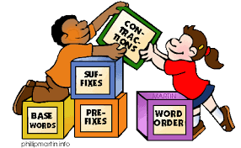
贵阳市英语学科带头人工作站“激励教学”2022年教师培训工作坊
Session 9
From Grammar to Grammaring
Dr Helen Hou
Ulster University & QNUN
20/12/2022

Slide 4
A disclaimer!
Viewer discretion is advised!
Some information may make teachers
who love grammar and are good at
teaching grammar a bit uncomfortable.

Slide 5
We are going to
Reexamine your understanding of grammar & deeply-held belief on grammar
Rethink what is grammar (types of grammar, definitions)
Realise the connection between what you believe and what you do.
Reflect, analyse and share your takeaway

Slide 6
Grammatical? Ungrammatical? Acceptable?
A
How are you? I am good. You?
Last week me and my mum watched a BBC documentary together.
She had less problems with the move to a new school than she thought she would.
My sister Alice, who is older than I, still lives at home.
I am going to lunch with Helen at the weekend.
I’m not going to do nothing about that missing part. (actual meaning: take no action)
Imagine there's no countries. It isn't hard to do.
We all want to get highly paid job, innit?
A nurse should be able to make appropriate decisions about the care of their patient.
A
A
G
A/G
A
A/G
A
A/G

Slide 7
Types of grammar?
Descriptive grammar (spoken grammar)
Prescriptive grammar (written grammar)
refers to the structure of a language as it is actually used by speakers and writers. We don’t ‘judge’ good or bad grammar.
refers to the structure of a language as certain people (editors, researchers, teachers, etc.) think it should be used. In other words, correct use of language .

Slide 8
What’s your definition of grammar?

Slide 9
What is grammar? (1) Traditional view:
Grammar may be roughly defined as the way language manipulates and combines words (or bits of words) in order to form longer units of meaning (Ur 1988:4).
A description of the structure of a language and the way in which units such as words and phrases are combined to produce sentences in the language (Richards, Platt and Weber, 2003).
A system of rules governing the conventional arrangement and relationship of words in a sentence (Brown, 2000)

Slide 10
Definition of grammar (2) Modern or communicative view
Grammar is the structural foundation of our ability to express ourselves. The more we are aware of how it works, the more we can monitor the meaning and effectiveness of the way we and others use language. It can help foster precision, detect ambiguity, and exploit the richness of expression available in English. And it can help everyone--not only teachers of English, but teachers of anything, for all teaching is ultimately a matter of getting to grips with meaning.
(Crystal, "In Word and Deed," TES Teacher, April 30, 2004)

Slide 11
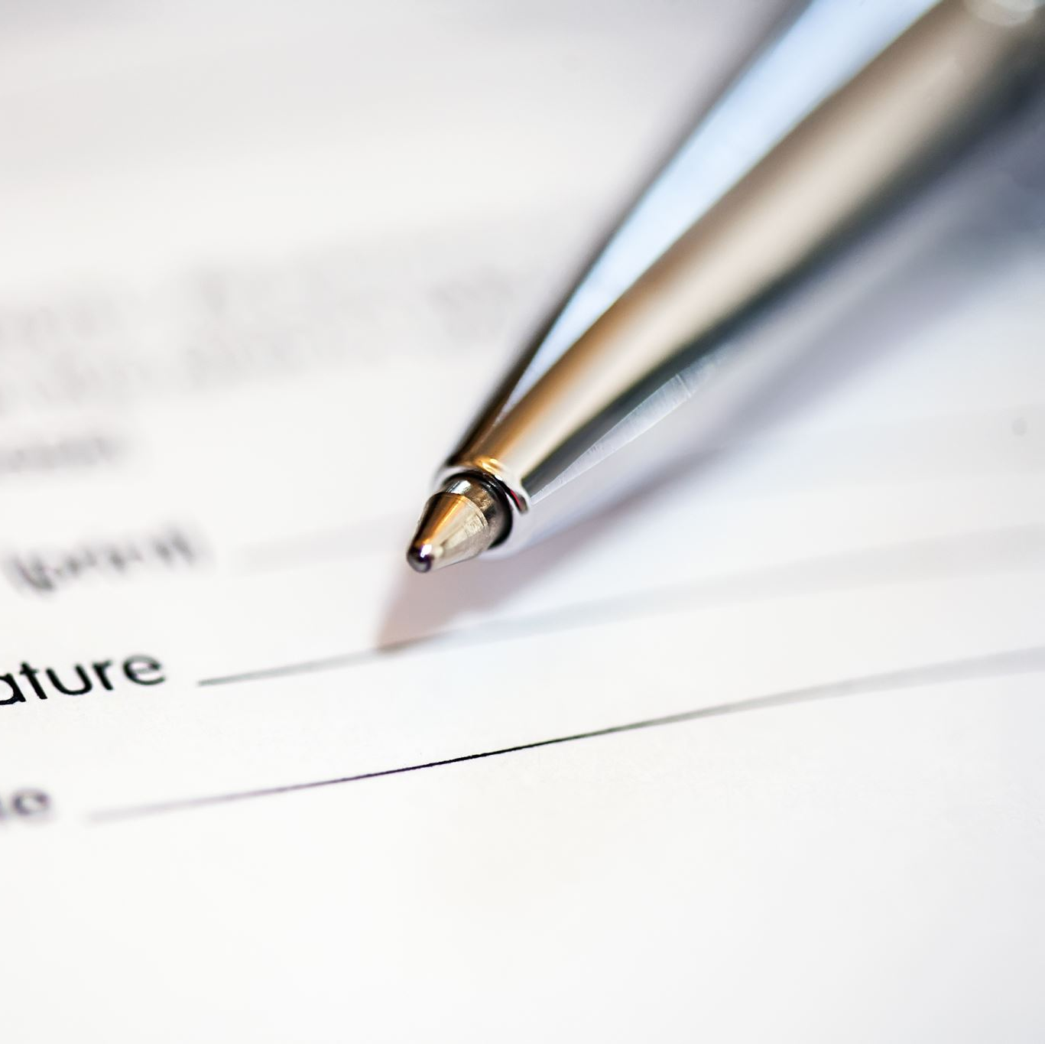
A ‘communicative’ definition
Grammar is a resource that enables us:
to get things done
to make choices
to express ourselves as individuals
to articulate our feelings & attitudes
Notes:
Implication: grammar teaching is the means to help, enhance and empower a learner’s ability in communicating effectively, not an end it self.

Slide 12
Reconceptualising the definition & place of grammar in the communicative methodology
Grammar gives us the form or the structures of language, but those forms are literally meaningless without a second dimension, that of semantics (meaning), and a third dimension, pragmatics.
---Larsen-Freeman (1991)

Slide 13
STRUCTURE
Morphosyntactic and lexical patterns
Phonemic/ graphemic patterns
Accuracy
SEMANTICS
Lexical meaning
Grammatical meaning
Meaningfulness
PRAGMATICS
Social context
Linguistic discourse context
Presuppositions about context
Appropriateness
(when, why, to whom, where, how do we use a structure?)
Grammar is one of three dimensions of language that are interconnected. (Larsen-Freeman, 1991)
Notes:
Grammatical structures not only have (morpho-syntactic form, they are also used to express meaning (semantics) in context-appropriate use (pragmatics)).
Larsen-Freeman (2003) does not organise language according to a hierarchical
system as she sees a strong interrelationship between the three dimensions with no
part being more important than another. T

Slide 14
My bag is heavy.
Structure: subject+(be+adjective ) predicative
Meaning: heavy bag which belongs to me
Pragmatics:
A straightforward statement, telling the hearer that his bag is heavy.
An indirect, polite request, asking the hearer to help him carry the bag.
A declining of someone’s request for help.
What else?
A complaint, to show off, to compare
Jump off the building, now!
Notes:
a complaint, to show off, to compare,

Slide 15
Teacher Cognition Does it matter?
What teachers think, know, and believe and the relationships of these mental constructs is closely related to what teachers do in the language teaching classroom.
Borg, 2003, p81
Key words: beliefs, with/out enjoyment, comfort zone, desire to change

Slide 16
Grammaring The process of ‘adding ‘to language to cope with the demands imposed by distance.

Slide 17
Here and now, social distance/register Where’s grammar?
A Would you like some of this coffee?
B Yes, I would like some of that coffee, please.
A how would you take your coffee?
Would you like any milk or any sugar?
B I don’t take milk. But I will take one sugar, thanks.
A Would you like some toast?
B I’d prefer not to have any, thanks.
A Can I offer you some juice?
B Yes, please. I would like some. Thank you.
A Coffee?
B Please.
A Milk? Sugar?
B No milk. One sugar. Thanks.
A Toast?
B No, thanks.
A Juice?
B Mmm.
Notes:
One stick or a sachet

Slide 18
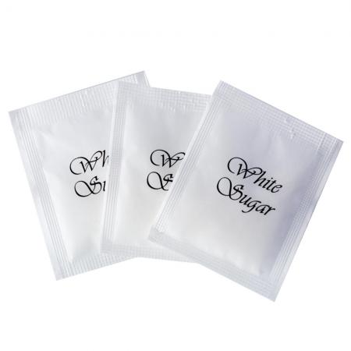
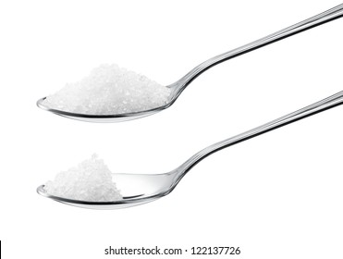
Two sugars, please
stick
sachet
teaspoon

Slide 19
Conceptual
I’m not rich. I can’t buy a big house.
If I were richer, I’d be able to buy a bigger house.
If I’d been richer, I’d have been able to buy a bigger house.

Slide 20
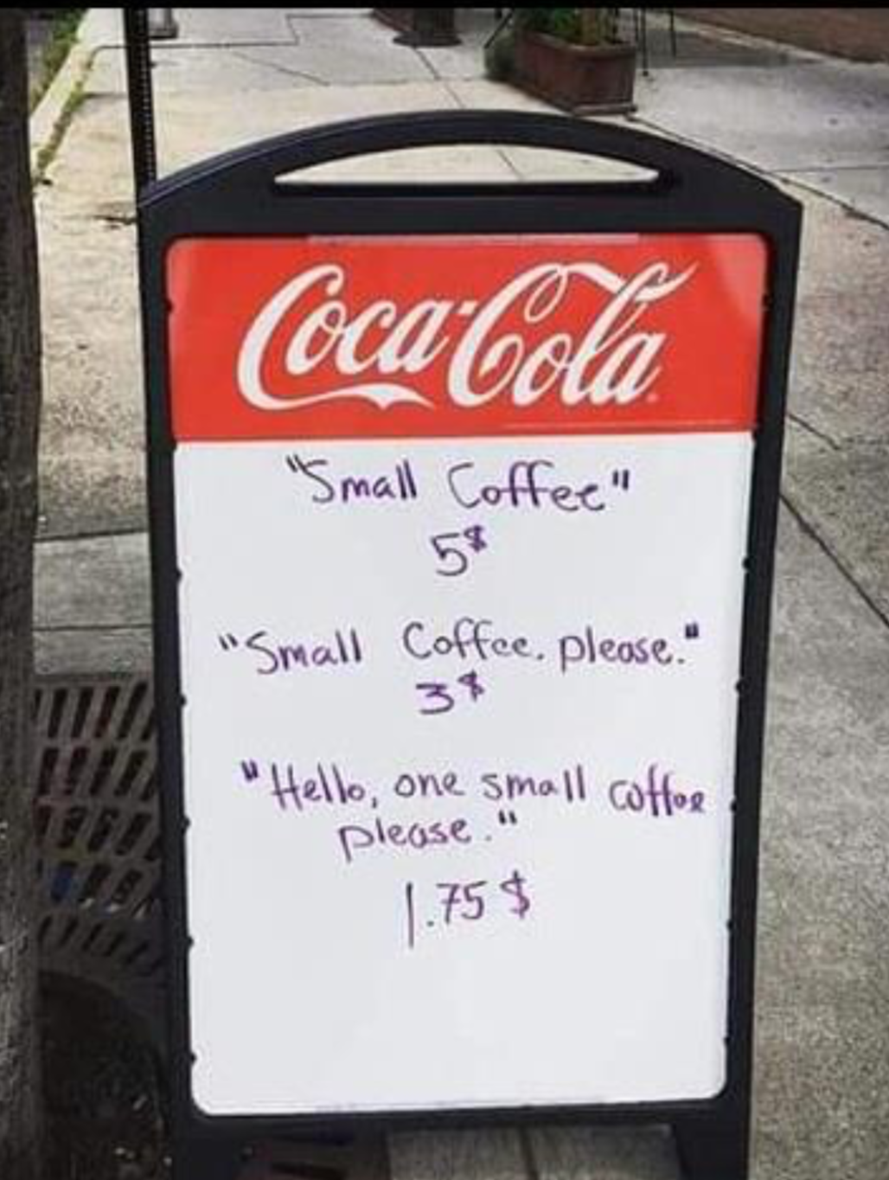
Social
formality/register

Slide 21
Can I open the window?
Could I open the window? Is it OK if I open the window? Do you mind if I open the window? Could I possibly open the window? Would it be OK if I opened the window? Would you mind if I opened the window? Would you mind at all if I opened the window? Do you think it would be OK if I opened the window? I was wondering if it would be possible to open the window?

Slide 22
The importance of being polite in English

Slide 23
Change ‘I need to borrow some money from you’ into more acceptable and appropriate English
How much grammar do you think you need in this situation?

Slide 24
Instead of ‘I need to borrow some money from you’ which can sound a bit blunt and impolite, we could say:
Could I possibly ask a favour? I am really short of money at the moment.
Could you kindly lend me a hand? … I will pay you back with interest ASAP I get paid from work.
I was wondering if you could kindly offer me some assistance.
I’m really sorry to have to ask you this, but I’ve come across some unexpected financial difficulties. I’m a bit short on rent money this month. Would you be able to help me out?

Slide 25
What did your other half/mum/daddy/daughter/son say to when when you went home yesterday afternoon? What did you eat last night? When did you go to bed? | When did you get up this morning? What did you have for breakfast this morning? How did you come to school today?
What does it aim to practice? How would you make it a bit communicative?
A memory challenge with a reward: pair work

Slide 26
where/ parents/ be from in China? What/ this time two weeks ago? what / do / this evening? do any sports? | what /do/ last night? favourite colour? how long / teach/learn? how long/ live/ ?
What about this one? What does it aim to practice?

Slide 27
Process language for supporting this activity:
For pre-intermediate ss: The_____, _____ and ______ best represent me. I like _____ because______. I also choose a_____ because______
For intermediate ss: I’ve chosen (a) ______, ________, _________ that I think best represent me, because I think I am_____ (or because I like doing…, prefer to…, can…)
For more capable students, Ter can use this activity to expand Ss’ vocab/lexical chunks, e.g.,
family-oriented, enjoy being around my family, DIY-minded, like to get my hands dirty, gregarious/sociable/ a people-person, (a bit of a loner/enjoy one’s own company)
A follow-up activity: Do you know any friends who have some of the above qualities/ personal traits? Tell your partner who that person is. Use at least 3 words from the above.
3
Notes:
clover， a four-leaf clover, it’s a sign to suggest you will be lucky.

Slide 28
What is grammar?
Not a set of rules for learners to memorise but rather, a means to mobilise them to better express themselves and communicate with others more appropriately and effectively.
Grammar is a means to an end but not an end itself.

Slide 29
Refection, analysis & your takeaway
What’s new?
What surprises you?
What makes you think?
Any questions you’d like to ask?

Slide 30
Teacher Cognition Does it matter? Yes, It does!
What teachers think, know, and believe and the relationships of these mental constructs is closely related to what teachers do in the language teaching classroom.
Borg, 2003, p81
Key words: beliefs, with/out enjoyment, comfort zone, desire to change

Slide 31
Thank you for taking part!
See you on 6th Jan!

