Slide 1

Unit 6 Do you like bananas?
Section B 2a-3b Reading&Writing
No.2

Slide 2

01
Analysis of the Textbook
02
Analysis of the Core Competence
03
Analysis of the Teaching Procedure
CONTENTS
为人师表
04
The Teaching Reflection

Slide 3
01
Analysis of the Textbook

Slide 4
Unit 6 Do you like bananas? Section B 2a-3b Reading and writing
Learn how to express some foods and whether a person likes and dislikes to eat.
Reading
Eating habit
language input
Writing
Be able to express their eating habits, food they like or dislike, and give their reasons.

Slide 5
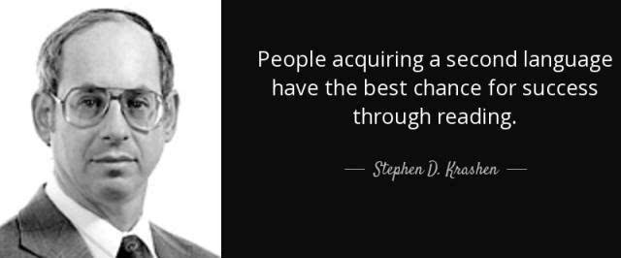
Krashen’s hypothesis of second language acquisition
Textual enhancement is used to draw language learners’ attention to grammatical form expressions and text structure.
Writing promoted by reading

Slide 6

Analysis of the Core Competence
02

Slide 7
Core competence of learning English
Divergent thinking
Creative thinking
Critical thinking
Cultural
character
Student-centered class
Ability of cooperation
Individual learning ability
Linguistic competence
Encourage students to finish the key sentences and structures by themselves by using what they’ve learned in the class.
Show them a photo of
national volleyball
team to cultivate
students’ patriotism.
Learn different eating
habits all over the
world by watching the video.
Thinking
quality
Learning
ability

Slide 8

Analysis of the Teaching Procedure
03

Slide 9
Teaching Procedure:
Audio-visual: Promote students' learning interest by creating a real situation
Lead in
SOAR: Supplement, Omit, Adapt and Replace
PBP: Private Before Public
Reading
CLT: Communicative Language Teaching(Create an information gap to help students do the survey)
Scaffolding
CLIL: Content and Language Integrated Learning (Combine the structure and the real situation)
Writing
Extension
PBL: Project Based Learning

Slide 10
04
Teaching Reflection

Slide 11
Teaching Reflection
Encourage students
Arrange time better
better
Be patient to say the order in another way to make them understand.
Make full use of time and arrange the whole class better.

Slide 12
Exchange the role
teacher
student

Slide 13
Theories
Practice

Slide 14
Activities
Rationale

Slide 15
Hit the Road
做自己没做过的事是成长，做自己不愿意做的事是挑战，做你不敢做的事是突破。
改变是可怕的，愿在座的每一位教师都能突破自我，将自己的激情洒向你可塑的学生们。

Slide 16

Thank you for
listening!

