Slide 1
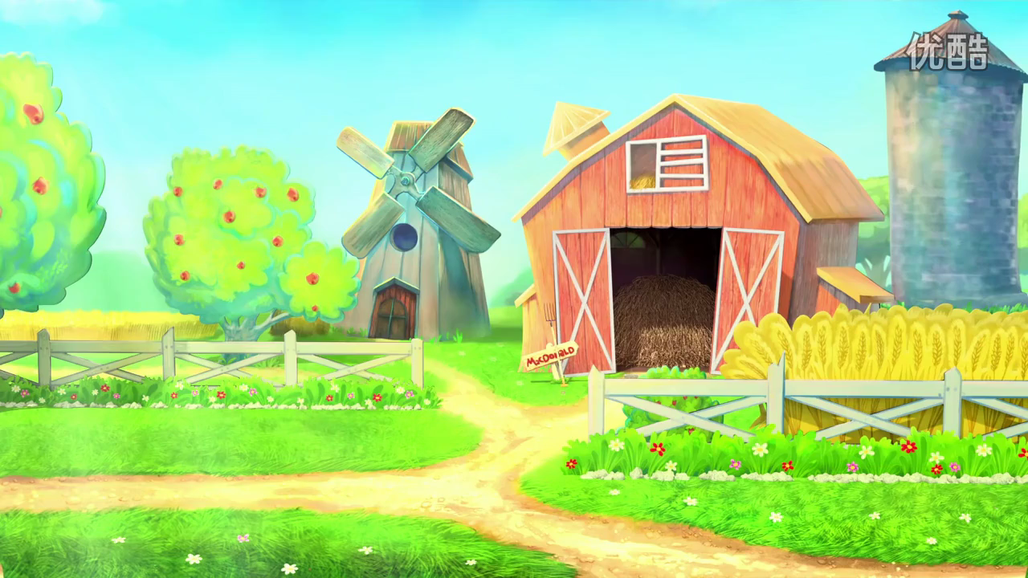

Slide 2

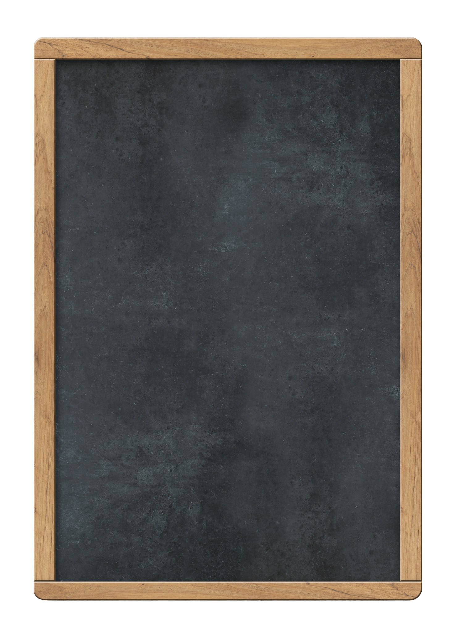












Topic1 What's the strongest animal on the farm?
Section A 1a-2a Listening & Speaking
Unit 4 Our World
贵州省贵阳市第七中学
宋洁莹

Slide 3
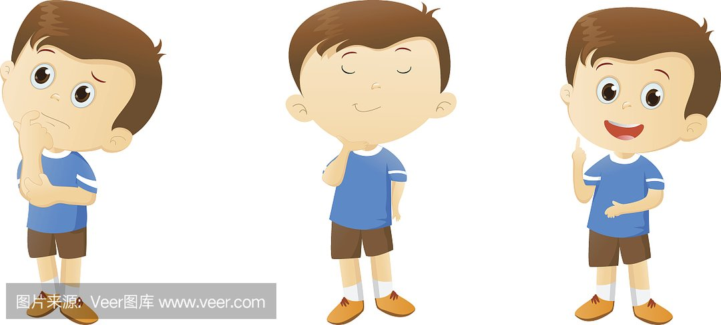

My grandma has a farm in the countryside.
Would you like to go with me?
Hello! I’m Wang Wei.
Nice to meet you!

Slide 4
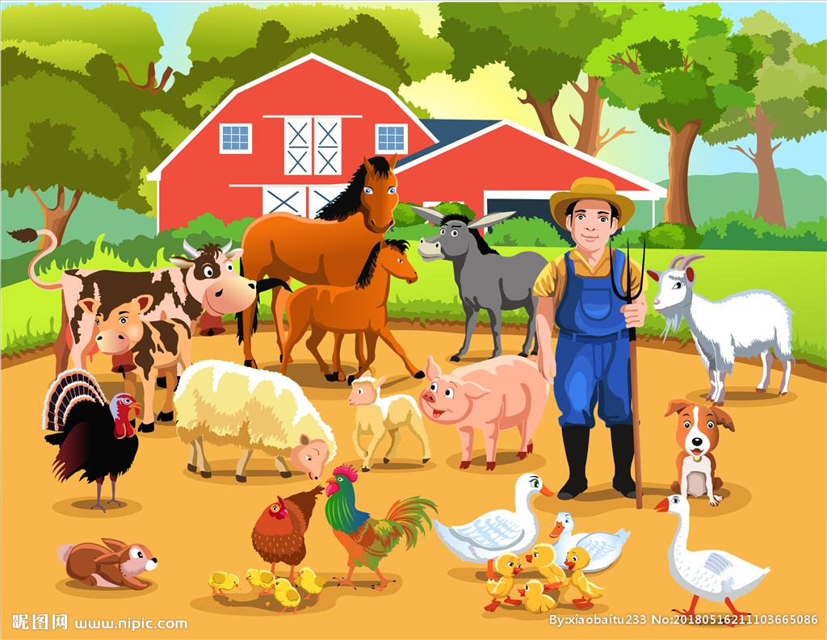
Have you ever been to a farm?

Slide 5
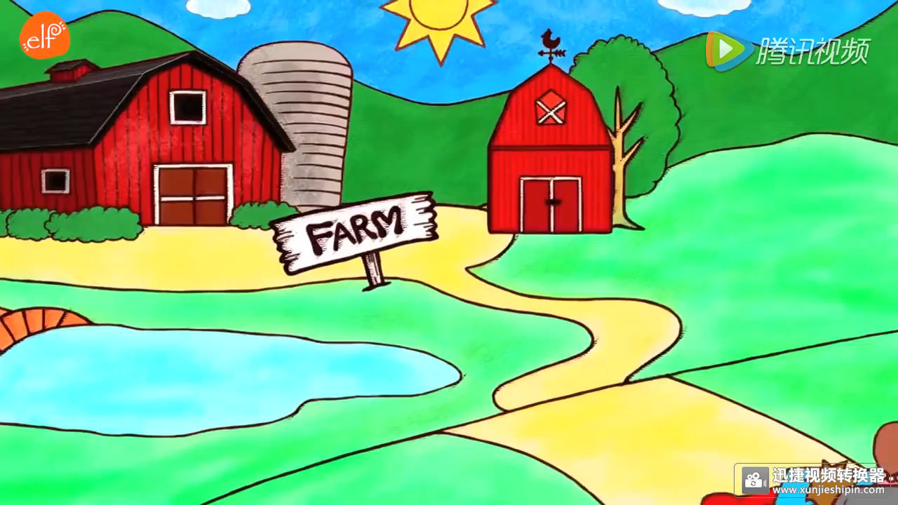

Slide 6
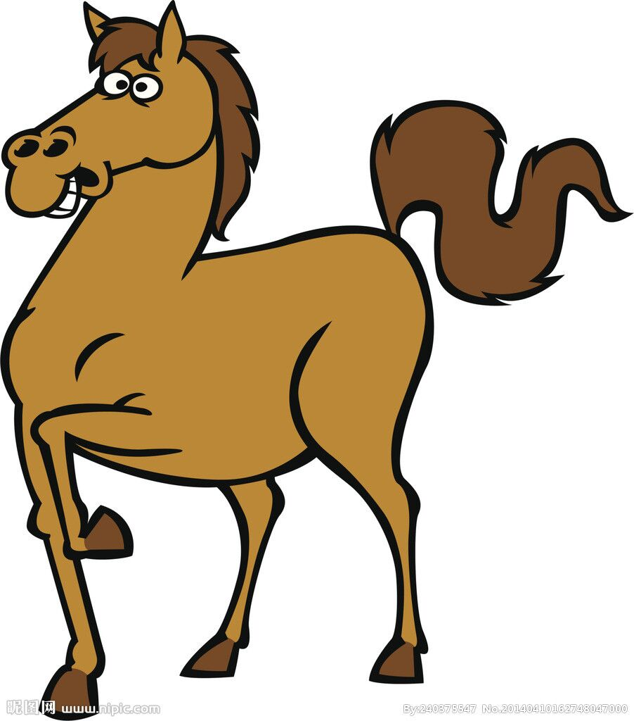
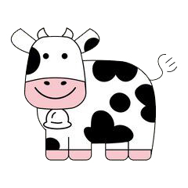
short or tall
cow
horse
/kaʊ/
/hɔːs/
A horse is ____.
short
tall
A cow is _____.
A horse is _____ than a cow.
taller
A cow is ______ than a horse.
shorter
Notes:
更多模板亮亮图文旗舰店：https://liangliangtuwen.tmall.com

Slide 7
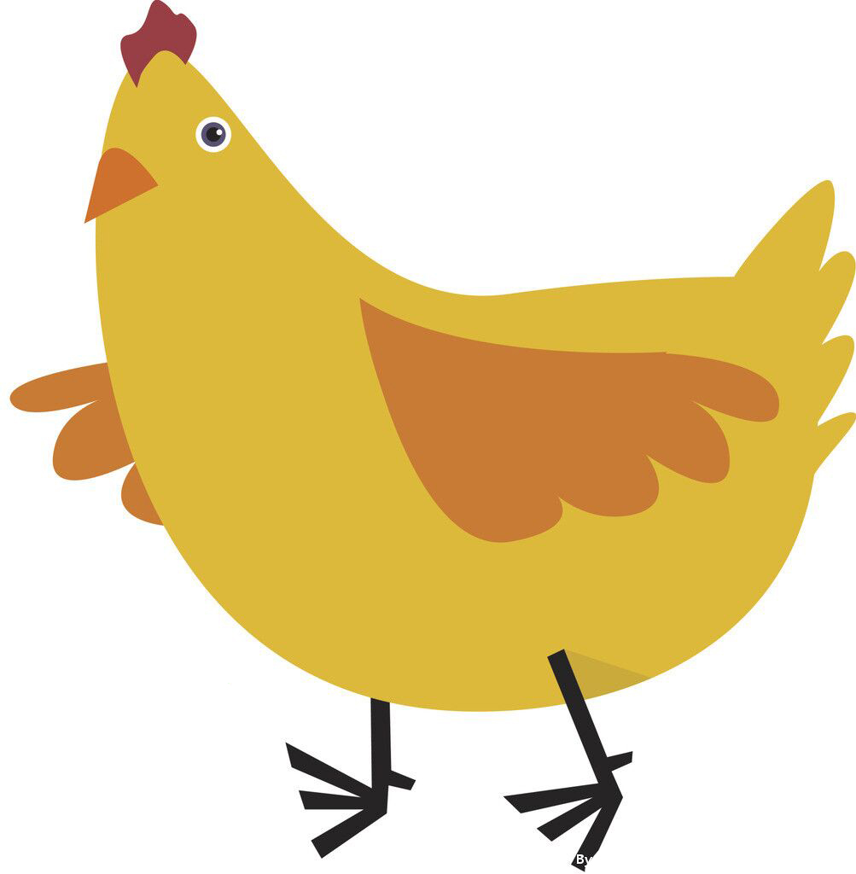

small or large
chicken
hen
/ 'tʃɪkɪn /
/ hen /
large
A chicken is _____.
A hen is _____.
small
A hen __ _____ than a chicken.
is
larger
A chicken __ _______ than a hen..
is
smaller
Notes:
更多模板亮亮图文旗舰店：https://liangliangtuwen.tmall.com

Slide 8
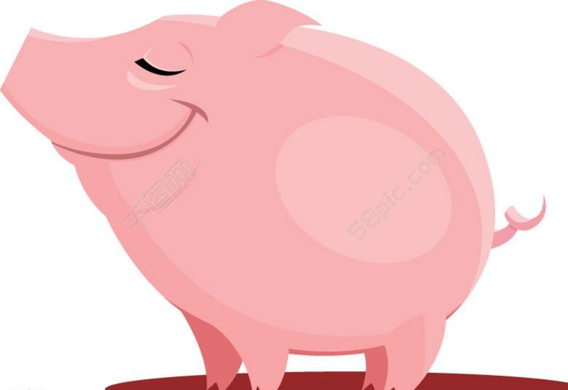
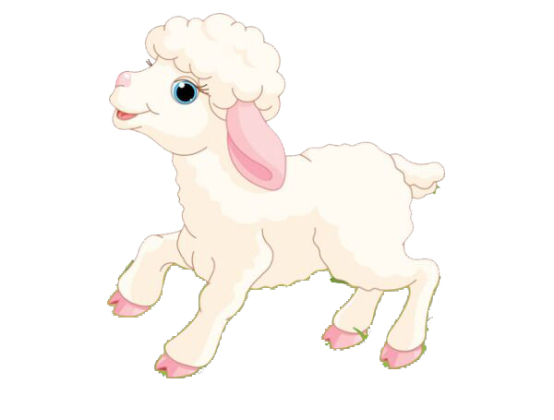
heavy or thin
sheep
pig
/ʃiːp/
/pɪg/
thin
heavy
A sheep is ____.
A pig is _____.
sheep
A pig __ ______ ____ __ _____..
is
heavier
than
a
thinner
pig
A sheep __ _______ ____ __ ___..
is
than
a
/'θɪnə /

Slide 9
I invited four of my friends to visit the farm
last week.
They talked about the animals on the farm happily.

Slide 10
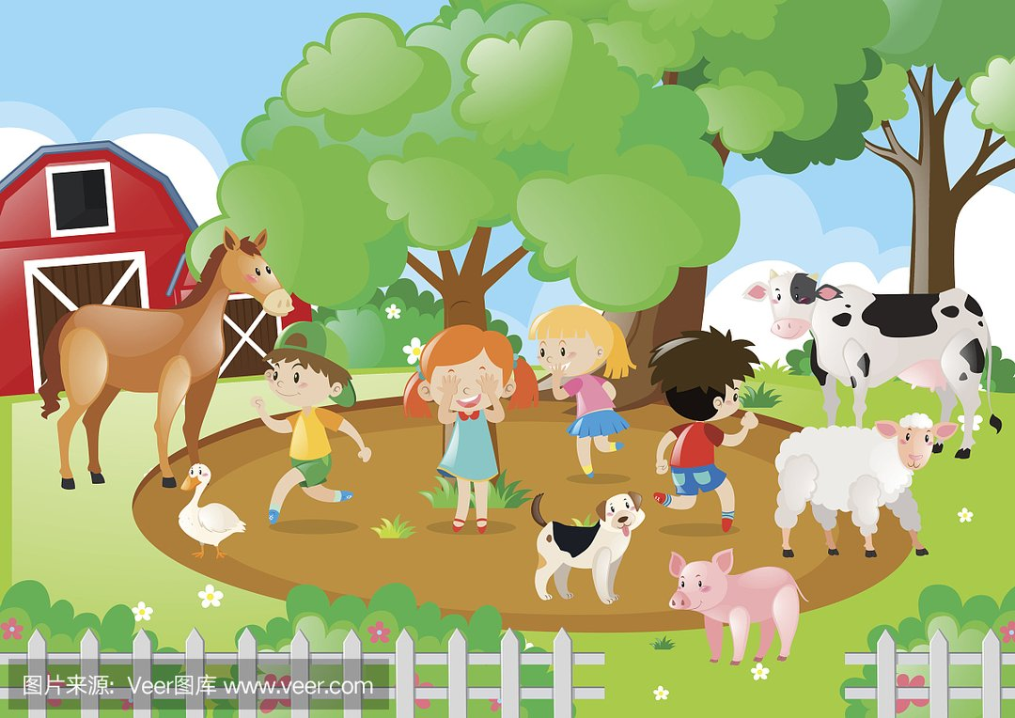
Sally
Helen
Kangkang
Yokio

Slide 11

Listening:
Listen to the conversation and circle the words you hear.
shorter
cuter
taller
fatter
nicer
stronger
better
lazier

Slide 12
taller shorter cuter stronger nicer better
Yokio: Kangkang, what's the strongest animal on the farm?
Kangkang: Horses. But I think the________horse over there is_________ than the________ horse.
Sally: I think the sheep are the nicest of all.
Helen: But I think this cat is _______. He lets me hold him.
Yokio: The pigs must be the fattest and laziest animals on the farm. What do you think, Sally?
Sally: But I think the pigs are_______. Look! They are swimming and chatting with the hens and ducks.
Kangkang: The cat is running after a mouse and the dog is playing with the rabbit.
Helen: Look! the cows and the sheep are eating. All the animals are living in a ________ life on the farm.
taller
stronger
shorter
nicer
cuter
添加标题内容
添加标题内容
better

Slide 13
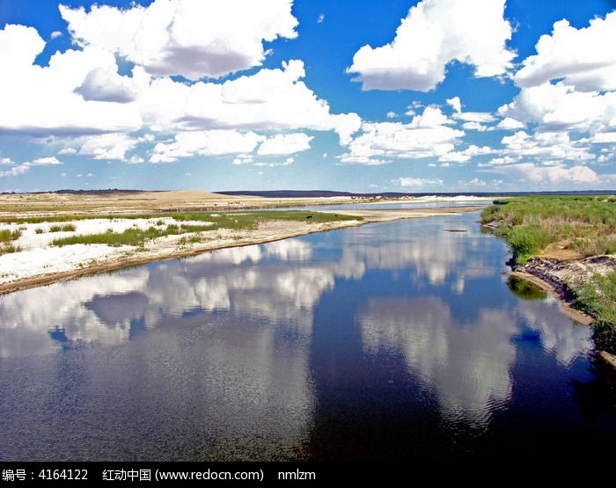
Why do the animals live a better life in the countryside?
The sky is…
The river is…
The air is…

Slide 14
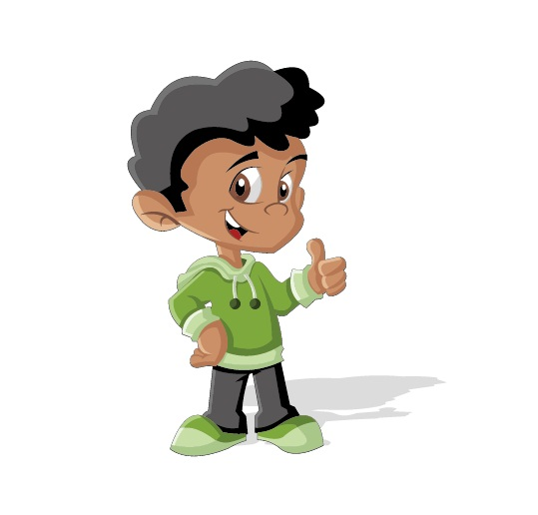
I think life in the countryside is…

Slide 15
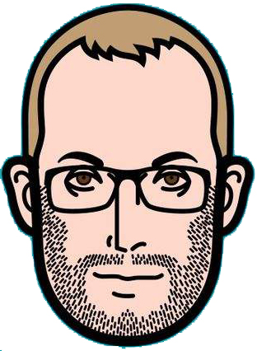

Michael: Hey, Wang Wei,what are you
thinking about?
Wang wei:Oh,_______.
Michael:Do you like countryside?
Wang wei: Yes, I like it very much because
________, and the sky is bluer and
_______there.
Michael:I think ________, too. People can
enjoy the beauty of nature there.
Wang wei: My grandma lives in the
countryside and I go there for my summer
holiday every year.
Michael:That must be fun!
Listen and fill in the blanks :
A
A. I'm thinking about
the life in the countryside
B. the countryside is
much quieter than the city
C. the rivers are clearer
D. the air is fresher
D
C
/’kwaɪətə/ 安静的
B
清澈的 /'klɪərə/
清新的/ˈfreʃə(r)/

Slide 16
fresher
The air is ______.
The rivers are ______.
clearer
Life in the countryside
bluer
The sky is ____.
The environment is ____________.
quieter/better

Slide 17
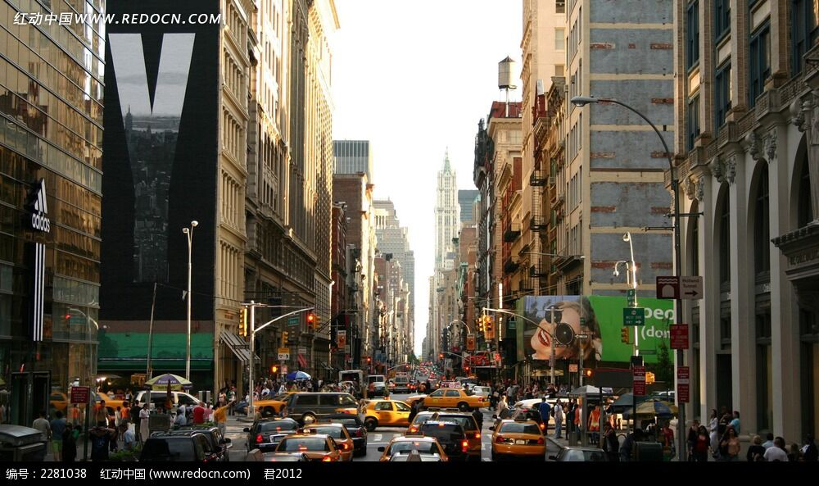

Slide 18
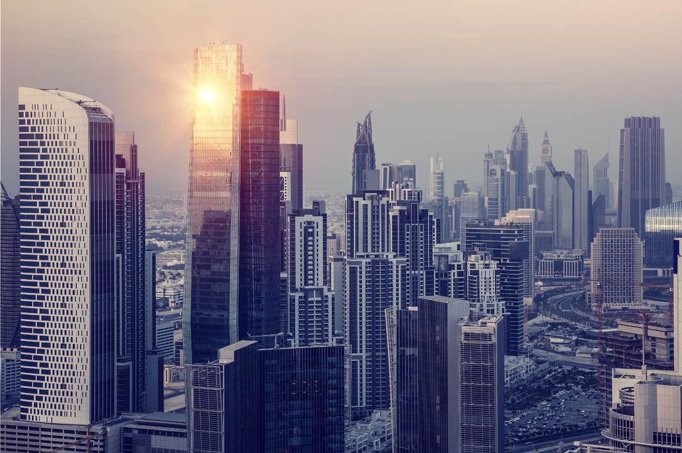
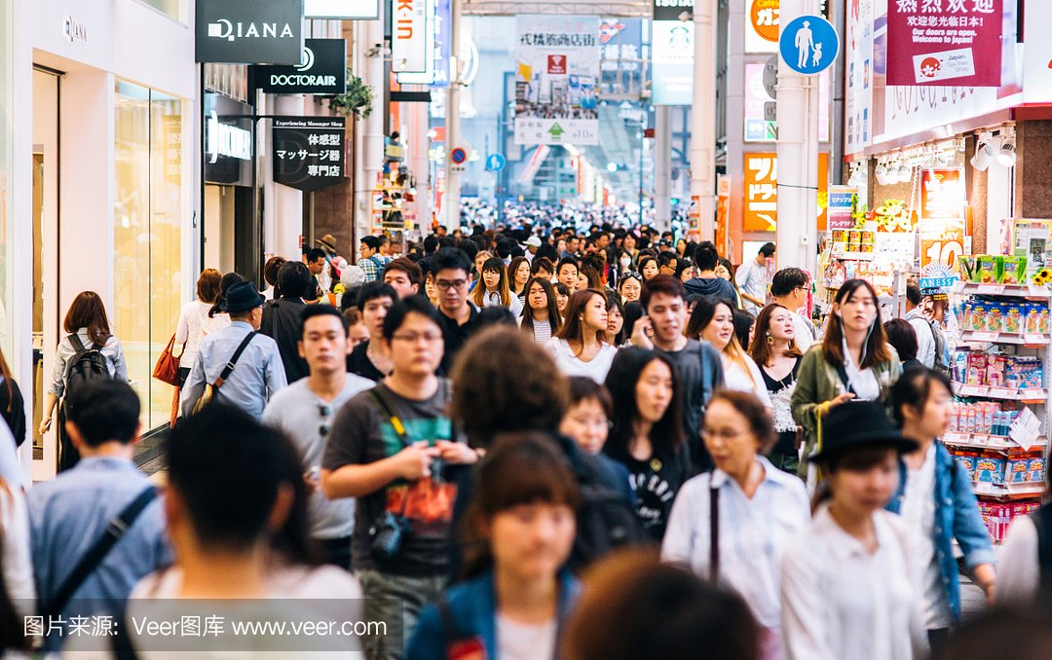
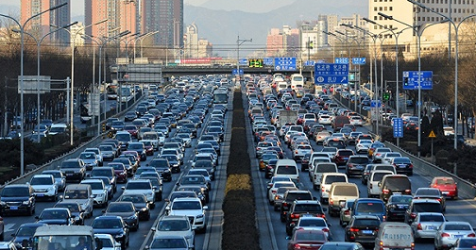
taller
busier
noisier

Slide 19
city
bigger
taller
The ___ is _____.
The ______ _ are _____.
buildings
Life in the city
people
busier
The ______ are ______.
streets
noiser
The ______ are ______.

Slide 20
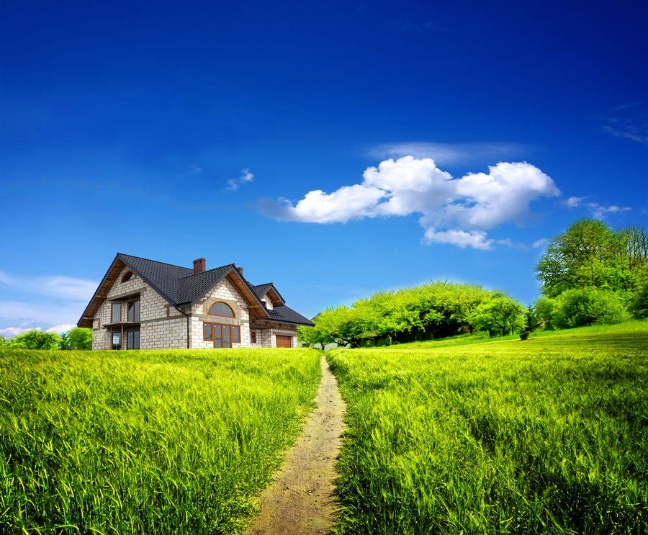
Do you like the life in the city or the countryside?
Notes:
更多模板亮亮图文旗舰店：https://liangliangtuwen.tmall.com

Slide 21
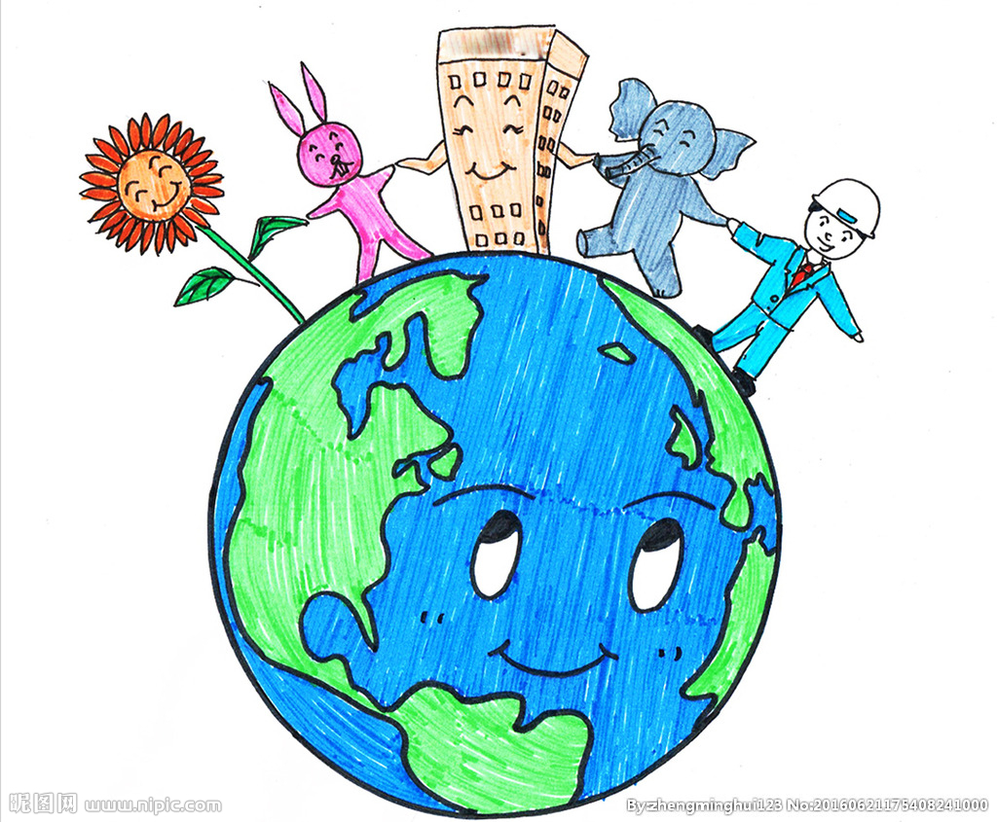
Protect the animals and environment!
Enjoy the beauty of nature.

Slide 22
Homework: You can choose one of them to do.
Finish the comparative part in 2b on page 82 and
preview the superlative degree.
Try to conclude the changing rules of the comparative
degree.

Slide 23
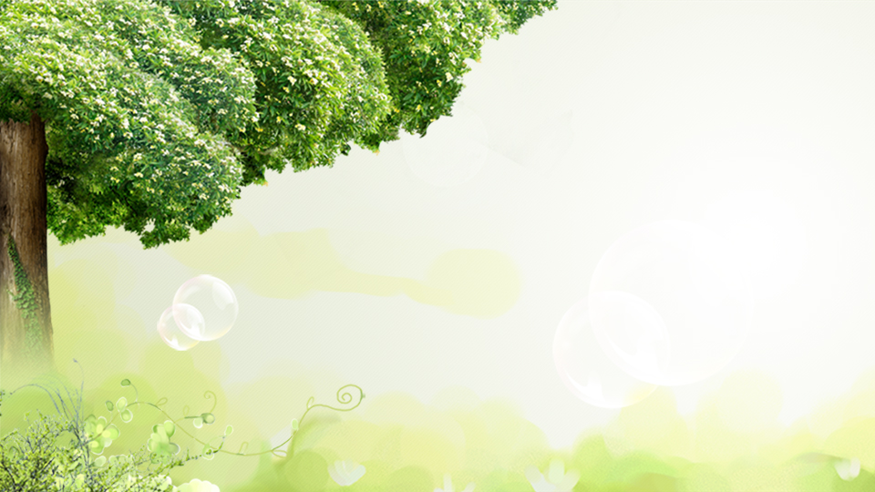
THANK YOU
Notes:
更多模板亮亮图文旗舰店：https://liangliangtuwen.tmall.com

