Slide 1
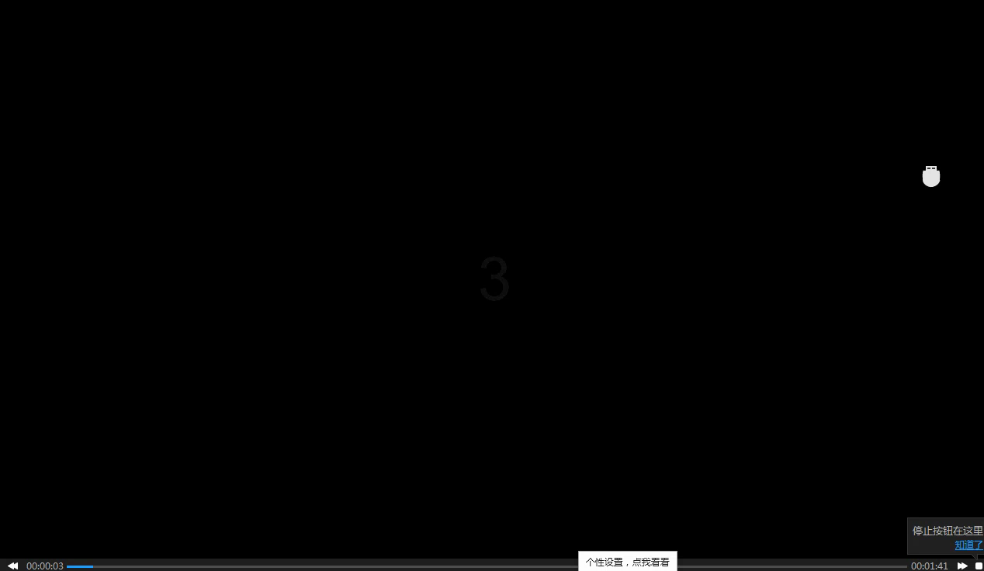

Slide 2
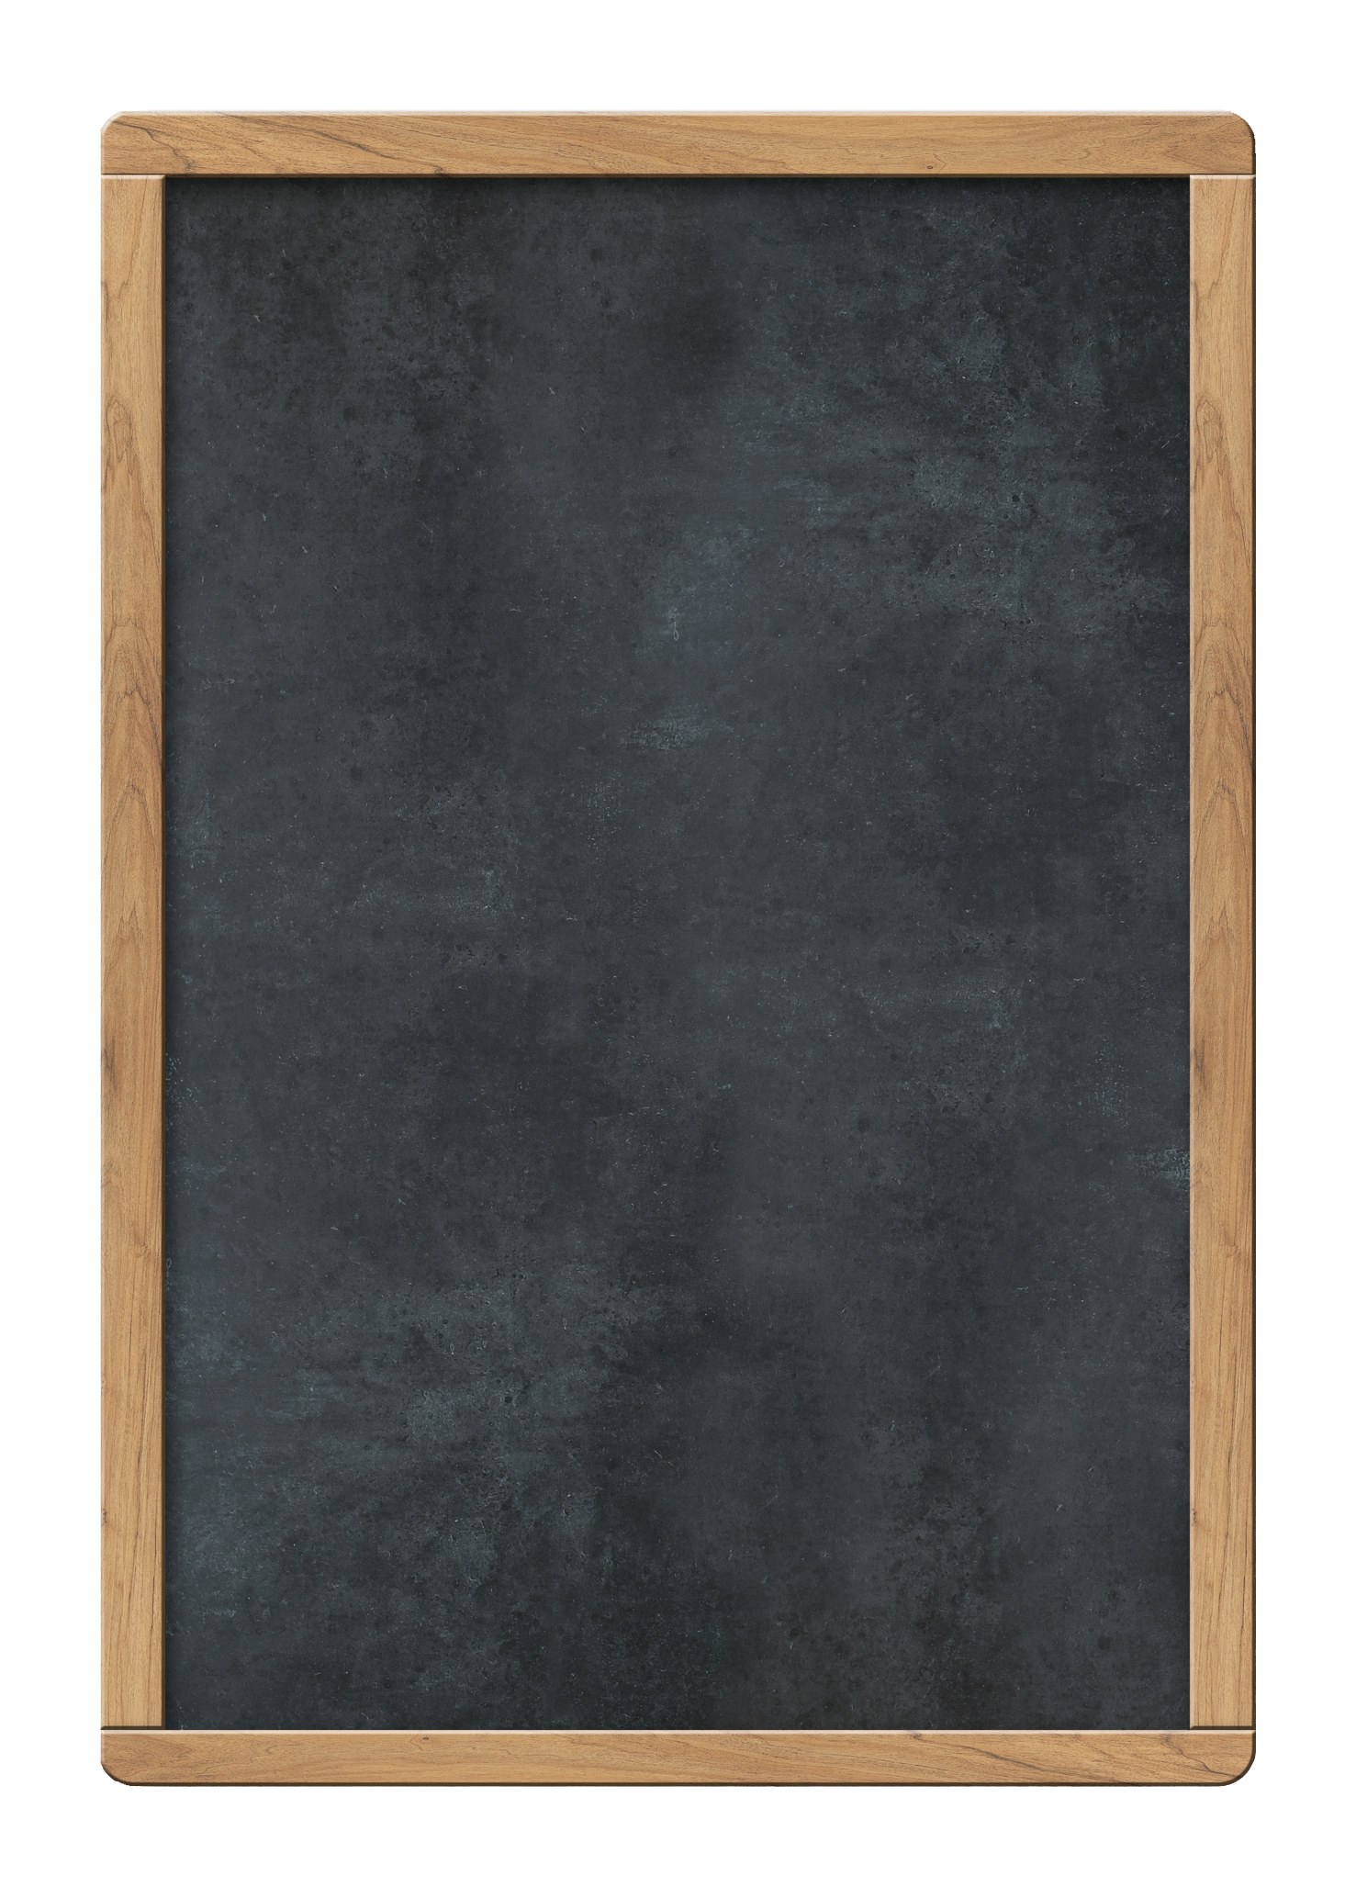













Unit 6
Do you like bananas? Section B 2a-3b Reading&Writing
贵州省贵阳市云岩区
NO.2

Slide 3
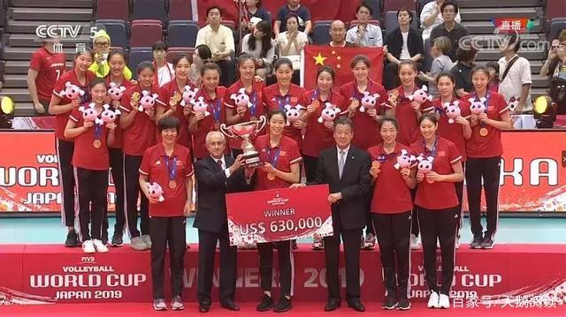

Slide 4


Slide 5
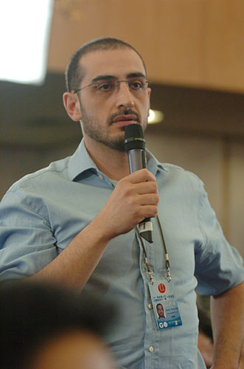
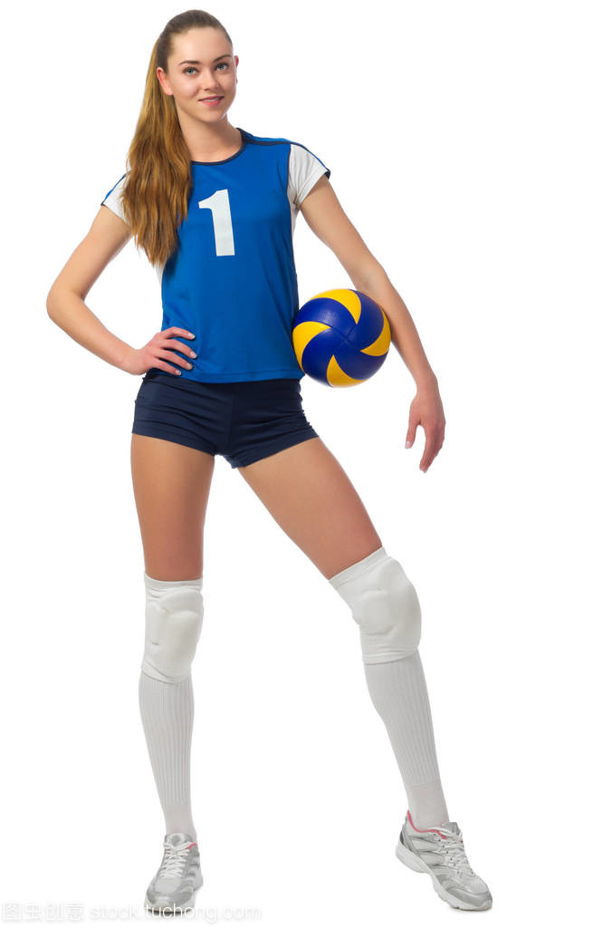
Do sports stars eat well every day?
David
Cindy Smith

Slide 6
Survey:
1. How many（多少） meals（餐）does Cindy have every day? What are they?
2. Circle the food words in the passage.

Slide 7

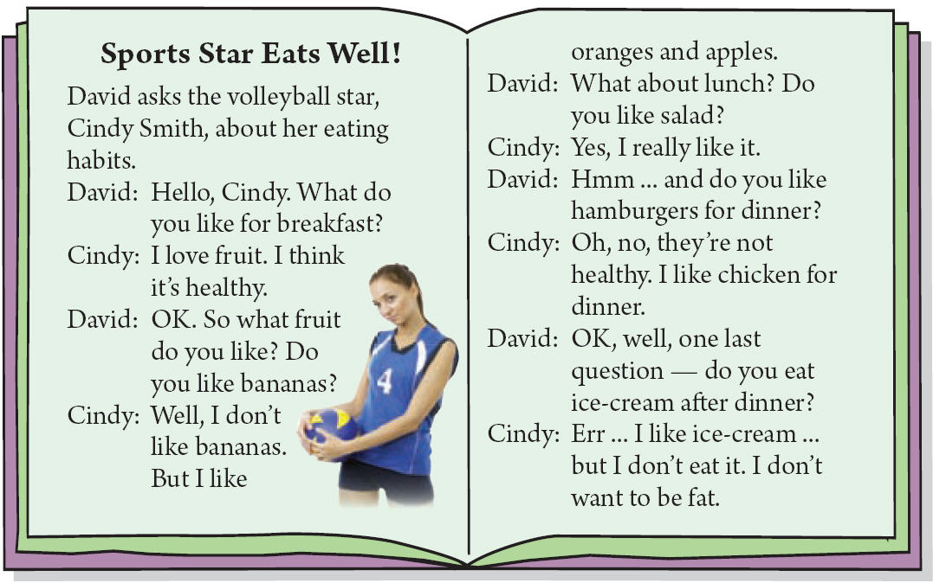
Read:
Read the magazine article and circle the food words.
2b

Slide 8
Retell:
Read the magazine article and circle the food words.
2b
Hamburgers are not healthy.
Fruit is healthy.
Ice-cream makes people fat.

Slide 9
Pair work:
 | Breakfast | Lunch | Dinner
I like | eggs
I don’t like | salad
My partner likes
My partner doesn’t like

Slide 10

3b
Write about what you and your partner like and don’t like for breakfast, lunch and dinner. Try to tell us why.
For breakfast, I like ________, but I don’t like ______. For lunch, _______________________.
And for dinner, __________________________.
I think I have a _____________ eating habit.
For breakfast, ______ likes ________________.
For lunch, ______________________________.
And for dinner, __________________________.
I think ________________________.

Slide 11
Evaluation:
Form
形式
Right sentences
content
内容
Like, Dislike, Why
Beautiful handwriting
书写工整

Slide 12
3b
Write about what you and your partner like and don’t like for breakfast, lunch and dinner. Try to tell us why.
For breakfast, I like ________, but I don’t like ______. For lunch, _______________________.
And for dinner, __________________________.
I think I have a _____________ eating habit.
For breakfast, ______ likes ________________.
For lunch, ______________________________.
And for dinner, __________________________.
I think ________________________.

Slide 13
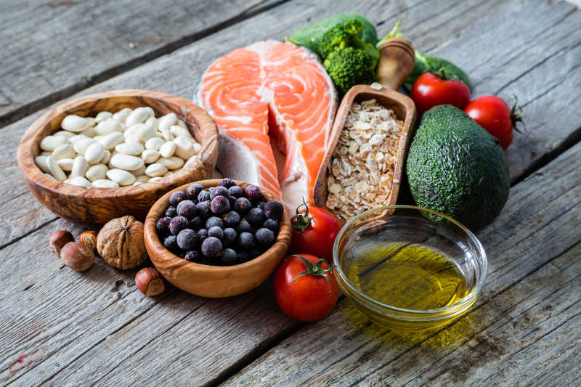
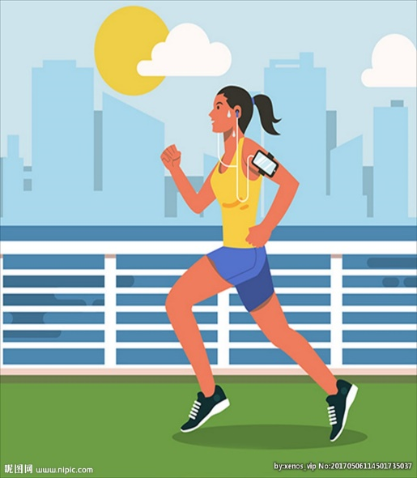
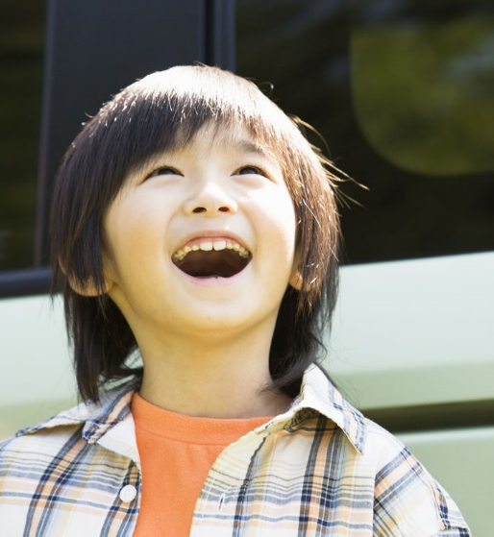
health
eat well
do sports
be happy
Health is more important than wealth!

Slide 14
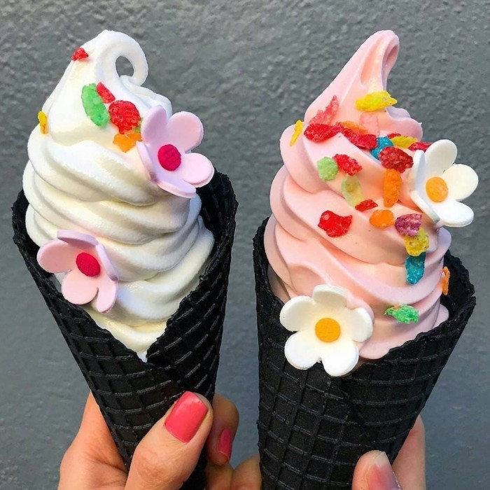
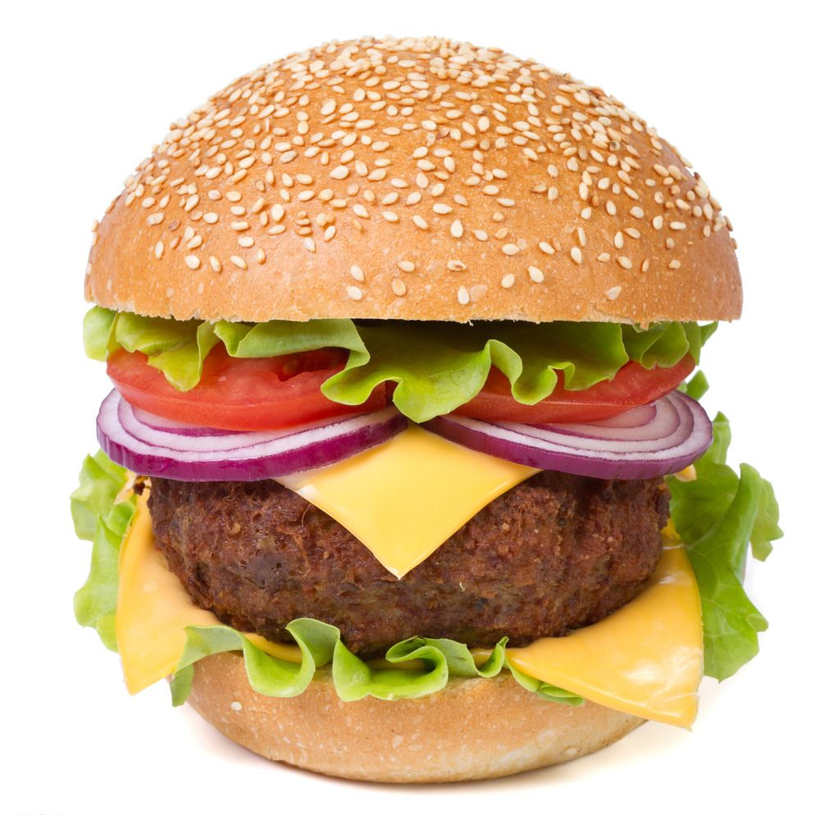

Is ice-cream healthy food?
What about hamburgers?
Shall we eat or not?

Slide 15
Homework: You can choose one of them to do.
Share your eating habits with your classmates and
rewrite your passage.
What food, sports and colors do your parents like
and dislike? Write at least five sentences.

Slide 16


Thank you for listening!

