Slide 1
Unit 9
My Favorite Subject is Science.
Section A 1a-2c
Listening & Speaking
罗亚丽

Slide 2






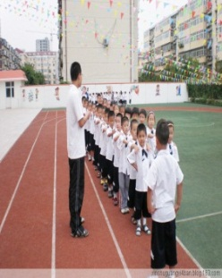

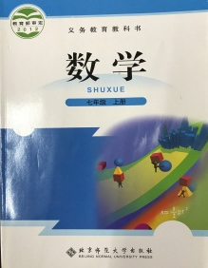


Pre-listening
English
music
Chinese
[ˈmjuːzɪk]
[ˌtʃaɪˈniːz]
history
science
[ˈhistri]
[ˈsaɪəns]
geography
P.E.
[dʒiˈɒɡrəfi]
math
art
[mæθ]
[ɑːt]

Slide 3



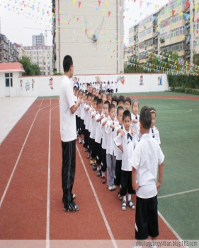
Pre-listening
Favorite, favorite,
What’s your favorite subject?
English, English, it’s interesting.
Favorite, favorite,
What’s your favorite subject?
Science, science, it’s fun
Favorite, favorite,
What’s your favorite subject?
History, history, it’s easy.
Favorite, favorite,
What’s your favorite subject?
P.E,P.E, it’s relaxing.

Slide 4
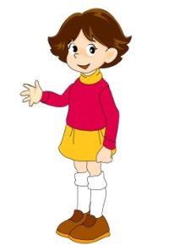
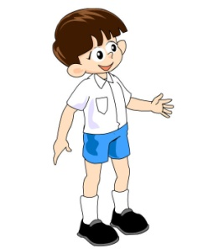
While-listening
1. Listen and put the conversation in order.
1
What’s your favorite subject?
4
Because it’s interesting.
3
Why do you like P.E?
2
My favorite subject is P.E.

Slide 5

While-listening
2. Listen and match the subjects with the descriptions.
art
fun
science
music
interesting
P.E.
boring
math
difficult
geography
relaxing
history

Slide 6
Post-listening
Pair work
What’s your favorite subject?
My favorite subject is ...
Why do you like it?
Because it’s ...
art, science, music, P.E., math, geography, history, English
fun, interesting, relaxing, difficult, boring, important, useful ...

Slide 7
Post-listening
Group work: Interview four people and complete the chart.
Group member | Favorite subject | Why | Favorite teacher | Why
xxx | Music | fun | Miss Yuan | beautiful
xxx | ... | ... | ... | ...
...
--What’s your favorite subject?
--Why do you like it?
--Who’s your favorite teacher?
--Why do you like him/her?

Slide 8

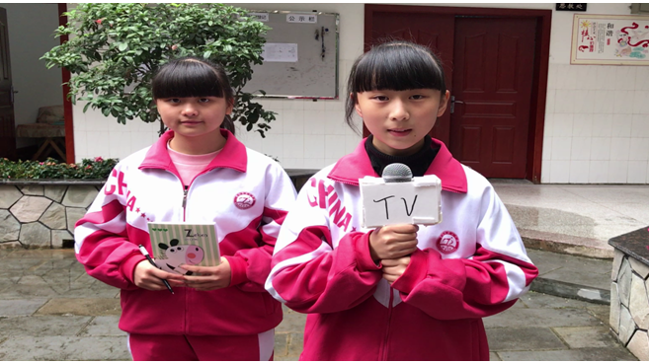
Post-listening

Slide 9

Do a report
In my group, XXX’s
favorite subject is…
She thinks it’s …
Her favorite teacher is
……

Slide 10
Post-listening
What’s his/her favorite subject?
His/ Her favorite subject is …
Why does he/she like it?
Because he/she thinks it’s …
art, science, music, P.E., math, geography, history, English
fun, interesting, relaxing, difficult, boring, important, useful ...

Slide 11
Summary
04
Why can’t we only study the subjects we like ?
03
Is it good to
have prefereces?
02
What do you think of working in groups?
01
What have we learnt
in this lesson?

Slide 12

Homework
Discuss your other favorite things with your classmates.
Listen to 1b & 2a and role play them with the partner.
03
01
02
Write down your own coversation you made in class

Slide 13

教学阐释 Teaching Interpretation
实践英语学习活动观，落实核心素养发展
七年级上册
Unit 9 My Favorite Subject is Science.
罗亚丽

Slide 14
Outline
Content
Methos
Objectives
Philosophy
Procedures
Students

Slide 15


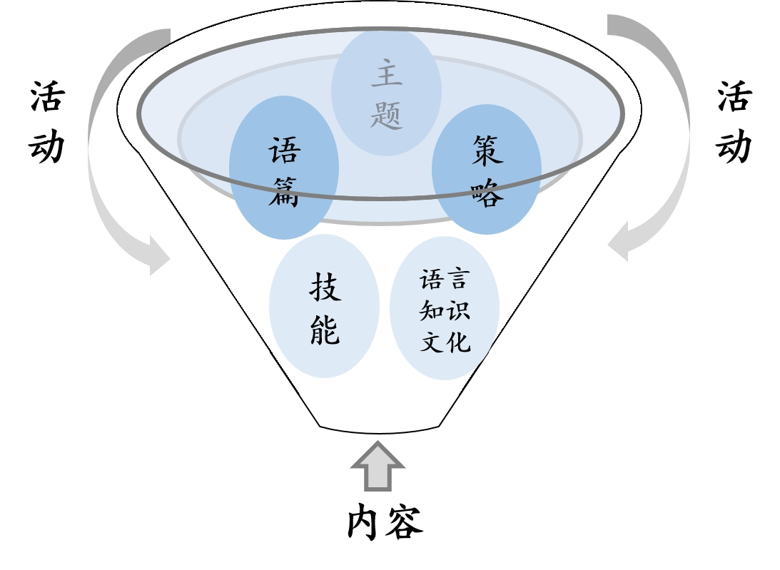
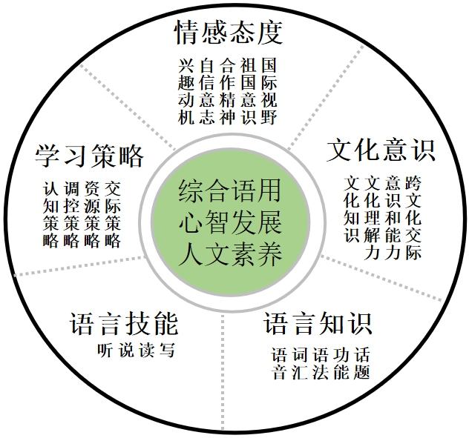
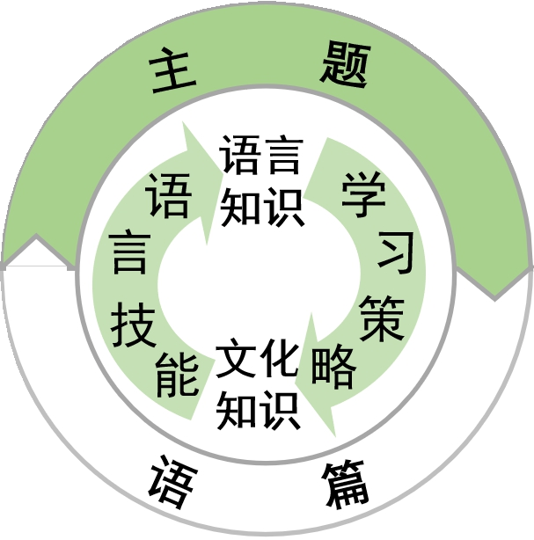
Teaching Philosophy
多要素整合的学习活动观
《义务教育英语课程标准（2011版）》 《普通高中英语课程标准（2017年版）》

Slide 16
Teaching Philosophy

Slide 17

Teaching Philosophy
一切为了学生
充分尊重学生
全面依靠学生
3
生本教育
全人教育
2
性格/能力/品质
1
人生观/价值观/世界观

Slide 18

Teaching Material Analysis
教材
特点：工具性+人文性
结构：层次分明、小步推进、螺旋上升
单元
话题：学科
功能：谈论喜好并阐释原因
课时
课型：听说课
内容：用特殊疑问句询问喜好及回答

Slide 19
Students Analysis
年龄特征
思维特征
学生已有储备
【知识储备】
What引导的特殊疑问句
表达感受的相关形容词
【经验储备】
七年级增加了各学科学习
12-13岁
热情活泼
专注时长短
短暂记忆能力强
形式运算阶段
有一定逻辑推理、
归纳和演绎能力
发散性思维能力较强

Slide 20
Teaching Objectives
目标内容 | 素养提升 | 素养内涵 | 活动性质
 |  |  | 学习理解 | 应用实践 | 迁移创新
100%的学生通过感知情境中的目标词汇和句型，了解其语意及语用。 | 语言能力 学习能力 | 感知与注意 | √
 |  | 获取与梳理 | √
 |  | 概括与整合 | √
70%及以上的学生通过勾画和关注关键信息，判断听力的所需信息和关键语言点。 | 语言能力 学习能力 | 描述与阐释 |  | √
 |  | 推理与判断 |  | √
 |  | 内化与运用 |  | √
50%以上的学生能采访同学最喜爱的科目及原因，并能积极探讨和思考各学科学习的重要性。 | 思维品质 文化品格 | 分析与论证 |  |  | √
 |  | 批判与评价 |  |  | √
 |  | 想象与创造 |  |  | √

Slide 21


Teaching Methods
CLT交际教学法
TBLT任务型教学
PACE教学模式
四情 推进
Attention 注重语言形式
明确主题
创设场景
任务呈现
情景创设 递进呈现
Presentation 呈现语言材料
互动课堂
融入场景
任务开展
视听读写 情节推动
模拟场景
交互学习
任务反馈
Co—construction
构建语言规则
归纳语言 情境体验
Extension
开展拓展活动
还原场景
解决问题
任务升华
拓展思考 情感渗透

Slide 22
Learning Methods
个体学习 小组合作
小组分享 Peer-learning
以学生为中心
培养主人翁的学习意识
自主
探究式
小组
合作式
基于教师启发式教学
发挥学生主观能动性
发展沟通、组织、合作的能力与品格

Slide 23
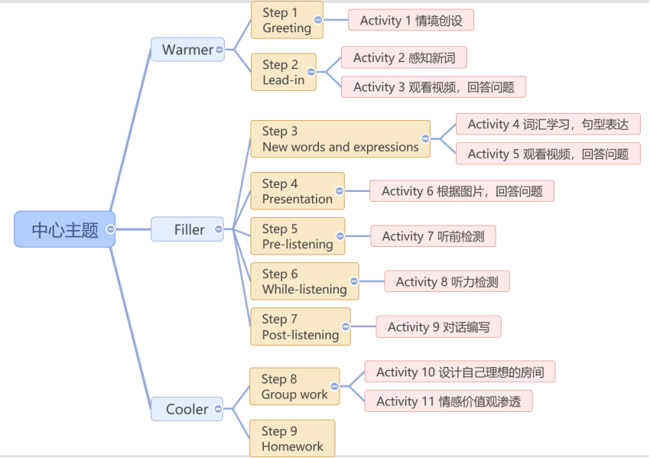
Teaching Procedures

Slide 24
Evaluation and Assessment
师生共评
生生互评
学生自评

Slide 25
In learning you will teach,
and in teaching you will learn.
--P. Collins

