Slide 1
Unit 6
I'm going to study computer science.
Section B 2a-2e
Reading
罗亚丽

Slide 2
Warm-up
What are James’s resolutions?

Slide 3
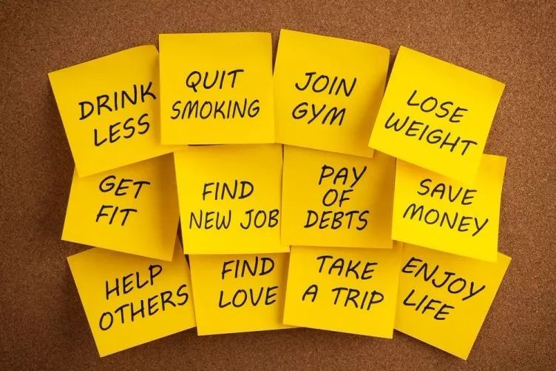
Pre-reading
Free Talk
Did you make any resolutions last year?
Were you able to keep them? Why or why not?

Slide 4
While-reading
Task 1. Look through the passage and match the main idea .
Underline the words and phrases that helped you . (2 minutes)
Para. 1
Para. 2
Para. 3
To question the idea of making resolutions
To give the meaning of resolution
To discuss the different kinds of resolutions

Slide 5
While-reading
Reading Strategy：Skimming
Look through the passage quickly.
Read the first sentence in each paragraph.
Find some specific information.

Slide 6
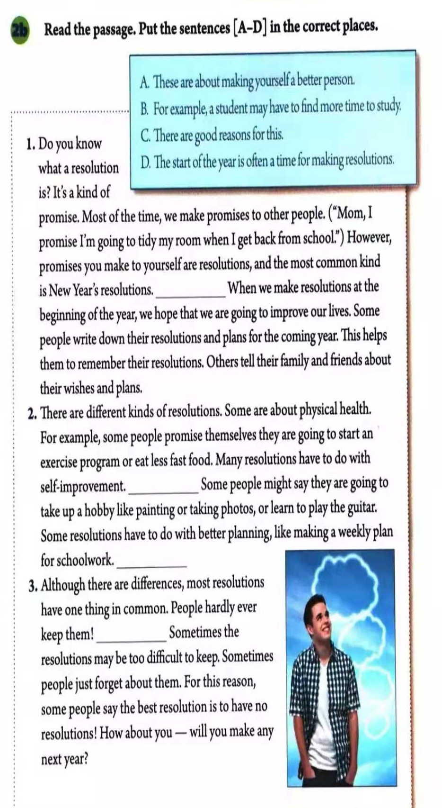
While-reading
Task 2. Read the passage and put the sentences in the correct places. (3 minutes)
A. These are about making yourself a better person.
B. For example, a student may
have to find more time to study.
C. There are good reasons for this.
D. The start of the year is often a
time for making resolutions.

Slide 7
While-reading
D. The start of the year is often a time for making resolutions.
1. Do you know what a resolution is? It’s a kind of promise. Most of the time, we make promises to other people. (“Mom, I promise I’m going to tidy my room when I get back from school.”) However, promises you make to yourself are resolutions, and the most common kind is New Year’s resolutions. When we make resolutions at the beginning of the year, we hope that we are going to improve our lives. Some people write down their resolutions and plans for the coming year. This helps them to remember their resolutions. Others tell their family and friends about their wish and plans.
D

Slide 8
While-reading
A. These are about making yourself a better person.
2. There are different kinds of resolutions. Some are about physical health. For example, some people promise themselves they are going to start an exercise program or eat less fast food. Many resolutions have to do with self-improvement. ______ Some people might say they are going to take up
a hobby like painting or taking photos, or learn to
play the guitar. Some resolutions have to do with
better planning, like making a weekly plan for schoolwork.______
A
B
B. For example, a student may have to find more time to study.

Slide 9
While-reading
C. There are good reasons for this.
3. Although there are differences, most resolutions have one thing in common. People hardly ever keep them! ________Sometimes the resolutions may be too difficult to keep. Sometimes people just forget about them. For this reason, some people say the best resolution is to have no resolutions! How about you--will you make any next year?
Reading Strategy: Using Context （上下文）
Step 1. Find out the key words in each sentence.
Step 2. Look for the related information around the blank.
Step 3. Fill in the blanks and check the cohesion of the dicouse.
C

Slide 10
While-reading
Task 3.Read Para.1 and complete the mind-map. (3 minutes)
__________ you make to yourself are resolutions.
01
What
We make resolutions __________ new year.
02
When
03
Why
Some people ______________ their resolutions. Others tell their resolutions to families and friends.
How
04
We make resolutions because
we hope to _______________.
Resolution

Slide 11
While-reading
Task 4. Read Para.2 and complete the chart. (2 minutes)
Kinds of resolutions | Examples
1.______________ | Starting an exercise program /eating less fast food
 | 3. ____________like painting or taking photos
2.________________ | 4.____________________ for schoolwork
Physical health
Taking up
Self-improvement
Better planning
Making a weekly plan
… …

Slide 12
While-reading
Task 5. Read Parag3 and answer the question. (1 minute)
Why do people hardly ever keep resolutions?
The best resolution is to have no resolutions.
Why or why not?
Agree
Disagree

Slide 13
Post-reading
Let’s share our resolutions!
Work in group of four!
1. Discuss the resolutions and the ways to make them work.
2. Write them on the post-it notes and then put it on the poster.
3. Share your resolutions about your group.

Slide 14
Post-reading
The wheel of life
Social
社交的
Physical
身体的
Family
家庭的
Intellectual
智力的
Career
职业的
Financial
金融的
Spiritual
精神的

Slide 15
Summary
What we have learnt in this lesson?
achievement
ways
difficulties
importance
kinds
meaning
resolutions

Slide 16
Summary
Make our dream come true,
Make Chinese’s dream come true.
You'll be a better person,
China will have
an even brighter future!

Slide 17
Homework
Discuss your resolution with your friends and design a poster .
Read the article on your handout and write down the ways to stick to the resolutions.

Slide 18
教学阐释 Teaching Interpretation
实践英语学习活动观，落实核心素养发展
八年级上册
Unit 6 I’m going to study computer science.
罗亚丽

Slide 19
Outline
Content
Methos
Objectives
Philosophy
Procedures
Students

Slide 20
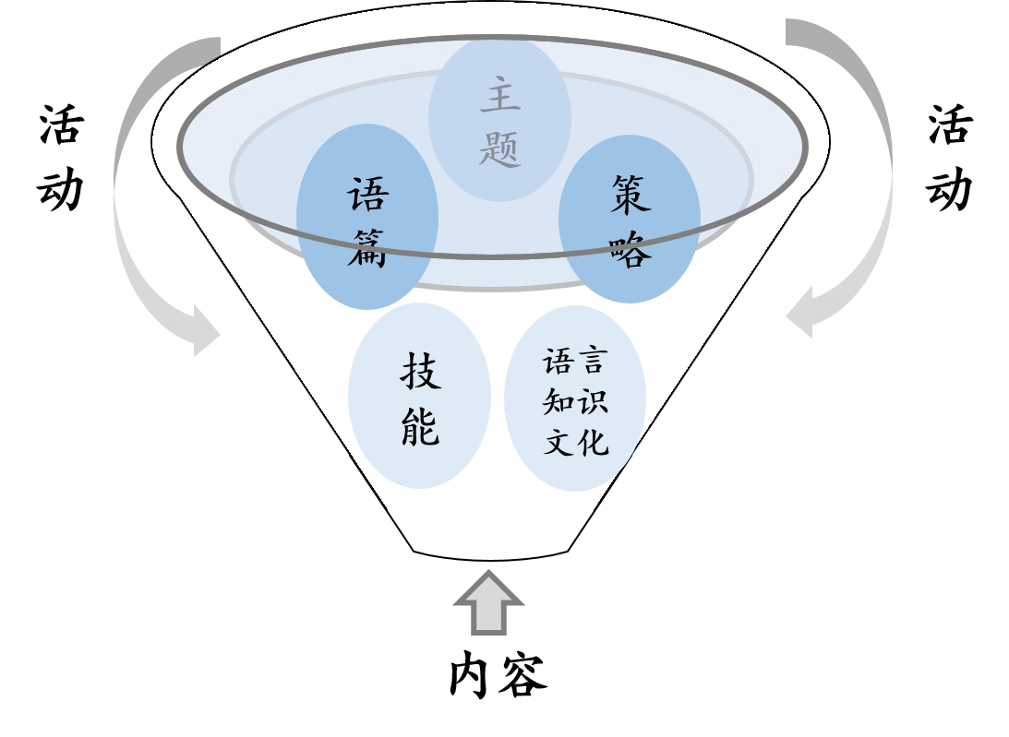
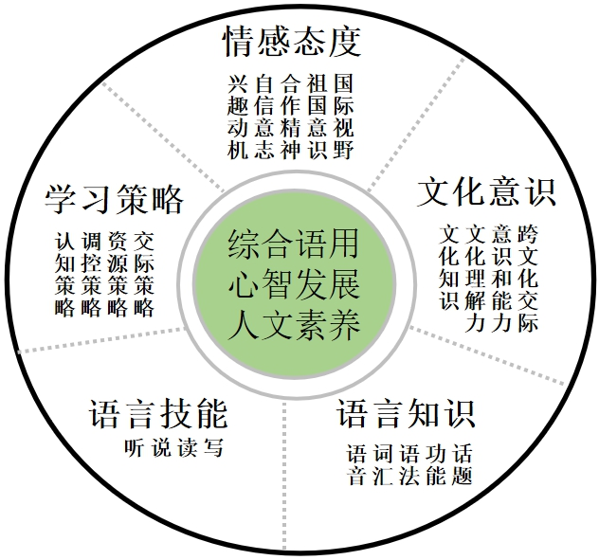
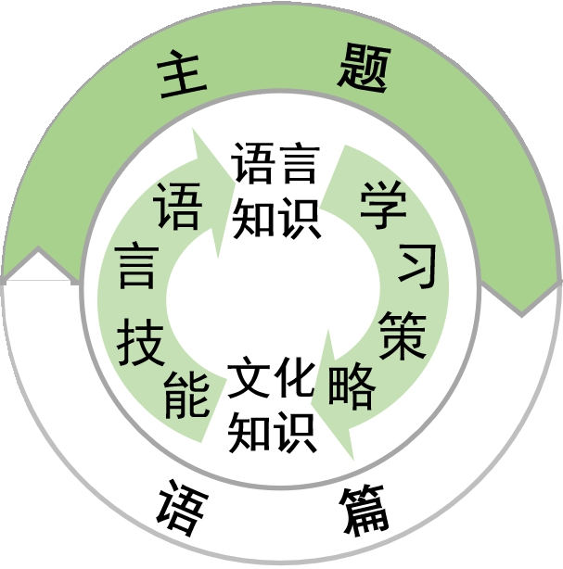
Teaching Philosophy
多要素整合的学习活动观
《义务教育英语课程标准（2011版）》 《普通高中英语课程标准（2017年版）》

Slide 21
Teaching Philosophy
中华文化
英美文化
世界文化
人与自我
人与社会
人与自然
认知
元认知
交际
情感
理想 本领 担当
指向核心素养发展
语言能力
文化意识
思维品质
学习能力
基于英语学习活动
听说读写看
主题意义
语言技能
文化知识
学习策略
评价
语言知识
评价
口语
书面语
多模态
语篇类型
语音 词汇
语法 语篇语用

Slide 22
Teaching Philosophy
一切为了学生
充分尊重学生
全面依靠学生
3
生本教育
全人教育
2
性格/能力/品质
1
人生观/价值观/世界观

Slide 23
Teaching Material Analysis
教材
特点：工具性+人文性
结构：层次分明、小步推进、螺旋上升
单元
话题：生活目标
功能：谈论对未来的打算
课时
课型：阅读课
内容：阅读语篇Resolution

Slide 24
Students Analysis
年龄特征
思维特征
学生已有储备
【八年级阶段】
心理与行为发展叛逆期，掌握一定的学习方法及策略
【形式运算阶段】
有一定逻辑推理、
归纳和演绎能力
发散性思维能力较强
【知识储备】
be going to将来时
【经验储备】
新年愿望、学习计划、职业规划

Slide 25
Teaching Objectives
目标内容 | 素养提升 | 素养内涵 | 活动性质
 |  |  | 学习理解 | 应用实践 | 迁移创新
100%的学生能通过阅读文本，获取并梳理关于resolution的含义和种类及实现的方法。 | 语言能力 学习能力 | 感知与注意 | √
 |  | 获取与梳理 | √
 |  | 概括与整合 | √
70%的学生能通过识别关键信息，推理与判断句子与篇章的逻辑关系；描述自己的resolution以及实现的方法。 | 语言能力 学习能力 | 描述与阐释 |  | √
 |  | 推理与判断 |  | √
 |  | 内化与运用 |  | √
50%以上的学生能通过语言技能的检测，联系个人实际，合理制定计划，树立健康积极的生活意识。 | 思维品质 文化品格 | 分析与论证 |  |  | √
 |  | 批判与评价 |  |  | √
 |  | 想象与创造 |  |  | √

Slide 26
Teaching Methods
CLT交际教学法
TBLT任务型教学
PACE教学模式
四情 推进
Attention 注重语言形式
明确主题
创设场景
任务呈现
情景创设 递进呈现
Presentation 呈现语言材料
互动课堂
融入场景
任务开展
视听读写 情节推动
模拟场景
交互学习
任务反馈
Co—construction
构建语言规则
归纳语言 情境体验
Extension
开展拓展活动
还原场景
解决问题
任务升华
拓展思考 情感渗透

Slide 27
Learning Methods
个体学习 小组合作
小组分享 Peer-learning
以学生为中心
培养主人翁的学习意识
自主
探究式
小组
合作式
基于教师启发式教学
发挥学生主观能动性
发展沟通、组织、合作的能力与品格

Slide 28
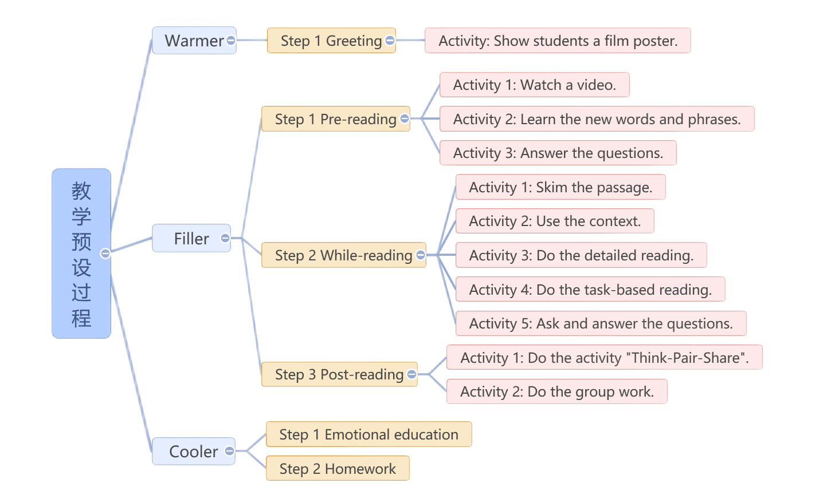
Teaching Procedures

Slide 29
Evaluation and Assessment
师生共评
生生互评
学生自评

Slide 30
In learning you will teach,
and in teaching you will learn.
--P. Collins

