Slide 1
Unit 4 Where's my schoolbag?
Section B Reading
贵阳市白云区第四中学
欧细雨

Slide 2
Learning
Objectives
After this class, you will be able to :
get the information about Kate and Gina’s room.
describe the positions of the things in Kate’s and Gina’s room.
figure out how Tom should tidy his room.

Slide 3
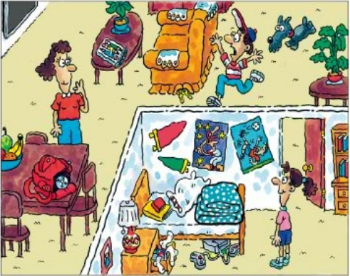
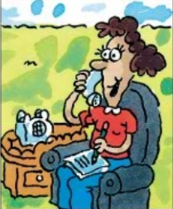
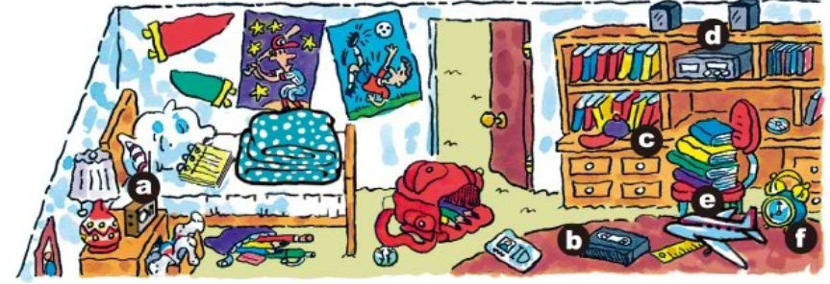
Revision
What problems does Tom have?
His room is really messy(untidy).
He is always looking for things.
He often forgets to take things to school.

Slide 4
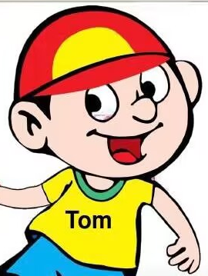
Pre-reading
Hi, I’m Tom. I want to become a tidy boy!

Slide 5
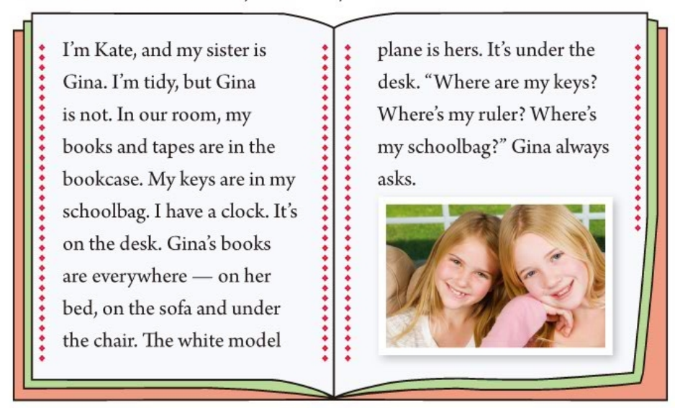
While-reading
What’s the topic sentence in this passage?
Underline the answers!

Slide 6
While-reading
How many parts does this passage be devided into?
Beginning
1. Know about
Kate and Gina
2. Kate is tidy
Body
3. Gina is not tidy

Slide 7
While-reading
Read part 2 and complete the chart.
In our room, my books and tapes are in the bookcase. My keys are in my schoolbag. I have a clock. It’s on the desk.
Kate’s room
Things | Where
books
in her bookcase
tapes
in her bookcase
keys
in her schoolbag
clock
on the desk

Slide 8
While-reading
Read part 3 and complete the chart.
Gina’s books are everywhere — on her bed, on the sofa and under the chair. The white model plane is hers. It’s under the desk.
“ Where are my keys? Where’s my ruler? Where’s my schoolbag?” Gina always asks.
everywhere
Gina’s room
Things | Where
on her bed, on the sofa and under the chair
books
always
model plane
under the desk

Slide 9
While-reading
Beginning
1. Know about
Kate and Gina
2. Kate is tidy
Ending?
Body
3. Gina is not tidy

Slide 10
Post-reading
discuss and think about an ending for this article.
I always help Gina
clean up the room. And I hope she can do it herself.

Slide 11
Hi, I’m Tom. I want to become a tidy boy!
This magazine may help you.

Slide 12
Work in group:
Please find useful tips for Tom and underline them.

Slide 13
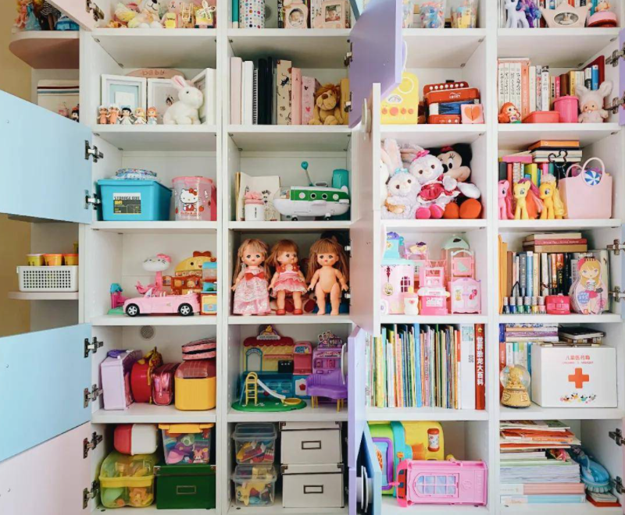
Clean Your Room for a Better Life.
Do you want a clean room but you don’t know how to clean it?
Don’t worry. The following tips(秘诀) will help.

Slide 14
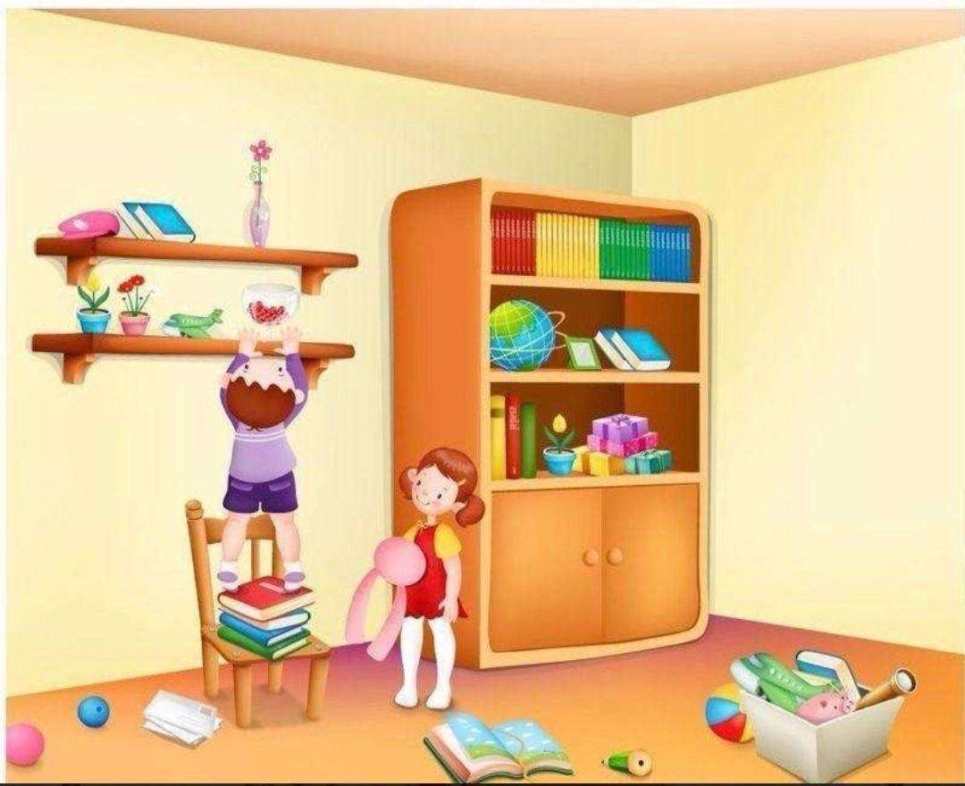
Pick up anything on the floor.
Look around your room and pick up things such as clothes, books, and so on.

Slide 15
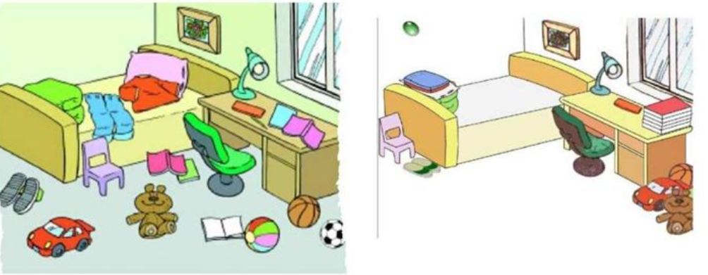
Make the bed every day.
Don’t have these things on your bed, such as books, snacks(零食), clothes, or smartphones.
√

Slide 16
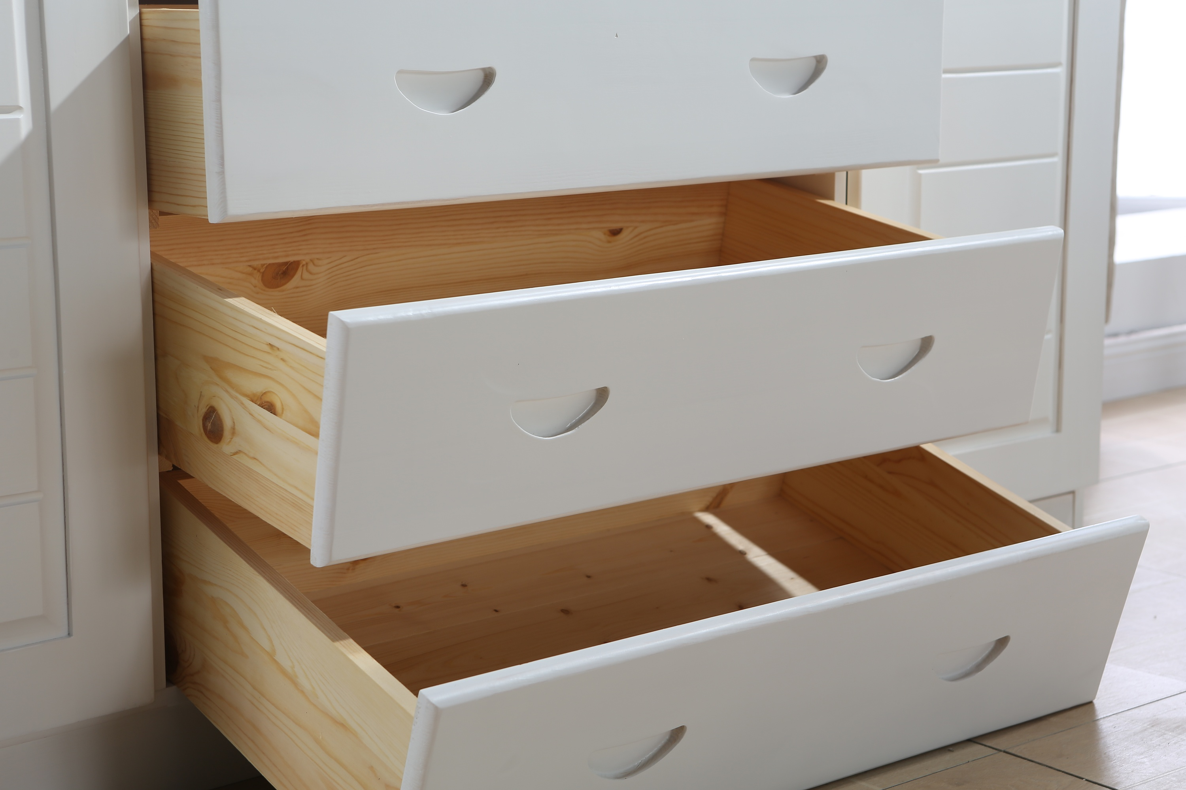
Put things back where you found them.(物归原位)
Everything should have a home. Drawers
(抽屉) are good places to keep small items like keys, or ID cards.

Slide 17
Get organized(有条理的) the night before.
Always pack(整理好)your schoolbag the night before. Put all your school things in your schoolbag.

Slide 18
If you follow these tips, your life will become easier and better.

Slide 19
Let’s help Tom
Tom should______________
· pick up things on the floor.
· make the bed every day.
· put things back where he found it.
· get organized for school the night before.

Slide 20
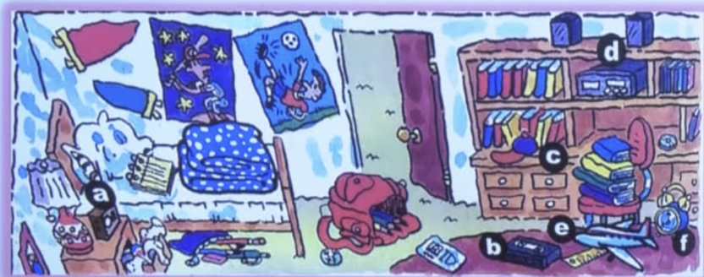
Put things back where he found them.
Where should Tom put them?
He should put _________________ in/on the_________ .
his computer games
bookcase

Slide 21
Get organized the night before.
How can Tom get organized for school?
He should put_________________________ the night before school.
the pencil case into his schoolbag

Slide 22
Before
• His room is really messy(untidy).
• He is always looking for things.
• He often forgets to take things to school.

Slide 23
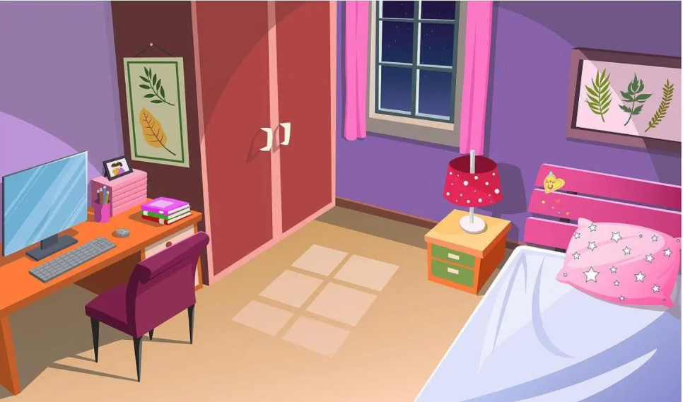
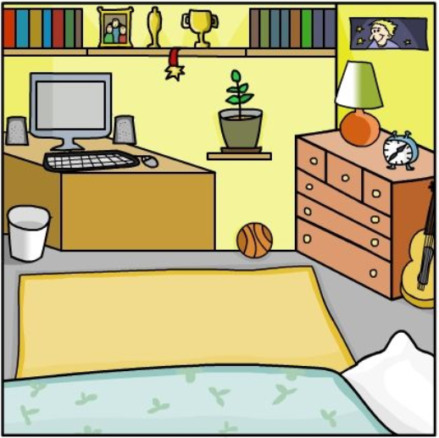
Is your bedroom tidy?
Share your photos!

Slide 24
Homework
Complete A or B
A. Look at our classroom. Is it clean or not?
If it is untidy, try to help the teacher make a to-do list.
B.What is your ideal room(理想的)like?
Draw a picture of it and write at least 5 sentences to describe it.

Slide 25
教学阐释 Explanation of my teaching

Slide 26
单元整体分析
The teaching material
学情分析
The students
重难点
Important and difficult points
指导思想
Guiding
Ideology
教学反思
After class reflection
教学步骤
Teaching procedures
教学策略
Teaching strategy
目标定位
Teaching aims

Slide 27
单元整体分析
内容：人教七上 Unit4 单元主题： Where’s my schoolbag？ 语言功能：谈论物品的位置
“人与自我”
“生活与学习，做人与做事”
2022新课标
“生活自理与卫生习惯”

Slide 28
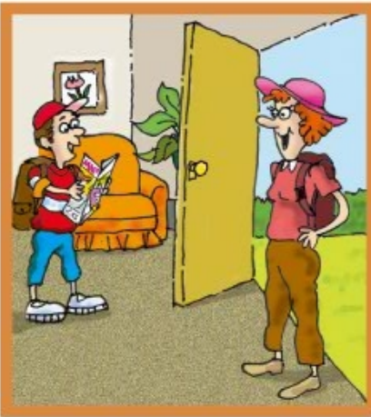
语篇组成
4 dialogues
1 monologue
线性排列
缺乏逻辑
初步意识到Tom问题：
总在找东西
Kata和Gina的房间：
形成鲜明对比
聚焦Tom房间：
物品摆放凌乱
Jack：没有提前整理物品，临时慌忙找东西
Tom的妈妈在打电话：
Tom让她送学习用品

Slide 29
语篇研读
What: Kate自述她和妹妹Gina房间的物品摆放。Kate有序，而Gina凌乱。
Why: 凸显出Kate爱干净整洁，而Gina却截然不同。
How: 通过对比，引起读者的思考，引导学生学习优秀的人、养成良好的生活、学习习惯。文章结构清晰，语言简单，结尾具有开放性，易续写和作延伸阅读。

Slide 30
Tom changes!
初步意识到Tom问题：
总在找东西
Kata和Gina的房间：
形成鲜明对比
聚焦Tom房间：
物品摆放凌乱
Tom的妈妈在打电话：
没有条理，让她送学习用品
Tom：没有提前整理物品，临时慌忙找东西

Slide 31
学情分析
Language: 已学完本单元前面部分，基本掌握如何描述物品位置。
psychology: 七年级学生刚小学毕业，还处于心理“断奶期”。各方面仍依赖父母，独立性较差。
Ability: 自我意识、评价的能力、自我管理还较欠缺。想养成良好学习习惯，仍是很大的挑战。

Slide 32
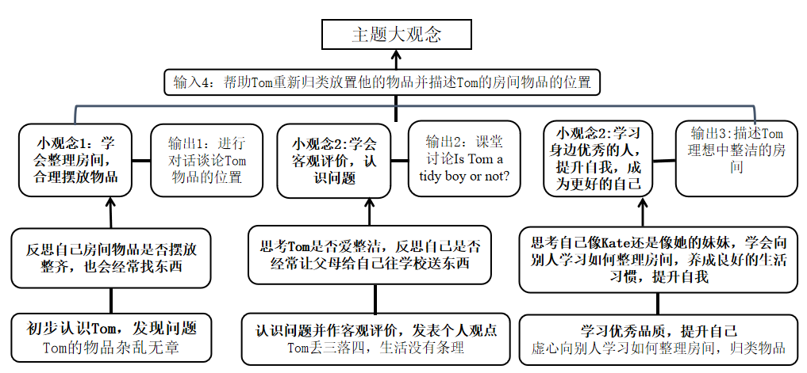
重难点
各个主题小观念形成本单元的主题大观念。
成为更好的人

Slide 33
指导思想
学习理解
育人为本
主题
秉持英语学习活
动组织和实施教学
加强单元整
体教学设计
应用实践
迁移创新
深入开展
语篇研读

Slide 34
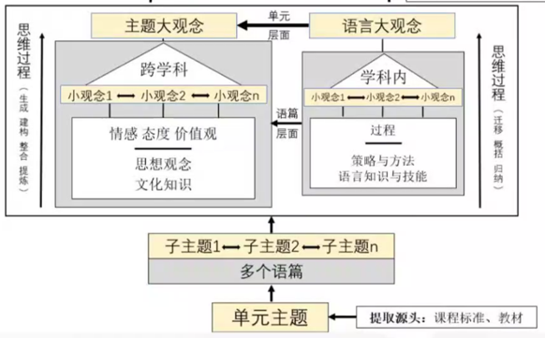
指导思想
核心素养
核心素养综合表现：运用所学语言和技能、方法和策略、思想观念等，基于单元主题建构并生成新的认知、解决问题的思想方法以及正确的价值观念。
单元大观念
英语学科大观念
—王蔷等， 2022

Slide 35
教学目标
第三课时
文本阅读及延伸阅读
After this class, students will be able to:
get the information about Kate and Gina’s room.
describe their ideal rooms.
figure out how to tidy their rooms.

Slide 36
教学策略
Reading
情景教学法
任务教学法
自主学习和合作学习结合

Slide 37
教学步骤
Step 1: Lead-in
Remind students of
previous content
Step 5: Extending reading
Help Tom and learn from Tom
Teaching procedures
Step 2: Pre-reading
Set a context
Step 4: Post-reading
Write an ending for the passage
Step 3: While-reading
Find the structure of the passage

Slide 38
教学步骤
Homework
知识的迁移和运用
Look at our classroom. Is it clean or not?
A. If it is untidy, try to help the teacher make a to-do list.
Look at your home or your own room. Is it clean or not?
B. If it is tidy, please describe the position of your things.

Slide 39
教学反思
本节课上完感觉，充分的语境和具有批判性思维问题的设置，引导着学生在整堂课不断地思考并解决问题，使得学生积极参与其中。拓展阅读使得这堂阅读课显得更加饱满，核心素养的培养得以达成。

Slide 40
Thank you
感谢聆听

